Slide 1
Common Market for Eastern and Southern Africa
Future Proofing: Identifying Priority Sectors and Investment Promotion
Training Workshop
19 July 2023
Notes:
Update to Edmonton photography…

Slide 2
Content & Overview
Moving beyond COVID-19: Background and changes in the FDI landscape
Towards a new normal? Sectoral focus and sector identification
Adaption: The pre-conditions and adjustments
Promotion: Investment Promotion for sustainable development
/Investment & Trade Intelligence

Slide 3
Moving beyond COVID-19: the global FDI Landscape
Setting the scene
Global foreign direct investment (FDI) flows in 2022 declined by 12 per cent to $1.3 trillion, after nosediving in 2020 and rebounding in 2021.1
The multitude of crises and challenges on the global stage – the war in Ukraine, high food and energy prices, risks of recession and debt pressures in many countries – negatively affected global FDI.
The global environment for international business and cross-border investment remains challenging in 2023.
Although the economic headwinds shaping investment trends in 2022 have somewhat subsided, they have not disappeared. Commodity prices that rose sharply with the war In Ukraine have tempered, but the war continues, and geopolitical tensions are still high. Recent financial sector turmoil in some developed countries adds to investor uncertainty. In developing countries, continuing high debt levels limit fiscal space.
UNCTAD expects the downward trend of global FDI to continue in 2023.
Notes:
UNCTAD WIR 2023

Slide 4
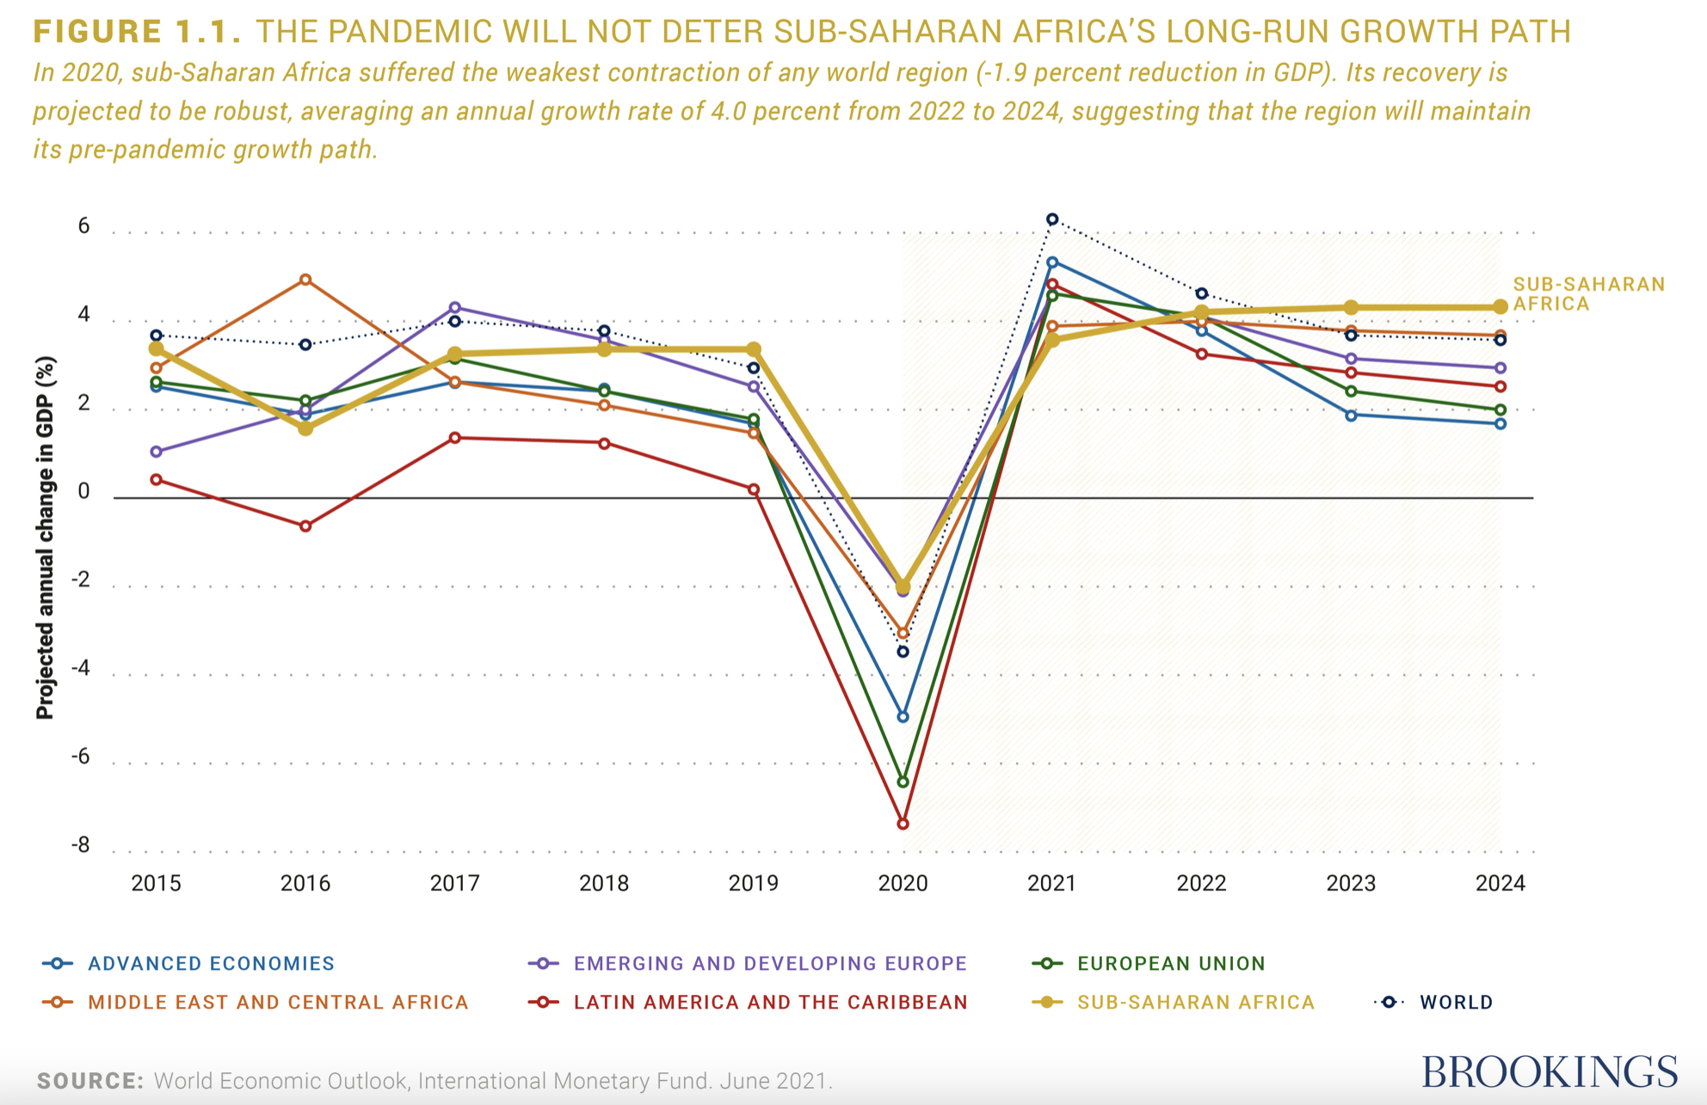
Moving beyond COVID-19: Africa on spotlight
Sub-Saharan Africa, the Middle East and Central Africa have recovered from the shock of the COVID-19 pandemic and its growth figures are ahead of Latin America and the Caribbean, Emerging and Developing Europe and the European Union.
Notes:
https://www.brookings.edu/articles/africas-economic-recovery-financing-robust-post-pandemic-growth/

Slide 5
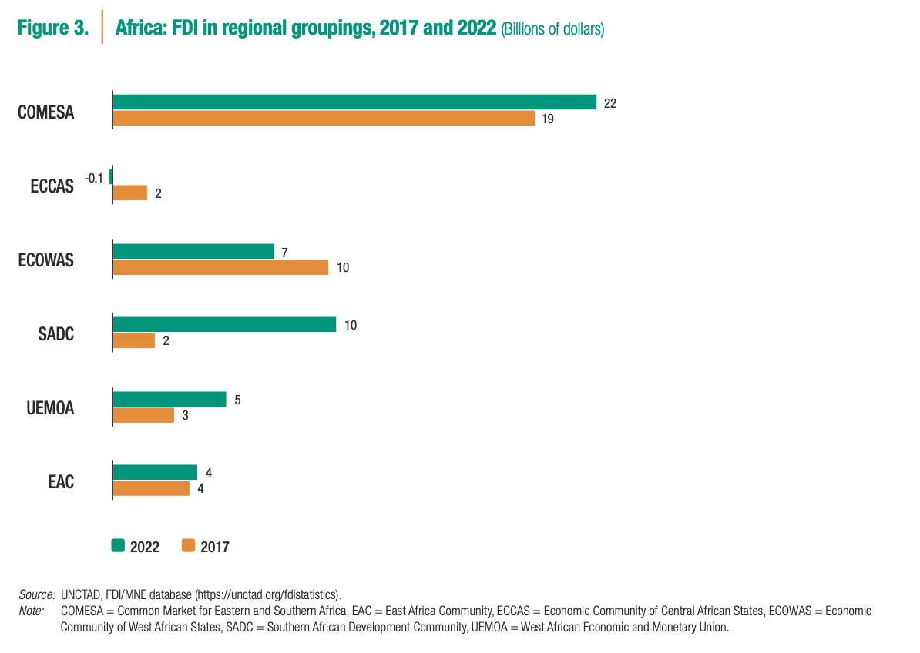
Moving beyond COVID-19: COMESA on spotlight
The value of greenfield projects announced in Africa almost quadrupled, to a record $195 billion (from $52 billion in 2021). The number of projects also rose, by 39 per cent, to 766. Six of the top 15 greenfield megaprojects announced in 2022 were in Africa.
For COMESA Member states in particular, the outlook is promising:
Over the past five years, FDI inflows have risen in four of the regional economic groupings on the continent. FDI in the COMESA grew by 14 per cent to $22 billion. Similarly, SADC, UEMOA and EAC have also been able to increase their FDI inflows.
Notes:
UNCTAD WIR 2023

Slide 6
Moving beyond COVID-19: identifying the framework conditions
The growth outlook is subject to significant downside risks, including
subdued global growth weighing on Africa’s exports, persistence of tight global financial conditions exacerbating debt servicing costs;
significant losses and damages due to frequent extreme weather events exacerbating fiscal pressures;
the prolongation of Russia’s invasion of Ukraine, which is increasing global uncertainty; and
persistent disruptions to global supply chains.
Other factors include elevated geopolitical risks due to upcoming national elections in some countries.
Furthermore, for the median emerging market economy in Africa, real income losses due to geoeconomic fragmentation are more than twice as large as for the median advanced economy.
Notes:
https://www.afdb.org/en/knowledge/publications/african-economic-outlook
2023 World Economic Outlook IMF

Slide 7
Moving beyond COVID-19: Identifiying the framework conditions
However, while this also portrays opportunities , some explicit chances have also cristallised:
The year was marked by the conclusion of negotiations of several investment governance instruments that contain proactive investment facilitation features and pay greater attention to responsible investment and to the right of host States to regulate in the public interest.
African Heads of State and Government adopted the African Continental Free Trade Area (AfCFTA) Investment Protocol.
Notes:
UNCTAD WIR 2023
2023 World Economic Outlook IMF

Slide 8
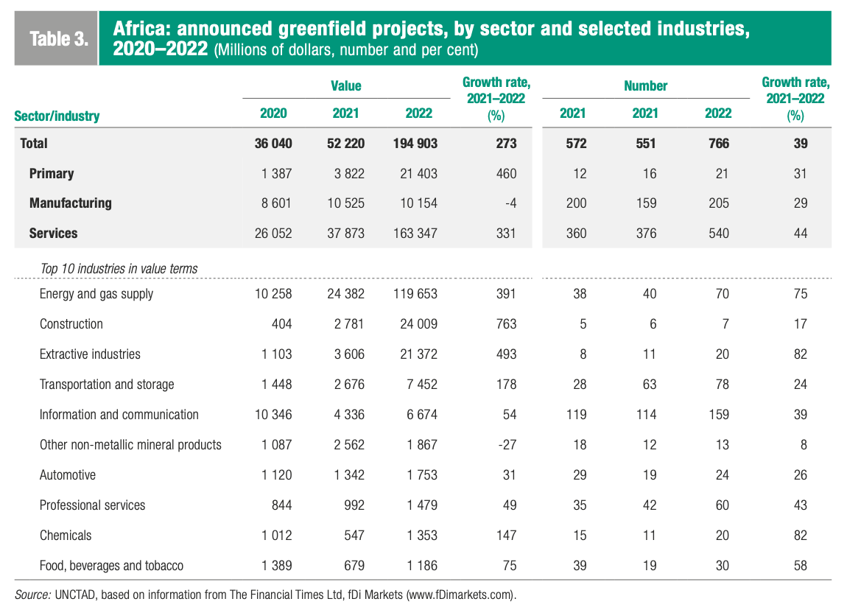
Meandering to a new normal: Sectoral focus
Notes:
UNCTAD WIR 2023

Slide 9
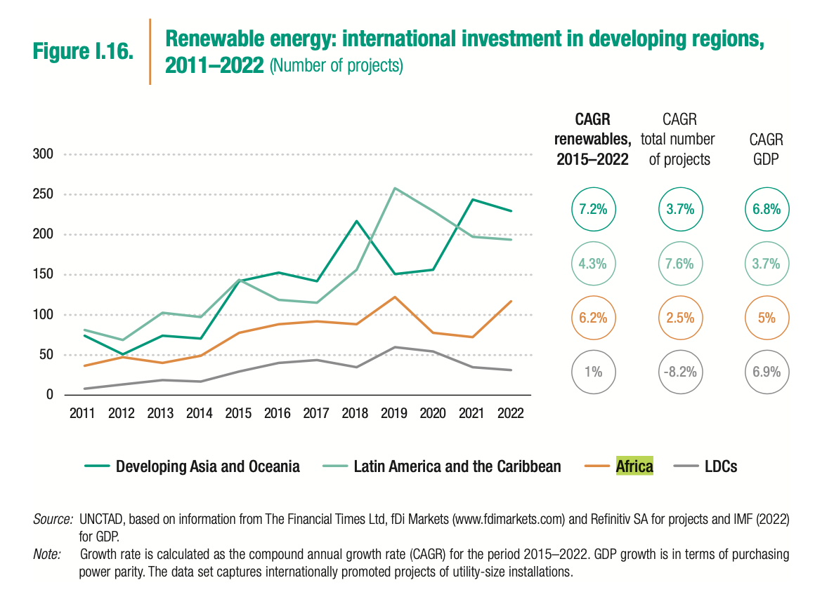
Meandering to a new normal: Sectoral focus
The economies of South Africa, Egypt, Kenya, Nigeria and Zambia account for about 40 per cent of projects on the continent. Among the LDCs, five countries attracted almost 40 per cent of investments in 2022, while as many as 11 countries did not register a single international project in renewable energy between 2015 and 2022.
Over the past decade, two thirds of all renewable energy projects in Africa were in solar energy, as it is the continent’s cheapest and best fitting source.
New announcements of renewables investments in 2022 included several megaprojects: and the Masdar Tanzania renewable energy project, which will create a 2 GW solar power plant.
Notes:
UNCTAD WIR 2023

Slide 10
Meandering to a new normal: Sectoral focus
In 2016, Harvard Business Review set out the sectors ‘poised for growth‘ in Africa:
wholesale and retail,
food and agri-processing,
health care,
financial services, a
light manufacturing, and construction.
Fast forward 7 years, and Arise IIP set out the following sectors:
Fishing
Textile
Mining
Infrastructure
Agriculture
Oil
Finance
Transport
Healthcare
Space
Notes:
https://hbr.org/2016/09/these-6-sectors-of-africas-economy-are-poised-for-growth
https://www.ariseiip.com/top-10-fastest-growing-industries-in-africa/

Slide 11
Meandering to a new normal: Sectoral focus
Thus, for 2023:
Top 10 Sectors by investment value:
Energy and gas supply
Construction
Extractive industries
Transportation and storage
Information and communication
Other non-metallic mineral products
Automotive
Professional services
Chemicals
Food, beverages and tobacco
Aforementioned sectors by growth rate:
Construction
Extractive industries
Energy and gas supply
Transportation and storage
Chemicals
Food, beverages and tobacco
Information and communication
Professional services
Automotive
Other non-metallic mineral products
Notes:
UNCTAD WIR 2023

Slide 12
Meandering to a new normal: Sectoral focus
These already reflect global developments (geopolitical tensions), regional developments (trade and investment agreements) and domestic policy changes.
The main sectors of the post-pandemic FDI landscape can be selected in conjunction with national developmental strategies and economic conditions and composition of individual economies.
COMESA Member States can draw on relevant sectors meeting their strategy and demand and move forward on the sectoral ladder accordingly.

Slide 13
Adaption: The pre-conditions - necessary conditions
Generally, the following pre-conditions are the necessary conditions, regardless of the sectors:
…and recently specifically:
Push for supply chain resilience
Recovery investment priorities
A policy framework for investments in sustainable recovery
Economic conditions | Host country policies and legal framework | MNE strategies
Markets Resources Competitiveness Macroeconomic fundamentals | Macroeconomic policies and laws Trade and industry policies and laws FDI policies | Risk perception Location, sourcing, integration and transfer
Notes:
https://www.unescap.org/kp/2022/handbook-policies-promotion-and-facilitation-foreign-direct-investment-sustainable
https://unctad.org/press-material/investment-priorities-countries-and-firms-build-back-better-hinge-resilience-and

Slide 14
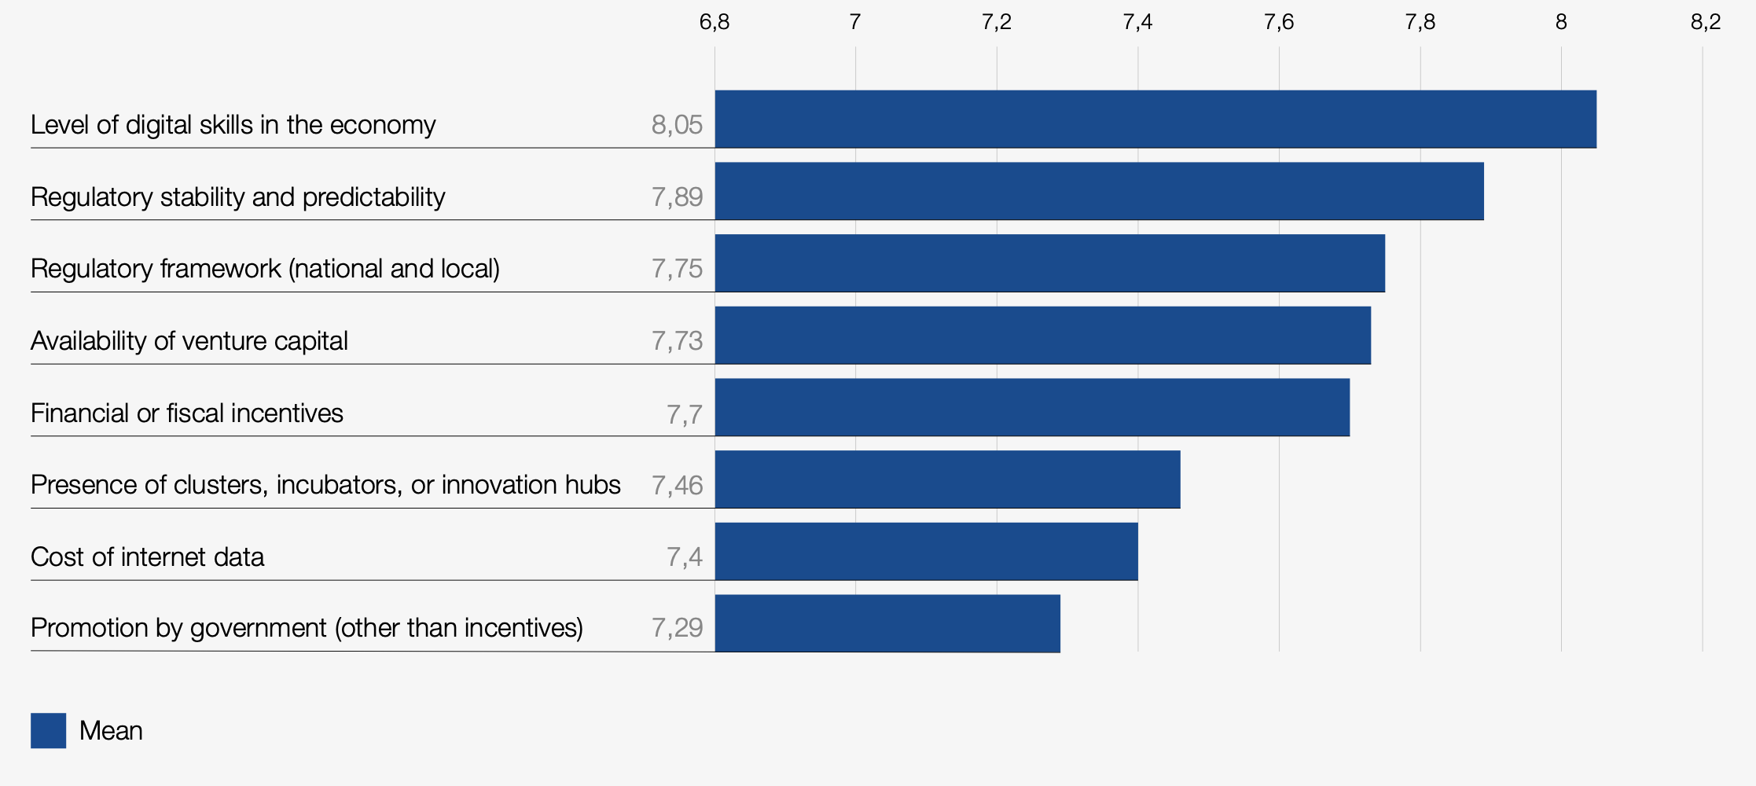
Adaption: The pre-conditions – sufficient conditions
The sector specific level:
Apart from general structural, policy and promotional factors to foster a facilitative environment for these sectors, it is imperative to have a grasp of investor motivations and priorities in the specific sectors when investing abroad.
For instance, the World Economic Forum conducted a study examining the most important factors for investing abroad in the digital sphere (this may include digital infrastructure, adoption or digital business in each of the sectors). The results were the following:
Notes:
https://www.weforum.org/whitepapers/digital-fdi-policies-regulations-and-measures-to-attract-fdi-in-the-digital-economy/

Slide 15
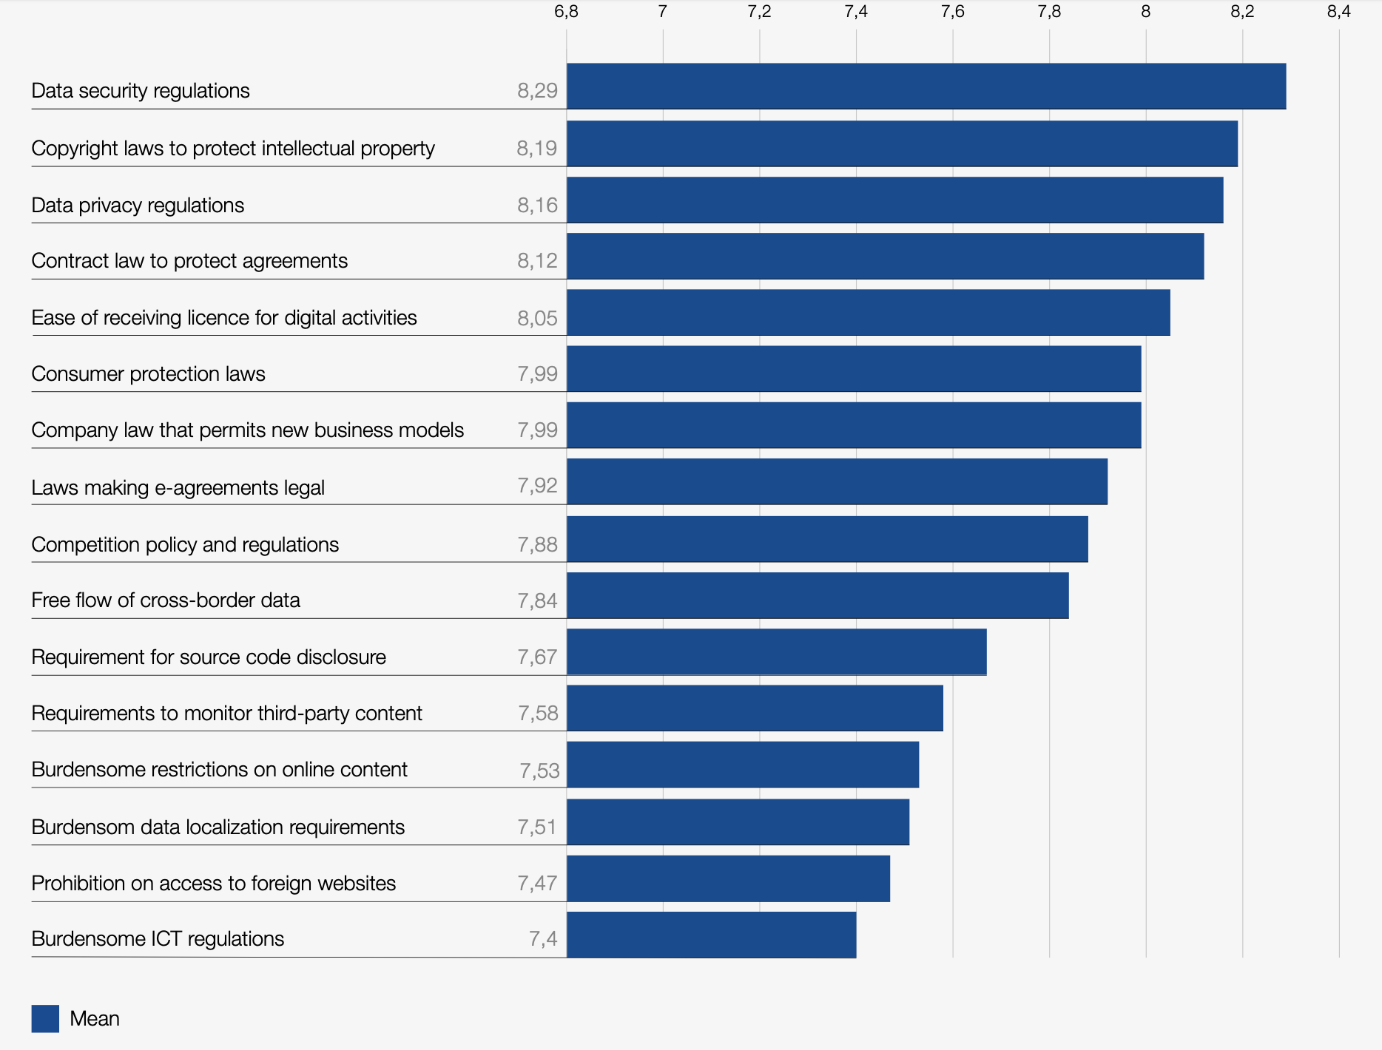
Adaption: The pre-conditions – sufficient conditions
Notes:
https://www.weforum.org/whitepapers/digital-fdi-policies-regulations-and-measures-to-attract-fdi-in-the-digital-economy/

Slide 16
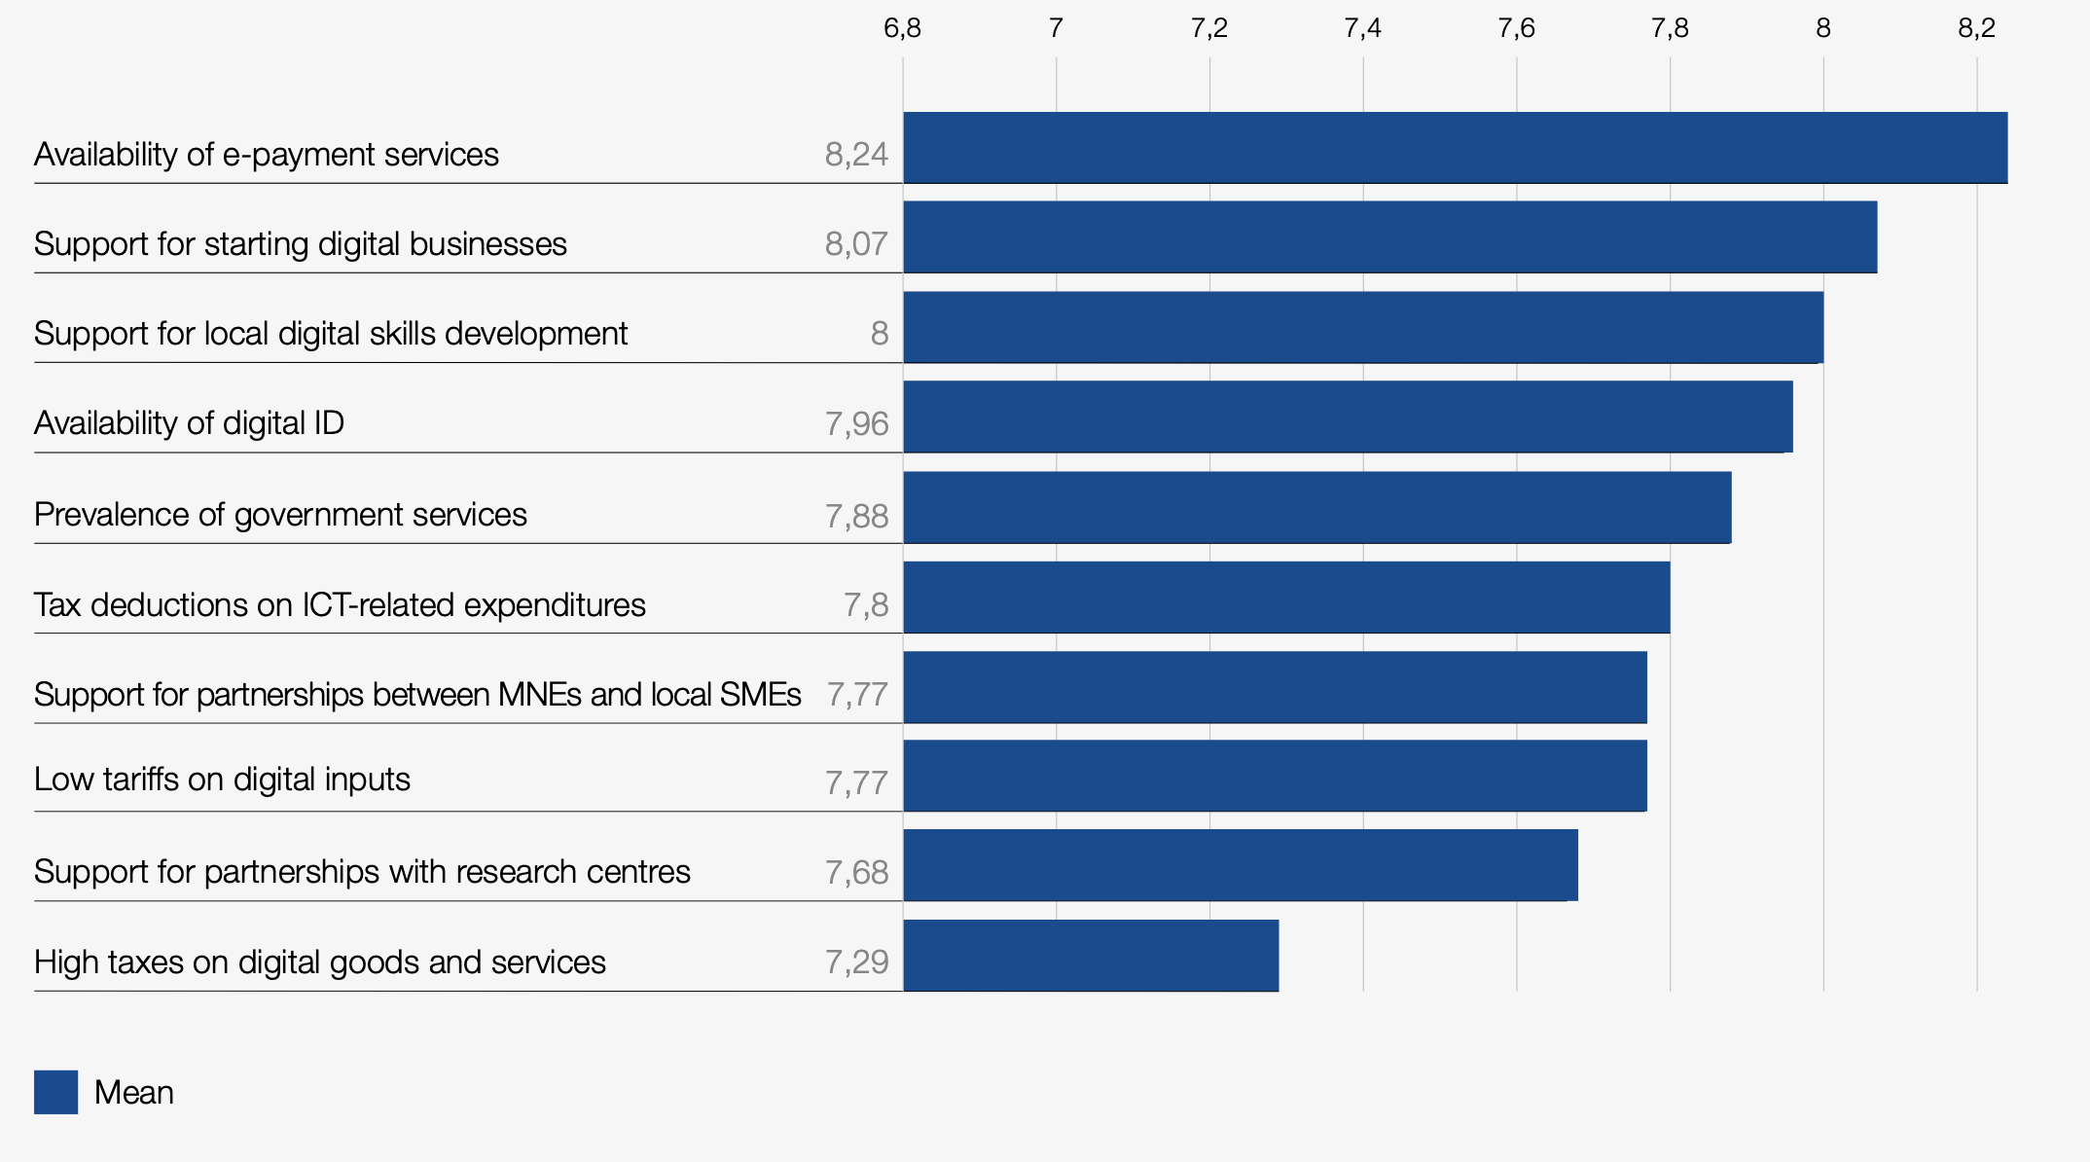
Adaption: The pre-conditions – sufficient conditions
Notes:
https://www.weforum.org/whitepapers/digital-fdi-policies-regulations-and-measures-to-attract-fdi-in-the-digital-economy/

Slide 17
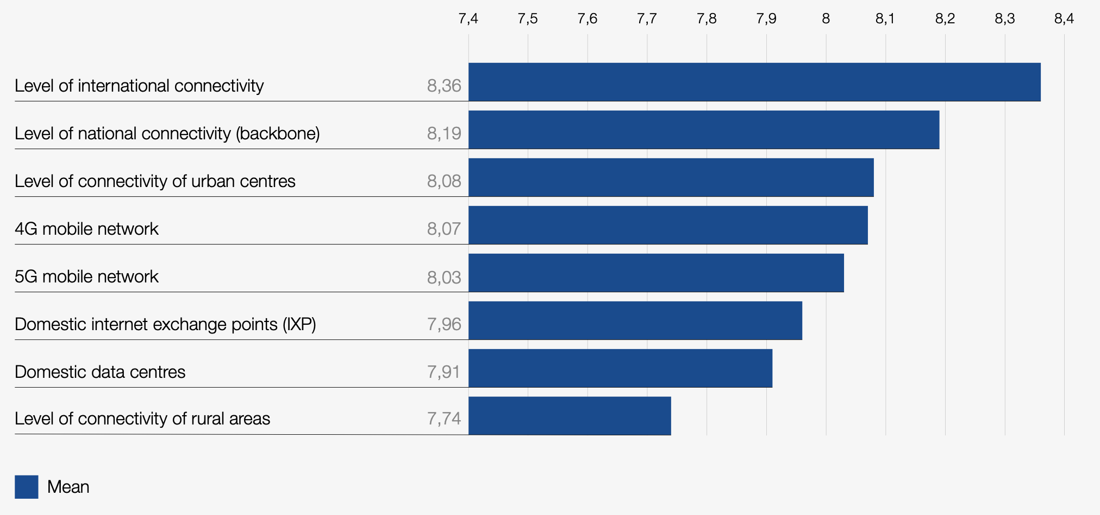
Adaption: The pre-conditions – sufficient conditions
Notes:
https://www.weforum.org/whitepapers/digital-fdi-policies-regulations-and-measures-to-attract-fdi-in-the-digital-economy/

Slide 18
Adaption: The pre-conditions – sufficient conditions
To determine the most important aspects for policy improvement, the following process may be followed:
2. Targeted survey and consultations
4. Implementation
State of play
Benchmarking
Sectoral Goals
Country-specific interests and challenges
Investor score of market pre-reform
Multistakeholder process
Identification
Validation
Public-private Working Group
Number of reforms enacted
Investor score post-reform
1. Diagnostic
3. Reform recommendations
Notes:
Adapted from: https://www.weforum.org/whitepapers/digital-fdi-policies-regulations-and-measures-to-attract-fdi-in-the-digital-economy/

Slide 19
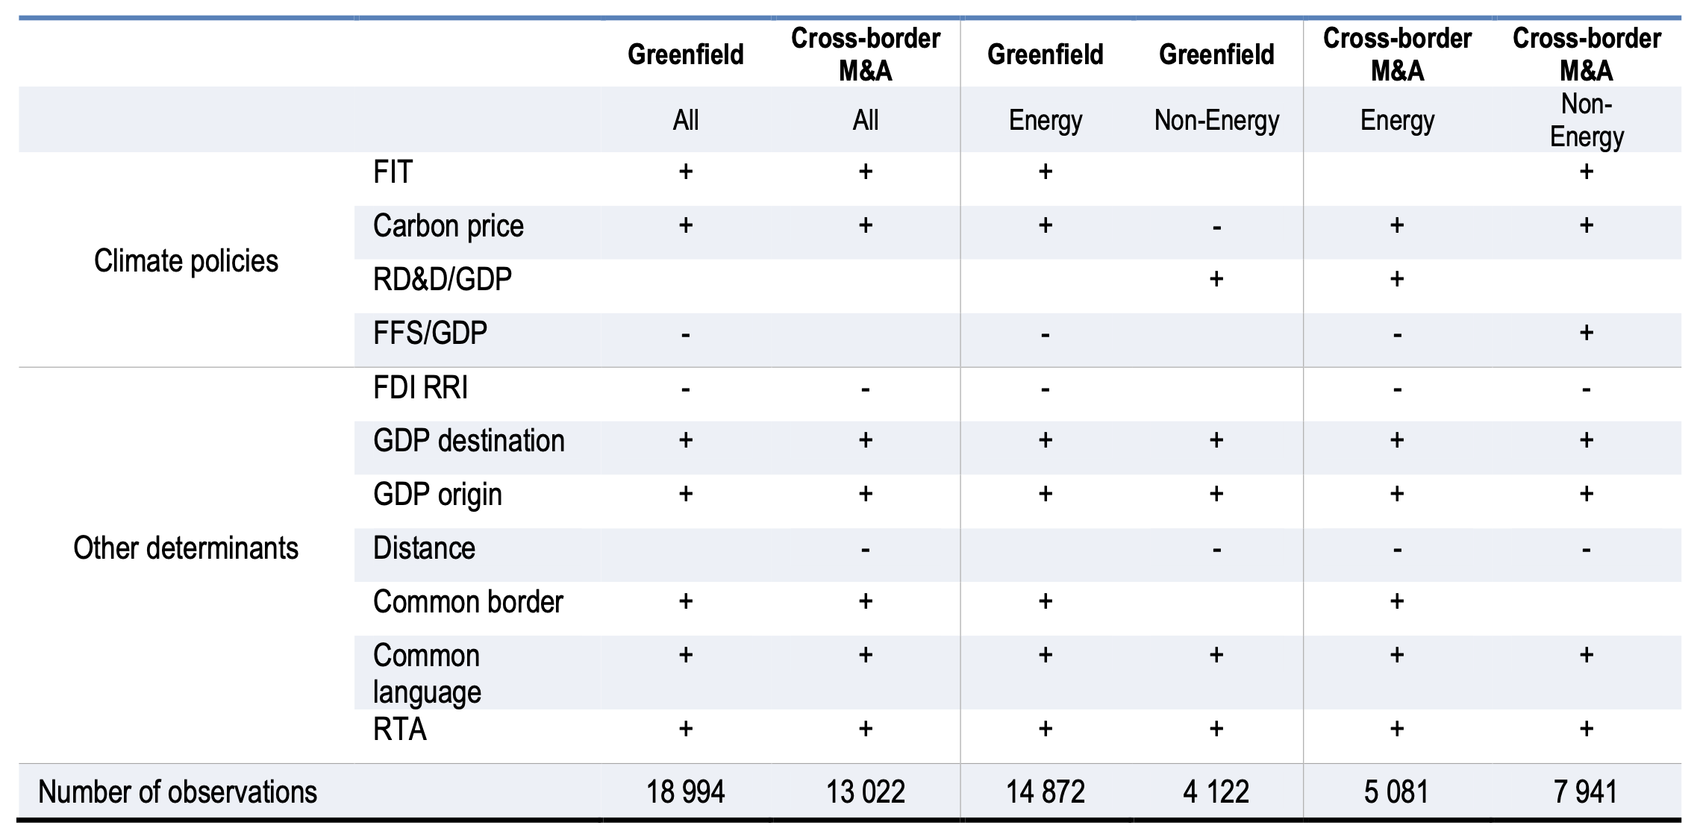
Adaption: The pre-conditions – sufficient conditions
For Renewable Energy for instance, the OECD conducted a study on the impact of climate policies and other determinants on FDI in the sectors. Note: + corresponds to statistically significant, while – indicators insignificance.
Notes:
https://www.oecd-ilibrary.org/docserver/4390289d-en.pdf?expires=1689097108&id=id&accname=guest&checksum=EBBAE171ADF1CA5552FFA3322F1EA330

Slide 20
Adaption: The pre-conditions – sufficient conditions
Lastly, and linking to the last part of the presentation, the promotional efforts play a significant role in setting and promoting the pre-conditions present and attracting the investment…
FDI 4.0
What is FDI 4.0?
Notes:
https://www.weforum.org/whitepapers/digital-fdi-policies-regulations-and-measures-to-attract-fdi-in-the-digital-economy/

Slide 21
What is FDI 4.0?
FDI 4.0 is cross border foreign involvement which capitalizes on the 4th Industrial Revolution to attract foreign direct investment for the benefit of Planet, People & Profit
Different industries and sub-sectors: transformation and innovation
Different players
Hybrid forms of FDI – NFIs
Different requirements to business climate of a country
Collaboration versus competition
Increased focus on sustainability and SDGs
Different IPAs
FDI 4.0 tag words: sustainability, digitalization, innovation, start up eco systems, entrepreneurship, collaboration, partnerships - all part of industry 4.0 and offers many opportunities for countries.
© 2021 Douglas van den Berghe

Slide 22
INVESTMENT PROMOTION LIFE CYCLE, FRAMEWORK AND KEY IPA ACTIVITIES AND FUNCTIONS
Investment promotion. Pre-investment: Business development. Awareness
Investment facilitation. (post) investment/project Client servicing and after sales
Image Building & Marketing
Investor Servicing & Facilitation
Investor Aftercare & Policy (Advocacy)
Lead Generation & Targeting
Organization, coordination, Intelligence & Knowledge
© 2021 Douglas van den Berghe
Image Building & Marketing
Create awareness and the market perception of your location as attractive locations for international investment.
Lead Generation & Targeting
Attract new investment projects by actively targeting specific investors in (prioritized) sectors. Lead generation entails targeting specific sectors and companies with a view to creating investment leads.
Investor Servicing & Facilitation
Facilitate the efforts of foreign investors seeking to invest by providing services that can assist an investor in analysing investment decisions and establishing the business. Potential project start up.
Investor Aftercare & Policy Advocacy
Facilitate the continuing development of a foreign affiliate with a view towards maximising its contribution to the local economic development, including acting as a conduit for foreign investors.

Slide 23
Combining site selection with IPA services
Initial Decision-Making
Pre-Investment
Investment
Post-Investment
Strategy Building
Site Visits & Implementation
Operational
Identifying Opportunities & Due Diligence
Investment Decision-Making Process
Demand
Image Building & Marketing
Investor Servicing & Facilitation
Investor Aftercare & Policy Advocacy
Lead Generation & Targeting
Investment Promotion Activities & Services
Supply
© 2021 Douglas van den Berghe
Notes:
Roles of IPAs vs TPOs
I – Product & Market Intelligence
A TPO ought to be proactive and help to identify both current and future products or services with potential in international markets. Working with trade or industry representatives and the founding committee and utilizing the initial baseline study as a starting point, specialists should visit producers, distributors, and current or potential exporters to evaluate products or services that could most benefit from trade promotion. In the same manner, it is critical to fully assess the nature of the supply chain and its bottlenecks or constraints.
After identifying the target markets that demonstrate the most potential, a general set of market profiles ought to be developed. TPOs can conduct market studies that are considerably more detailed than market profiles. These provide in-depth information about a particular sector or subsector and its characteristics.
II – Trade Information Services
TPO's can help provide a one-stop shop for trade information and can serve the valuable function of helping associations or exporters to interpret the vast amounts of data available.
III – Specialized Support Services
Knowledge about trade payment methods
Access to financing and foreign direct investment
Export procedures
Commercial terms and terms of international trade
Transportation logistics and procedures
Quality control methods
Export packaging
Pricing strategy
Handling business expansion requirements, i.e. infrastructure, management, bookkeeping, etc.
Contract negotiations
Moreover, a number of organizations utilize funds to stimulate and support exporters to enter foreign markets.
IV – Promotion & Policy Advocacy
Competent and experienced TPOs have been known to advocate:
The elimination or reduction of restrictions on exports i.e. quotas and licensing.
Improved access of exporters to imports i.e. duty-free schemes.
The reduction or more transparent application of export taxes and subsidies.
Improved access to export credit i.e. pre-and post shipment financing and insurance.
Balanced or more favorable exchange rate policies.
Improved policy, regulatory, and legal environment for both trade transactions and investment, i.e. domestic or foreign direct investment (FDI).
Because of their marketing focus TPOs can be particularly well-suited to assist individual enterprises in designing, developing, and implementing their international marketing plans. For many TPOs this service can be linked to the more general publicity and promotion that they develop and conduct for a country or sector as a whole.
Source: http://documents.worldbank.org/curated/en/658381468137984834/pdf/402650Trade1Pr1Giovannucci01PUBLIC1.pdf

Slide 24
Which other marketing channels can you use?
Newsletters
Websites but also, and more research driven……
Investor Guides
Investment Opportunities Guides
Value Propositions
Sector Profiles
Competitive Analysis of your country
But you will need a Brand Book, Research Tools like Benchmarking Databases and a database of contacts

Slide 25
EFFECTIVE STRATEGIES & TOOLS - SELECTION
 | Image Building & Marketing | Lead Generation & Targeting | Investor Servicing & Facilitation | Investor Aftercare & Policy Advocacy
Brand Book | X
Competitiveness Benchmarks & Analyses | X
Local Value Proposition | X
Website & Social Media | X | X
FDI Benchmarks & Analyses |  | X
Country Profiles |  | X
Sector Profiles |  | X
Investment Opportunities Booklet |  | X
Investor Guide |  |  | X | X
Public Databases | X | X | X | X
Paid Databases | X | X | X | X
CRM System |  | X | X | X
Training Needs Assessment & Program | X | X | X | X

Slide 26
Digital tools for investment promotion and facilitation
IPAs are using three types of digital economy applications to promote and facilitate investments:
Websites: include key features, local economic data, and testimonials. Often used as a matchmaking platform.
Social Media: LinkedIn for investor identification and gathering intelligence; Facebook, Instagram, and YouTube to advertise host location; SMS and WhatsApp for investor queries.
Video Conferencing: used to remotely pitch their countries to foreign audiences, showcase investment locations, and answer queries from interested parties.
Notes:
Websites - Websites were IPA’s first digital tool. Typically the websites include the key features of the host location, accompanied by maps, local economic and demographic data, and relevant FDI sector and regulation data. More recently these websites have become more interactive and include welcome videos from host country officials and testimonials from satisfied investors. Websites now, increasingly, serve as matchmaking platforms, presenting listings of local businesses in a particular sector or location. More advanced websites now also enable virtual tours of cities and potential project sites.
Social Media - IPAs now employ social media for various purposes. IPAs rely heavily on LinkedIn to identify investors, gather investor intelligence, engage with investment promotion consultants, and identify and recruit staff. They also principally use LinkedIn to obtain meetings, though in this case Twitter, Facebook, WhatsApp and blogs also play a role. These IPAs mostly use Facebook to advertise their host location and service offerings, though LinkedIn, YouTube and Twitter also play a role here. They use a mix of social media to research and engage with other IPAs and competing investment locations. Many have live SMS chat or WhatsApp for queries. IPAs are now investing in social media campaigns to internationally advertise their host locations and direct potential investors to their website.
Video-conferencing and virtual meetings – IPAs have suddenly been forced to turn to video-conferencing and virtual meeting software to remotely pitch their countries to foreign audiences, showcase investment locations, and answer queries from interested parties. They also use these tools to keep digitally in touch with foreign firms already invested in their countries to handhold them through the COVID-19 pandemic, understanding their lockdown difficulties and helping to find solutions, explaining government COVID-19 regulations and ensuring compliance. Many have successfully used virtual meetings to remotely negotiate, conclude and facilitate investment deals with digital economy investors, eg: Invest India and Pegatron Corporation.

Slide 27
Investment Promotion 4.0
Notes:
Update to Edmonton photography…

Slide 28
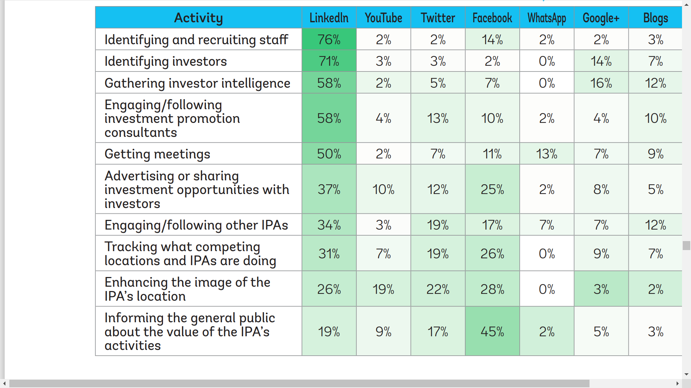
Social media and IPAs: 2020 survey

Slide 29
Digitalizing your IPA services: virtual site visits
Given the COVID-19 pandemic many IPAs, Free Zone staff and corporate investors cannot travel. Many IPAs hence have limited opportunities to showcase the USPs of their location value proposition, attract investors or organize site visits. With the pandemic taking place ‘traditional’ internet and web-based marketing becomes even more important and many IPAs and Free Zones do not seem to be fully prepared or miss out on the many opportunities they have at their disposal. Some of which are very cost effective and can be very successful.
Equal level playing field for all IPAs
Harmonizing your IPA activities in line with the corporate investment and location decision making process
What would investors like to see when you digitalize your IPA process of activities?
Which digital tools can you use for which part of your IPA and Free Zone activities?
How can you best use Virtual Reality in your IPA activities?
How can you best organize a VR site visit and what should be included?
How can you conduct a virtual site tour for potential corporate investors?
Digitalizing your IPA services: virtual site visits
During this pandemic many IPAs have limited opportunities to showcase the USPs of their location value proposition, attract investors or organize site visits.
With the pandemic taking place ‘traditional’ internet and web-based marketing becomes even more important. Equal level playing field.
So in order to be prepared and not miss out on the many opportunities need to digitalize their investor attraction and marketing services. How to start this process and what to do?
What would investors like to see when you digitalize your IPA process of activities?
Which digital tools can you use for which part of your IPA and Free Zone activities?
How can you best use Virtual Reality in your IPA activities?
How can you conduct a virtual site tour for potential corporate investors?
How do you start?

Slide 30
Digitalizing the IPA service cycle
Lead Generation & Targeting
Investor Servicing & Facilitation
Investor Aftercare & Policy Advocacy
Investor Aftercare & Policy Advocacy
Image Building & Marketing
Investor Servicing & Facilitation
Intelligence & Knowledge
© 2021 Douglas van den Berghe
Level of Digitalization
Virtual reality tools
Traditional digital tools
Phases of IPA Services
Image Building & Marketing
Lead Generation & Targeting
Investor Servicing & Facilitation
Investor Aftercare & Policy Advocacy
COVID-19 proof Website
SEO
Social Media Toolkit
Investor Messaging
LinkedIn targeting
Webinars
Virtual Meetings
Zoom, Microsoft Teams, Skype
Podcasts, YouTube
Virtual Meetings
Online Meetings and Webinars for existing Investors
Aftercare events
Virtual Site Tour app and Video
Interviews with IPA staff and Stakeholders

Slide 31
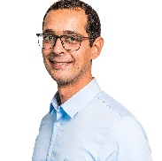
Thank you valued COMESA RIA member state participants, we appreciate your precious time!
Your team,
ITI Integrating Economies GmbH
Find us: Soldiner Strasse 19 13359 Berlin Germany
Visit our website: www.itiinvestment.com
Drop us an email: Info@itiinvestment.com
Omar Eleish
Email: eleish@itiinvestment.com
Phone: +49 176 24630538

