Slide 1
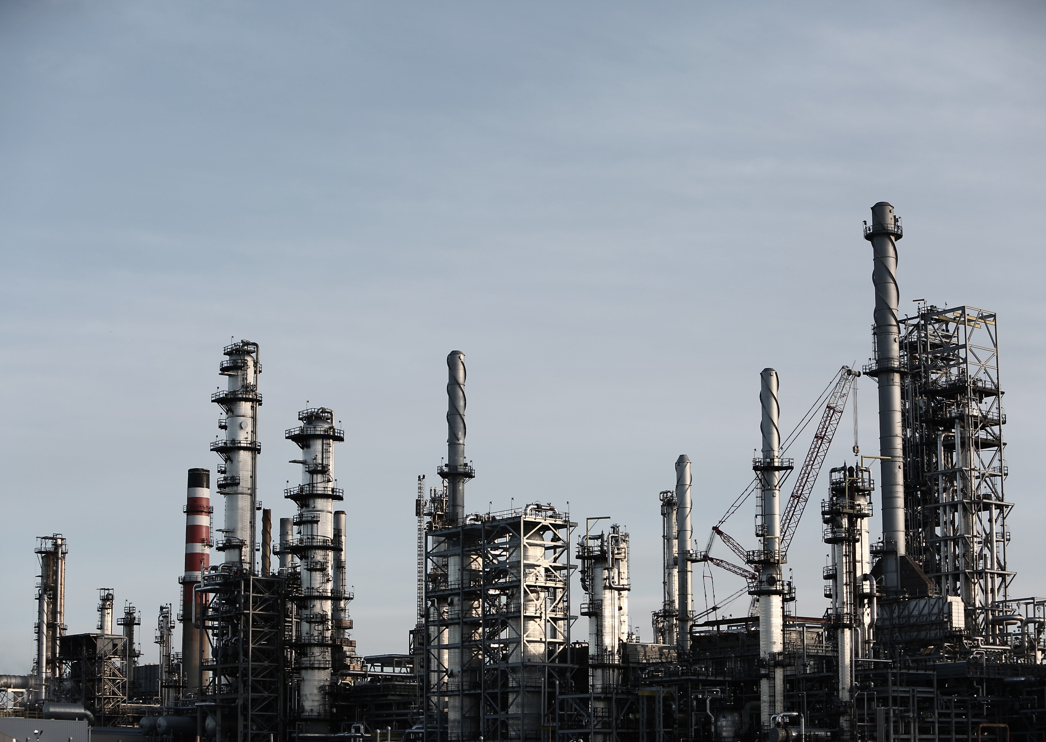
Common Market for Eastern and Southern Africa
FDI Magnet Approach: Breaking Down Sectoral Investment Incentives
Webinar Training
5 September 2023

Slide 2
Webinar briefing
Webinar Name: | FDI magnet approach: breaking down the sectoral investment incentives
Topic: | The Sectoral Investment Incentives
Date: | Tuesday the 5th of September 2023
Time: | 11am Cairo, Egypt Time
Duration: | 2 hours in total – 90 mins core session & 60 mins Q&As, Case Studies & open discussion
Registration Link: | https://us06web.zoom.us/webinar/register/WN_L6R8-cg1RBGVBJlK-P--Xg
Webinar Objective
The webinar contributes to upscaling the COMESA RIA member states IPAs and investment promotion agencies & authorities scientific & practical expertise in the sectoral investment incentives.
The webinar breaks down all the investment incentives aspects: 1) the rationale & concept behind investment incentives,
2) practical assessment to determine the package of incentives, 3) forms & ways of offering investment incentives.
What to expect as participant
Deeper understanding of the sectoral investment incentives.
Strong orientation of the incentives as a determinant of FDI.
Actual awareness on the exact incentives international companies seek
How to conduct cost-benefit analysis to offer an optimal incentives packages.

Slide 3
Webinar Agenda
Introduction | Who we are and the webinar objectives What to expect from the webinar | 5 mins
Training Section 1 | The Investment Incentives Rationale from IPAs & Corporate Perspectives Differentiating between different types of incentives | 20 mins
Case Studies | Bringing real-life examples of successful incentives scenarios | 5
Q&As | Section 1 open floor for Q&As and discussion | 10 mins
Training Section 2 | Incorporating incentives into your value proposition Moving towards sectoral incentives | 20 mins
Case Studies | Bringing real-life examples of successful sectoral incentives | 5
Q&As | Section 2 open floor for Q&As and discussion | 10 mins
Training Section 3 | Reviewing and analysing the costs & benefits of incentives | 20 mins
Q&As | Questions discussed during the webinar on the discussion box On spot questions upon flagging though the webinar platform | 20
Ending Recap | Summarizing the highlights of the training by the expert & COMESA RIA Open mic and camera to everyone for active discussion | 10 mins

Slide 4
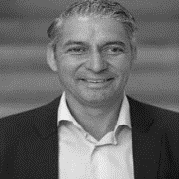
Who we are
Dr. Douglas Van Den Berghe
Expert – Trainer
Tom Becker
Market Intelligence Lead
Omar Eleish
Moderator
Background
Douglas is currently the CEO of NxtZones - a new Economic Zone (EZ) model and advisory for the future customized to a changing global economy, industry 4.0 and based on the most innovative and best practices of many SEZs around the world. He was previously the CEO and founder of Investment Consulting Associates – ICA. He is also the founder of two B2B tech ventures – both acquired in 2015. Before setting up his own company he was a Director at Ernst & Young and economic affairs officer at UNCTAD. Douglas is considered one of the leading global experts on FDI, location strategy, Special Economic Zones (SEZs), investment and incentives, and how to develop FDI policies for economic development and increase competitiveness. He has been an advisor to numerous governments and SEZs.
Background
Tom is an International Political Economist and is a Senior Advisor at NxtZones and works in Economic Affairs at the United Nations Economic and Social Commission for Asia and the Pacific. He holds a Bacherlor’s in International Relations from Durham University and a Master’s in International Political Economy from the London School of Economics and Political Science. His main research interests include sustainable industrial policy for trade and investment, Special Economic Zones and their contributions to the wider economy, the changing dynamics in the global political economy, infrastructure projects from investment to construction and the economic diplomacy of small and developing countries.
Background
Omar is an Economist currently managing director at Investment & Trade Intelligence (ITI) with proven track record in economic development through FDI attraction, facilitation policies & government incenivtes. He support European & Middle Eastern clients projects within the complete value chain of FDI. Prior to ITI Omar worked as investment attraction project manager at OCO Global, where he managed one of the largest FDI attraction project world-wide, attracting companies to the Gulf region and North Africa. Omar hold MSc in the Economics, LL.M Economic Analyses of Laws & BSc in Quantitative Economics.
Functional Expertise
Special Economic Zones
Economic development
FDI attraction
Industry 4.0 strategy
PR & Marketing
Business strategy
Implementation strategy
Functional Expertise
Special Economic Zones
Economic development and policy
FDI attraction, promotion and facilitation
Trade and Investment Treaties, Negotiations and Policy
Economic Diplomacy
Geopolitics and Geo-economics
Functional Expertise
Investment Attraction
Location Marketing
FDI Incentives
Investment Intelligence
FDI pipeline building

Slide 5
FRAMING THE INCENTIVES DEBATE
Increased Media Attention
Public Debate on Investment Incentives
Emotional but without a depth of understanding
Financial Crisis

Slide 6
Three views on incentives
Orthodox: Incentives have little or no effect
Traditional: It’s all about the incentives
Mixed: Incentives do matter, but it very much depends on situation, type and structure

Slide 7
The Current Incentives Debate
Emotional but without a depth of understanding
The orthodox view versus the market view. Are incentives a necessary evil, harmful or irrelevant?
NY Times Article – Race to the Bottom
IEDC Response and ED response. Corporate response?
International setting and debate (EU changes coming up and discussions in emerging markets)
Differentiation between discretionary negotiations and true “but-for” approach

Slide 8
Why give incentives?
Policy objectives that incentives are used to achieve:
To overcome a competitive weakness
To promote investment in deprived areas
To attract particular industries
To correct for market failures
To change the image of a location
Despite funding pressure, Governments feel that they have to offer incentives because their competitors offer incentives - simply to ensure that they are in the game

Slide 9
Do incentives work? Making sense of the evidence
Fiscal or other cost-reducing incentives tend to be effective where the investment decision is among either:
Similarly attractive platforms, which meet underlying project requirements, for producing for export to other markets, or
Similarly attractive parts of one large market (such as USA, EU, China)
New start-up projects prefer incentives that reduce their initial expenses
Established, expanding firms may prefer tax-related incentives that affect profit
All firms value transparent, easy to understand, and certainty in incentives policy

Slide 10
Do incentives work? Evidence FOR AND against
For: OECD and academic studies
Typically find corporate tax rates at a country and state level having a negative impact on FDI – with a 1% increase in tax reducing FDI by 1-5%. Most recent 2013 FT study found a very high correlation between corporate tax and FDI performance
Against: PricewaterhouseCoopers
“Many incentives result in low absolute value and obviously have minor impact on the investment decision. In fact most of them are of this nature”

Slide 11
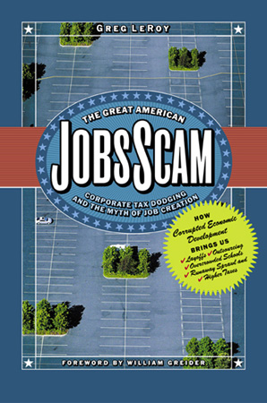
Incentives (and tax) do not alter basic business facts
“[As a businessman] I never made an investment decision based on the Tax Code . . . [I]f you are giving money away I will take it. If you want to give me inducements for something I am going to do anyway, I will take it.
“But good business people do not do things because of inducements, they do it because they can see that they are going to be able to earn the cost of capital out of their own intelligence and organization of resources.”
—Paul O’Neill, former CEO of Alcoa and President George W. Bush’s first Secretary of the Treasury

Slide 12
The overall Incentive Philosophy
Good incentive policy starts with clear goals and
an understanding of corporate motivation
Why give incentives?
What are the Economic Development Objectives?
Do incentives work (and when)?
What types of incentives are available?
What criteria should be used to award incentives?
Stipulate on Clawback Provisions

Slide 13
Section 2 The types of Incentives

Slide 14
DIFFERENT TYPES OF INCENTIVES
Direction of Incentive Instrument
Mode of Incentive Instrument
 | Type of Incentive
Direct Incentives | Investment Incentives Provision of financing options primarily aimed to offset capital expenditures required for start-up, upgrade and/or stabilization of operation(s)
 | Land and Infrastructure Incentives Reduced rates and/or direct provision of land, public utilities or transportation granted for specific investments
 | Training and Employment Incentives Subsidized training programs and education subsidies to reduce investors’ training costs to develop workforce skills
 | R&D Incentives Grants, credits and lending instruments to support investments in R&D and innovation
 | Type of Incentive
Indirect Incentives | Regulatory and Administrative Incentives Grating exceptions from rules and regulations in combination with streamlined and simplified administrative procedures through One-Stop Shop services (OSS)
 | Technical Incentives Investment facilitation services, information provision and aftercare to ensure a “soft landing” of the investment project or further expansion

Slide 15
GLOBAL INCENTIVE TRENDS 2018
3,253
awarded
129,840
retained jobs
$21.98 bln.
value
504,647
total jobs
374,807
new jobs
$100.02 bln.
capex
Source: IncentivesMonitor.com Date range: 2018

Slide 16
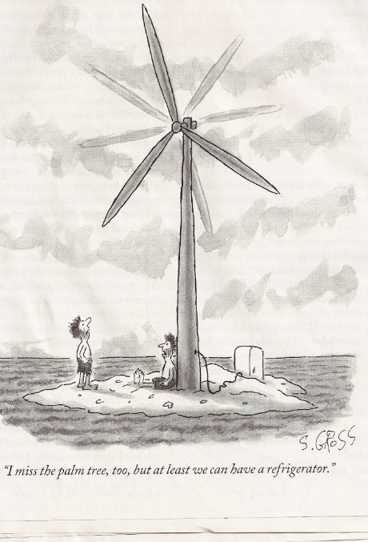
Final thoughts on incentives: Stimulate versus compensate
Compensate
Stimulate

Slide 17
Objectives in awarding incentives
Different objectives based on situation:
To overcome a competitive weakness
To promote investment in deprived areas
To attract particular industries or activities (R&D Centers, RHQ)
To correct for market failures (e.g. research or emerging industries)
To change the image of a location….
And because their competitors offer incentives i.e. simply to ensure that they are in the game
Incentives are most effective in #3 above!

Slide 18
Do Fiscal Incentives work?
Well, Yes and No:
Incentives have played a huge role in attracting mobile international investment (e.g., Intel in Israel & Ireland, garment factories worldwide)
In the USA, GM received $1.7bn in local incentives since 2007; South Carolina took on $218m in debt to assist Boeing’s expansion and offered 10-year tax holiday
But research in the Philippines suggests that over 90% of fiscal incentives go to firms that would have invested anyway
Companies still close or move facilities after getting incentives
Difficult to calculate the net cost or benefit – but lets try

Slide 19
CORPORATE SITE SELECTION PROCESS
Section 3

Slide 20
PROCESS OF INTERNATIONALIZATION
Cost
Internal
Market
We have to internationalize or die
All bets are off tomorrow
Internationalization is strategic
Are competitors are already doing it
We have to take positions now
Only a few players will survive
We’re just following our clients – they are global
Eat or to be eaten
Bigger is better
Foreign competitors are entering our market
Our home market is saturated
Our home market is too small
We need to be international from the start
It is key to have global access to clients
We need to be where the market is
It is too risky to depend on the home market alone

Slide 21
ENTERING A FOREIGN MARKET…
Commitment to Home Market
STRONG
EXPORTS
FRANCHISE & LICENSE
Commitment to Foreign Market
JOINT VENTURES
M&A
FDI
WEAK
WEAK
STRONG

Slide 22
Determinants of FDI
Both factors interact and vary strongly by company size; market orientation (domestic versus export); industry sub-sector; and investor nationality
Site selection criteria are of interest at both national (e.g. access to markets & suppliers; FDI framework) and a regional (e.g. real estate; geographically variable costs) scale
Host-country variables
Influences the final destination
of the investment
Firm/industry variables
Concerns initial decision
to undertake an investment
National variables
Local variables

Slide 23
Determinants of FDI
Firm/industry variables
Securing market access
Securing access to labour and natural resources
Access to suppliers
Following a sourcing strategy
Staying ahead of competition
Lowering production costs
Host-country variables
Political & economic stability
Favouring FDI policies
Adequate infrastructure & services
Adequate skill and labour base
Good supplier networks & services
Streamlined procedures

Slide 24
Foreign investors’ decision-making factors
Regulations/Laws
Taxation/tariffs
Ownership rules
Hiring practices
Legal frameworks
Investment incentives
Intellectual property protection
Finance
Repatriation of funds
Access to finance
Investment costs
Currency risk
Credit assessment

Slide 25
Foreign investors’ decision-making factors
Commercial Practices
Role and influence of large banks
Role and influence of large corporations
Business culture
Attitude to profit
Preferential relationships
Culture
Behaviour
Religion
Labour practices
Attitude to foreigners
Political/Economic Security
Logistics/Distance
Market/Profitability

Slide 26
Survey results on FDI determinants
Survey among top executives of world’s 500 largest corporations
Survey among 100 transnational corporations that had overseas expansion plans
Both surveys indicate that both economic and political fundamentals are pre-requisites in order to attract FDI
Rank | Factor | Response
1 | Political stability | 42%
2 | Skilled workforce | 30%
3 | Telecommunication infrastructure | 24%
4 | Technology | 21%
5 | Cost of capital | 20%
6 | Cost of raw materials | 19%
7 | Government involvement | 18%
8 | Transportation | 16%
Rank | Factor | Response
1 | Access to customers | 77%
2 | Stable social and political environment | 64%
3 | Ease of doing business | 54%
4 | Reliability and quality of infrastructure | 50%
5 | Ability to hire technical professionals | 39%
6 | Ability to hire management staff | 38%
7 | Level of corruption | 36%
8 | Cost of labour | 33%
8 | Crime and safety | 33%
10 | Ability to hire skilled workers | 32%
Sources: Capacity-Building Program on Investment Promotion and Attraction Module 2 VN and Worldbank Investment Group Investment Climate Study

Slide 27
Who selects the sites?
Consultants
Accounting Firms (Big 5)
Engineer/Architect/Valuer/Real Estate Broker
Professional Site Consultant
Special in-house project team
The top management
International business associates
Existing offices abroad

Slide 28
Steps for site decision-making
Literature search
Define needs of new facility (immediate and future expansion)
Draw up specifications of new facility
Compile general data of locations
Assemble site options
Visit sites
Analyze the options

Slide 29
Basic site selection principles
Process typically moves from macro to micro
Site selection is process of elimination (fatal flaw analysis)
Both public and private sectors are essential contributors
Providers of secondary data
Government supporters
Service providers
Employer testimonials

Slide 30
Themes...
Principles and factors to the site selection decision-making process
Case study of a corporate investor investment location selection
Evaluation determinants of corporate investor site selection

Slide 31
MOTIVES FOR FDI
Resource-Seeking
Market-Seeking
Asset-Seeking
Efficiency-Seeking
Network-Seeking

Slide 32
MARKET-SEEKING & ASSET-SEEKING
European Data Center Location and Incentives Optimization
Background:
Appnovation Technologies requested ICA’s services to assist with implementing its location strategy for its European data centers (to be located in France and Germany). A labor costs assessment, real estate evaluation and availability of incentives were main drivers of the site selection procedure. ICA assessed the various incentive regimes applicable for the business case of Appnovation Technologies’ data centers and selected relevant incentive programs. Through its network of European IPAs, ICA was able to reach out to local and regional officials to negotiate the incentive package and ensure Appnovation Technologies to fully comply with the requirements as stipulated by the incentive programs (both pre-incentive eligibility criteria as well as post-incentive monitoring and evaluation criteria).
Activities:
Evaluation of labor costs, real estate and incentives
Selection of incentive programs relevant to the business cases and its parameters
Completing the process of incentive application and communicating requested project information to ensure full requirement compliance to so obtain the agreed incentive rate
Organizing and preparing meetings with officials and Appnovation Technologies to guarantee full project engagement
Translation of application into local language
Submission of incentive applications to local and regional officials
Deliverables:
Benchmark report on the labor costs, real estate availability and incentive programs
Completed and submitted incentive applications in the local language

Slide 33
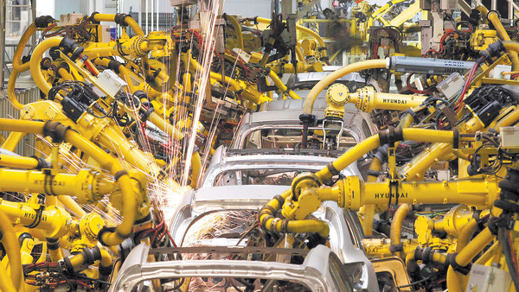
MARKET-SEEKING & EFFICIENCY SEEKING
Location Strategy Automotive European CDC
Background:
The project entails a Centralized Distribution Center (CDC) with significant capital investments in warehouse operations, human resources, value added logistics as well as globally integrated IT systems. The project directly contributes to regional economic development as well as indirect multiplier effects (i.e. security, facility management, utilities, etc.).
Activities:
Evaluated feasibility of CDC locations across Europe
Established connections with local Investment Promotion Agencies to explore incentive possibilities
Developed methodology to systematically evaluate incentive regimes
Financial modeling to calculate range of potential incentives
Deliverables:
Incentive regime analysis
Cost analysis based on relevant incentives
Recommendation to board
Confidential

Slide 34
MARKET-SEEKING & RESOURCE-SEEKING
Greenfield Plan Global Location Strategy
Background:
Corbion Purac requested location advisory service from ICA to support the company in its growth ambitions through international greenfield expansions and optimize its international value chain. To accommodate its future growth, Corbion Purac was exploring for additional greenfield investment opportunities in emerging markets. Project objective was to reduce a long-list based on an integrated regional assessment of incentives as well as operational costs.
Activities:
Evaluated feasibility of multiple locations across the globe: Canada (2), Brazil, South Africa (2), Germany, France, Indonesia, Vietnam, China (2) and Australia
Established connections with local Investment Promotion Agencies and local utility providers
Developed assessment templates for incentives and operational costs
Summarized all relevant incentive schemes per region
Utility assessment per region
Deliverables:
Recommendation to board
Incentive assessment including summary of incentive regimes, qualitative and quantitative analyses
Operational costs analysis including costs of human resources, electricity and gas

Slide 35
UNDERSTANDING THE CORPORATE INVESTMENT PROCESS
Strategic Assessment
Location Screening,
modeling & benchmarking
Cost Comparison
Community Evaluations
Implementation
Phase 1
Phase 2
Phase 3
Phase 4
Phase 5
Client
Define project and goals
Business requirements
Project assumptions
Input cost model
Resources for site visits
Define real estate objectives and accommodation needs
Project definition & understanding of strategy
Analysis and comparison
of locations
Comparison of costs
Site visits
Real estate support
Data gathering
Build model for location analysis
Present rankings of locations
Sensitivity analysis
Exploration of incentives
Real estate transaction and acquisition support
Set up cost model
Cost differentials between locations
Prepare site visits
Prepare discussions with relevant governments and service providers
Incentive negotiations
Consultant
Determine geographic scope
Selection of location factors
Weighting location criteria

Slide 36
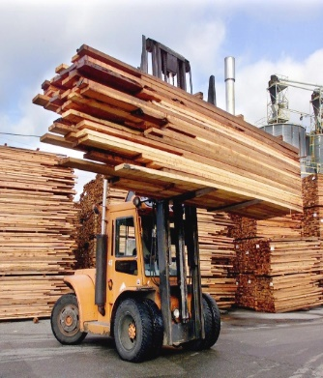
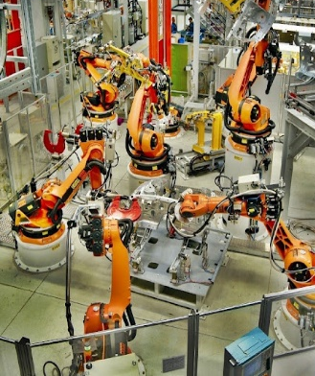
LINKING FDI MOTIVES WITH LOCATION FACTORS
FDI Motive
Resource-Seeking
Market-Seeking
Asset-Seeking
Efficiency-Seeking
Key Location
Determinant
Location of Resource
Market Potential
Location of Asset(s)
Lower Costs
Location Factors
Examples per
FDI Motive
1. Raw Materials
2. Natural Resources
3. Access to Resources
4. Abundance
5. Good Governance
1. Market Size
2. GDP per Capita
3. Proximity to Market
4. Access to Market
5. Growth Potential
1. Skilled Labor
2. Infrastructure
3. Access to Technology
4. Specialized Cluster
5. Network
1. Resource Costs
2. Input Costs
3. Labor Costs
4. Utility Costs
5. Productivity
Industries

Slide 37
FDI LOCATION SELECTION PROCESS
Long-List
Short-List
Location Decision
Implementation
Location
5-10 Potential Investment Locations
3-5 Potential Investment Locations
Final Location Decision
Realization of Investment
Risks
Institutional Risks
Operational Risks
Fundamentals
Location Criteria
FDI Motive
Business Facilitation

Slide 38
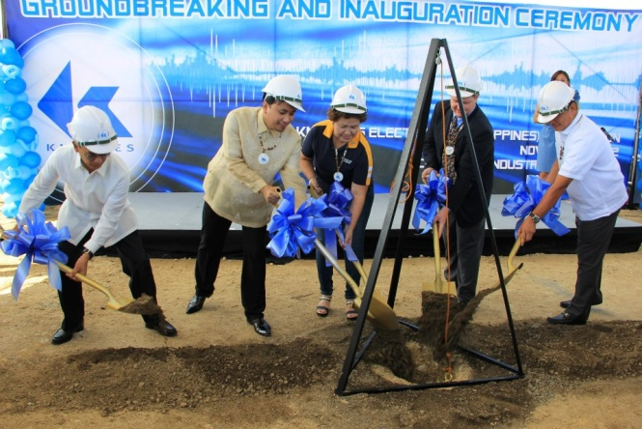
Knowles in the Philippines
http://www.ic-associates.com/newsletter/pressrelease/Press%20Release%2010-12-2012.html
ICA Guides Location Evaluation Process for Knowles Electronics Knowles Builds 4,000 Employee Manufacturing Facility in the Philippines
Knowles Electronics, producer of micro-acoustic components and part of Dover Corporation, publicly announced it will set up facilities at the Cebu Light Industrial Park (CLIP) in the Mactan Island, Cebu the Philippines. On Friday 9th of November, the company broke ground for what will be one of the biggest manufacturing facilities of Knowles in the world. The company will be among the biggest electronics companies to invest and operate in Cebu, and will ramp up their workforce to more than 4,000 employees in the next couple of years. Knowles makes components for hearing aid devices as well as MEMS surface mount microphones for major mobile phone brands and consumer electronic devices.
Joseph Emmanuel Liwag, Managing Director of the local Knowles unit, said his office currently has 40 employees but plans to increase workforce to 110 by yearend, 1,500 by the end of 2013, and a little over 4,000 by the end of 2014. “Cebu turns out to be a very positive location for a number of reasons. First of all, recruiting talented workers is clear-cut and their skills and attitude is outstanding. Ramping up our facilities is ongoing and the ease of doing our business here is surprisingly straightforward.” Joseph adds: “An investment project of this size requires a diligent and fact based location evaluation process and that is exactly what Investment Consulting Associates (ICA) did.”
Matthijs Weeink, ICA’s project manager “Our phased approach of location benchmarking, cost forecasting modeling, as well as three extensive rounds of site visits provided us with the tools, knowledge and understanding of recommending Cebu as the number one location”. “Throughout the whole location selection process, working with Knowles’ project team was a big pleasure, and this was truly a team effort.” Matthijs adds: “I would like to emphasize that Cebu Invest, the local investment promotion agency, did a great job and I am positive that this flagship project will have a tremendous impact on Cebu’s regional economic developments.”

Slide 39
Where are incentives positioned in this process

Slide 40
where corporates meet Governments
Strategic Assessment
Location Screening,
modeling & benchmarking
Cost comparison
Community Evaluations
Implementation
Phase 1
Phase 2
Phase 3
Phase 4
Phase 5
Lead Generation and Targeting
Aftercare and Policy Advocacy
Information & Sales Packs
Investment plans
Policies and incentives
Procedures and requirements
Progress and achievements
Create awareness
Information provision
Assistance with contacts
One-stop-shop services
Assessment of manpower,, Infrastructure service needs
Follow-up
Advertizing and PR
Information & Marketing
Missions & Events
Company targeting
Company visits
Follow-up
Continued “account executive attention”
“Ombudsman” role and trouble-shooting function
Follow-up on manpower, infrastructure, service needs
Image Building
Investor Servicing

Slide 41
Cherry on top principle

Slide 42
Section 3 The cost and benefits of incentives

Slide 43
Technical part towards incentives
Investment Project | Without incentives |  | With incentives
Capital Allowance
Depreciation
Annual Depreciation Rate Yr1 on Building | 10% |  | 20%
Subsequent Yrs on Building | 10% |  | 8%
Annual Depreciation Rate on Equipment and Utilities | 10% |  | 10%
Transportation Allowance | 0% |  | 25%
Training Incentive | 0% |  | 50%
Wage allowance for production workers | 0% |  | 25%
Corporate Income Tax Rate | 33.0% |  | 18.0%
Weighted Average Cost of Capital WACC | 10% |  | 10%
Support | Registered Manufacturers
Eligibility and Registration
 | Application to the Ministry of Trade and Industry and approval by the Ministry of Finance.
Corporate Tax | Set at a rate of 18% for a period of 10 years, where after it will revert to the general prevailing rate.
VAT | Exemption on purchase and import of manufacturing machinery and equipment
Stamp & Transfer Duty | Normal treatment
Established Tax Package | Negotiable rates and terms by special tax package.
Special Building Allowance | Factory buildings written off at 20% in first year and balance at 8% for 10 years
Transportation Allowance | Allowance for land-based transportation by road or rail of 25% deduction form total cost
Export Promotion Allowance | Additional deduction from taxable income of between 25% - 75%.
Incentive for Training | Additional deduction from taxable income of 25%.
Industrial Studies | Available at 50% of cost
Cash Grants | 50% of direct cost of approved export promotion activities.

Slide 44
NPV Analysis – without incentives
Case 1 | Food Processing Company
Namibia - Without Incentives
All in USD |  |  |  |  |  | Present | 2013 | 2014 | 2015 | 2016 | 2017 | 2018 | 2019 | 2020 | 2021 | 2022 | 2023
 |  |  |  |  |  | - | 0 | 1 | 2 | 3 | 4 | 5 | 6 | 7 | 8 | 9 | 10
Capex
Site |  |  |  |  |  | - | 1500000
Building |  |  |  |  |  | - | 3937500 | 1312500
Equipment |  |  |  |  |  | - | 8250000 | 8250000
Utilities |  |  |  |  |  | - | 2000000 | 2000000
Total Capex |  |  |  |  |  | - | 15687500 | 11562500
Turnover
Sales |  |  |  |  |  | - | 0 | 0 | 30000000 | 30000000 | 30000000 | 30000000 | 30000000 | 30000000 | 30000000 | 30000000 | 30000000
Operational Expenditures
Raw material |  |  |  |  |  | - | 0 | 10000000 | 10000000 | 10000000 | 10000000 | 10000000 | 10000000 | 10000000 | 10000000 | 10000000 | 10000000
Labour |  |  |  |  |  | - | 0 | 1500000 | 1500000 | 1500000 | 1500000 | 1500000 | 1500000 | 1500000 | 1500000 | 1500000 | 1500000
Power |  |  |  |  |  | - | 0 | 600000 | 600000 | 600000 | 600000 | 600000 | 600000 | 600000 | 600000 | 600000 | 600000
Water |  |  |  |  |  | - | 0 | 250000 | 250000 | 250000 | 250000 | 250000 | 250000 | 250000 | 250000 | 250000 | 250000
Gas |  |  |  |  |  | - | 0 | 300000 | 300000 | 300000 | 300000 | 300000 | 300000 | 300000 | 300000 | 300000 | 300000
Sewerage |  |  |  |  |  | - | 0 | 450000 | 450000 | 450000 | 450000 | 450000 | 450000 | 450000 | 450000 | 450000 | 450000
Transport |  |  |  |  |  | - | 0 | 1750000 | 1750000 | 1750000 | 1750000 | 1750000 | 1750000 | 1750000 | 1750000 | 1750000 | 1750000
Training |  |  |  |  |  | - | 0 | 300000 | 300000 | 300000 | 300000 | 300000 | 300000 | 300000 | 300000 | 300000 | 300000
Total OpEx |  |  |  |  |  | - | 0 | 15150000 | 15150000 | 15150000 | 15150000 | 15150000 | 15150000 | 15150000 | 15150000 | 15150000 | 15150000
Cashflow before taxes |  |  |  |  |  | - | -15687500 | -26712500 | 14850000 | 14850000 | 14850000 | 14850000 | 14850000 | 14850000 | 14850000 | 14850000 | 14850000
Capital Allowance and Depreciation
Building |  |  |  |  |  | - | 0 | 0 | 525000 | 525000 | 525000 | 525000 | 525000 | 525000 | 525000 | 525000 | 525000
Equipment and Utilities |  |  |  |  |  | - | 0 | 0 | 2050000 | 2050000 | 2050000 | 2050000 | 2050000 | 2050000 | 2050000 | 2050000 | 2050000
Total Capital Allowance |  |  |  |  |  | - | 0 | 0 | 2575000 | 2575000 | 2575000 | 2575000 | 2575000 | 2575000 | 2575000 | 2575000 | 2575000
Gross Profit |  |  |  |  |  | - | 0 | -15150000 | 12275000 | 12275000 | 12275000 | 12275000 | 12275000 | 12275000 | 12275000 | 12275000 | 12275000
Corporate Income Tax |  |  |  |  |  | - | 33.0% | 33.0% | 33.0% | 33.0% | 33.0% | 33.0% | 33.0% | 33.0% | 33.0% | 33.0% | 33.0%
Cashflow After Tax |  |  |  |  |  | - | -15687500 | -26712500 | 10799250 | 10799250 | 10799250 | 10799250 | 10799250 | 10799250 | 10799250 | 10799250 | 10799250
Discounted Cashflow After Tax |  |  |  |  |  | - | -15687500 | -24284091 | 8925000 | 8113636 | 7376033 | 6705485 | 6095895 | 5541723 | 5037930 | 4579936 | 4163578
NPV without incentives |  |  |  |  |  | 16567625
WACC Rate | 10%
Discounted CAPEX |  |  |  |  |  | - | 15687500 | 10511364
Present Value CAPEX (expenditure = minus) |  |  |  |  |  | -26198864
Discounted Cash Flow (Excl. Capex) |  |  |  |  |  |  | 0 | -13772727 | 8925000 | 8113636 | 7376033 | 6705485 | 6095895 | 5541723 | 5037930 | 4579936 | 4163578
Present Value (Excl. Capex) |  |  |  |  |  | 42766489
Profitability Index without Incentives |  |  |  |  |  | 1.63
EXAMPLE

Slide 45
NPV Analysis – with incentives
Case 1 | Food Processing Company
Namibia - With Incentives
All in USD |  |  |  |  |  | Present | 2013 | 2014 | 2015 | 2016 | 2017 | 2018 | 2019 | 2020 | 2021 | 2022 | 2023
 |  |  |  |  |  | - | 0 | 1 | 2 | 3 | 4 | 5 | 6 | 7 | 8 | 9 | 10
Capex
Site |  |  |  |  |  | - | 1500000
Building |  |  |  |  |  | - | 3937500 | 1312500
Equipment |  |  |  |  |  | - | 8250000 | 8250000
Utilities |  |  |  |  |  | - | 2000000 | 2000000
Total Capex |  |  |  |  |  | - | 15687500 | 11562500
Turnover
Sales |  |  |  |  |  | - | 0 | 0 | 30000000 | 30000000 | 30000000 | 30000000 | 30000000 | 30000000 | 30000000 | 30000000 | 30000000
Operational Expenditures
Raw material |  |  |  |  |  | - | 0 | 10000000 | 10000000 | 10000000 | 10000000 | 10000000 | 10000000 | 10000000 | 10000000 | 10000000 | 10000000
Labour |  |  |  |  |  | - | 0 | 1500000 | 1500000 | 1500000 | 1500000 | 1500000 | 1500000 | 1500000 | 1500000 | 1500000 | 1500000
Power |  |  |  |  |  | - | 0 | 600000 | 600000 | 600000 | 600000 | 600000 | 600000 | 600000 | 600000 | 600000 | 600000
Water |  |  |  |  |  | - | 0 | 250000 | 250000 | 250000 | 250000 | 250000 | 250000 | 250000 | 250000 | 250000 | 250000
Gas |  |  |  |  |  | - | 0 | 300000 | 300000 | 300000 | 300000 | 300000 | 300000 | 300000 | 300000 | 300000 | 300000
Sewerage |  |  |  |  |  | - | 0 | 450000 | 450000 | 450000 | 450000 | 450000 | 450000 | 450000 | 450000 | 450000 | 450000
Transport |  |  |  |  |  | - | 0 | 1,750,000 | 1,750,000 | 1,750,000 | 1,750,000 | 1,750,000 | 1,750,000 | 1,750,000 | 1,750,000 | 1,750,000 | 1,750,000
Training |  |  |  |  |  | - | 0 | 300,000 | 300,000 | 300,000 | 300,000 | 300,000 | 300,000 | 300,000 | 300,000 | 300,000 | 300,000
Total OpEx |  |  |  |  |  | - | 0 | 15150000 | 15150000 | 15150000 | 15150000 | 15150000 | 15150000 | 15150000 | 15150000 | 15150000 | 15150000
Cashflow before taxes |  |  |  |  |  | - | -15687500 | -26712500 | 14850000 | 14850000 | 14850000 | 14850000 | 14850000 | 14850000 | 14850000 | 14850000 | 14850000
Capital Allowance and Depreciation
Special Building Allowance |  |  |  |  |  | - | 0 | 0 | 1050000 | 336000 | 336000 | 336000 | 336000 | 336000 | 336000 | 336000 | 336000
Equipment and Utilities |  |  |  |  |  | - | 0 | 0 | 2050000 | 2050000 | 2050000 | 2050000 | 2050000 | 2050000 | 2050000 | 2050000 | 2050000
Transportation Allowance |  |  |  |  |  | - | 0 | 437500 | 437500 | 437500 | 437500 | 437500 | 437500 | 437500 | 437500 | 437500 | 437500
Training Incentive |  |  |  |  |  | - | 0 | 150000 | 150000 | 150000 | 150000 | 150000 | 150000 | 150000 | 150000 | 150000 | 150000
Wage allowance |  |  |  |  |  | - | 0 | 750000 | 750000 | 750000 | 750000 | 750000 | 750000 | 750000 | 750000 | 750000 | 750000
Total Capital Allowance |  |  |  |  |  | - | 0 | 1337500 | 4437500 | 3723500 | 3723500 | 3723500 | 3723500 | 3723500 | 3723500 | 3723500 | 3723500
Gross Profit |  |  |  |  |  | - | 0 | -16487500 | 10412500 | 11126500 | 11126500 | 11126500 | 11126500 | 11126500 | 11126500 | 11126500 | 11126500
Corporate Income Tax |  |  |  |  |  | - | 18.0% | 18.0% | 18.0% | 18.0% | 18.0% | 18.0% | 18.0% | 18.0% | 18.0% | 18.0% | 18.0%
Cashflow After Tax |  |  |  |  |  | - | -15687500 | -26712500 | 12975750 | 12847230 | 12847230 | 12847230 | 12847230 | 12847230 | 12847230 | 12847230 | 12847230
Discounted Cashflow After Tax |  |  |  |  |  | - | -15687500 | -24284091 | 10723760 | 9652314 | 8774831 | 7977119 | 7251926 | 6592660 | 5993328 | 5448480 | 4953163
NPV with incentives |  |  |  |  |  | 27395991
WACC Rate |  | 10%
Discounted CAPEX |  |  |  |  |  | - | 15687500 | 10511364
Present Value CAPEX (expenditure = minus) |  |  |  |  |  | -26198864
Discounted Cash Flow (Excl. Capex) |  |  |  |  |  |  | 0 | -13772727 | 10723760 | 9652314 | 8774831 | 7977119 | 7251926 | 6592660 | 5993328 | 5448480 | 4953163
Present Value (Excl. Capex) |  |  |  |  |  | 53594854
Profitability Index without Incentives |  |  |  |  |  | 2.05
EXAMPLE

Slide 46
Financial modeling – incorporating incentives
NPV Analysis
Net Gain Incentives
Net Present Value
 | Country 1 | Country 2 | Country 3 | Country 4
Without Incentives | $16,567,625 | $20,630,740 | $18,737,794 | $15,282,316
Rank | 3 | 1 | 2 | 4
With Incentives | $27,395,991 | $28,735,666 | $25,713,125 | $19,811,165
Rank | 2 | 1 | 3 | 4
Gain in % | 65% | 39% | 37% | 30%

Slide 47
Pointers The future of incentives

Slide 48
Intelligent incentive design introduction & agenda
Design Considerations for Incentive Programs
Basic Structure & Targets
Eligibility & Benefits
Monitoring & Evaluation
Resources, Roles & Responsibilities
Objective(s)
Application Procedure
M&E Systems
Administrative Responsibility
Strategy
KPIs
Vision
Eligibility Criteria
Clawback Provisions
Financial Responsibility
Mission
Financial Benefits
Unforeseen Circumstances
M&E Responsibility
Payment
Beneficiary Requirements
Transparency and Accountability
Notes:
Outline for today. This framework shows the components of a Best Practice Incentive Design. The objective of this presentation is to get you acquainted with some of the main features, challenges, elements of an Incentive Design, based on ICA’s global experience. It therefore gives an insight into the role this ICA’s Service Line can play for clients looking for incentive services: where can we facilitate the process and add value?
This framework is not a fully chronological process; elements partly overlap and interact with each other. This particularly true for the fourth section (RRR), which is gradually established throughout the whole process. As a such, the process is characterized as iterative.

Slide 49
Intelligent incentive design monitoring & evaluation
Economic Impact
Transparency
Monitoring & Evaluation
Notes:
Economic Impact
It is imperative that the initaited incentive program features the largest possible economic impact. In order to accomplish this, incentive programs should be focused on firms that provide the greater social benefits at lower incentive costs. Related to the general size of the project’s effect is the relative return being provided: creating jobs is important but it should be done based on which project yields the largest return on investment. This is particularly relevant in times of shrinking budgets and programs becoming more politically intense.
As a result, these investment programs must be able to provide large positive returns for taxpayers. In order to gauge the return on any project, KPIs need to be observalbe and goals must be defined. Without such metrics, it is impossible to determine program effectiveness and compare projects for resources within a limited budget.
Transparency
Measuring the outcome and impacts of an investment program is only possible of the process is transparent from both the business-government perspective as well as the government-citizen perspective.
- Business-Government: companies must be willing to provide data detailing for instance the capital investment and number of jobs created. This allows officials to esnure that all criteria are being met.
- Government-Citizen: officials need to be clear why taxes are being forgone and how much revenu is being lost. The aim should be to help taxpayers understand the overall improvements being created by the programs. Transparency becomes more difficult when confidential data needs to be reviewed. This not only improves transparency but also enhances accountability.
Monitoring & Evaluation
To comply with transparency, incentive programs need to be subject to strict audit reviews and standards as instituted by governments. Regular audits evaluate:
The performance of the programs to determine their success at achieving the economic development goals;
The effectiveness of the programs in terms of administration; and
The perforamnce of individual beneficiaries to make sure that they have complied with the minimum requirements.
A strong M&E system will ensure that program fraud is minimized and guarantees governements will be able to monitor the direct benefits realized by their programs.
Reporting and Monitoring Continuing Compliance. Conditions are sometimes attached
to incentives that are related to ongoing performance -- for example, requirements that a
given number of jobs are maintained, or that a certain percentage of production is exported,
throughout the tax holiday period. Incentives of this type require continuing monitoring.
Although this imposes an additional administrative burden on the authorities it does have the
merit of providing the host government with a reasonably accurate idea of how an
investment is performing. Without a formal monitoring mechanism, investors have little
reason to make realistic projections as to the number of jobs that will be created, or the
volume of exports that will be produced, and some studies have shown large discrepancies
between investor prediction and performance. However, it is important that administrative
capabilities to conduct necessary monitoring are taken into account when incentive
legislation is drafted, so that unnecessary supervision is avoided.
Common abuses. On-going monitoring of investments is necessary not only to ensure
continuing compliance with qualifying conditions but also to detect tax avoidance or
evasion. Tax avoidance presents greater difficulties, because countries have different
attitudes as to what constitutes avoidance, and what to do about it. For example, a tax
holiday may be conditional on employing a given number of persons. In some countries an
investor could legitimately make up the qualifying number by hiring “employees” with
minimal duties and at low wages. In other countries, this course of action might be
considered an abuse of the legislation and result in the denial or withdrawal of the tax
privilege.

Slide 50
Intelligent incentive design conclusion
“The key is to make sure the programs are properly designed with clear goals and measurable outcomes, offer high transparency to increase accountability, and be carefully monitored to ensure performance”
“Taxpayers are entitled to and should receive a reasonable return on their investment. When properly employed, incentive programs are effective tools for promoting economic development”

Slide 51
Criteria to award incentives
The most straightforward criteria are based on capital investment and employment creation, which can be measured accurately
Quality criteria. Incentives often vary depending on:
Quality of jobs created
Sector and/or the type of activity
Incentives awarded should be the amount needed to attract the project (not the maximum available!). This is influenced by:
Market size
Corporate tax rate
What other locations are offering
The incentive awarded should always take into account what the net economic and social benefits of the project will be

Slide 52
What a proper Incentive solution provides
Maximizes return on investment through:
Earlier revenue generation through accelerated start up
Cost optimization; and
Maintained or Improved quality/service levels
Achieves ‘best deal’ with:
Financial grants and incentives
Efficient VAT
Transparent Taxation and Transfer Pricing issues
Provides an objective decision process:
Independent and transparent
Based on “Best Practices”
Minimum use of resources and time to administer and monitor
Over 4X in 10 years

Slide 53
Summary: The Role of Smart Incentives
Incentives Can’t
Make a bad location into a good one
Address gross disconnects between location and business need
Create an industry cluster where it doesn’t already want to exist
Ensure a long-term connection between business and community
Incentives Can
Create partnerships which benefit both community and company
Address short-term hurdles
Fix small regulatory and tax problems
Create a sense of a community’s willingness to work with business

Slide 54
Recommendations
IPAs should have as much knowledge as possible about the project parameters, underlying benefits of the location, and profitability of the location compared to competitors with sensitivity analysis of incentives packages
Financial models can greatly assist in negotiating with an investor to understand the profitability/NPV of the project
Incentives should be part of the overall investment proposition. Do not lose sight of the fundamentals for why the company is investing and the benefits of your locations
Time is money and your soft incentives can be equally important for the investor

Slide 55
INNOVATION IN FREE ZONE CONCEPTS
Traditional Free Zone Incentives
Investment Incentives
Land & Infrastructure Incentives
Training and Employment Incentives
R&D Incentives
New Generation Free Zone Incentives
Regulatory and Administrative Incentives & Services
Technical Incentives & Services
Notes:
Investment Incentives
Provision of financing options primarily aimed to offset capital expenditures required for start-up, upgrade and/or stabilization of operation(s)
Land and Infrastructure Incentives
Reduced rates and/or direct provision of land, public utilities or transportation granted for specific investments
Training and Employment Incentives
Subsidized training programs and education subsidies to reduce investors’ training costs to develop workforce skills
R&D Incentives
Grants, credits and lending instruments to support investments in R&D and innovation
Regulatory and Administrative Incentives & Services
Grating exceptions from rules and regulations in combination with streamlined and simplified administrative procedures through One-Stop Shop services (OSS)
Technical Incentives & Services
Investment facilitation services, information provision and aftercare to ensure a “soft landing” of the investment project or further expansion

Slide 56
INNOVATION IN FREE ZONE SERVICES
Zone Infrastructure & Real Estate
Economy & Investment
Services & Governance
Monitoring & Evaluation
Notes:
1. Zone Infrastructure & Real Estate - Improve physical assets such as infrastructure and real estate in a sustainable manner through applying, connecting and integrating cloud-based services, real-time user interfaces (e.g. smartphones), ICT, IoT, big data & advanced data analytics, and artificial intelligence.
2. Economy & Investment - Attracting new investment in platforms disrupted by the 4th Industrial Revolution with considerable opportunities for investment attraction (e.g. FinTech, agro- & food-technology, IT security, identity & privacy services, and IT consultancy) by focusing on talent, knowledge, training and innovation.
3. Services & Governance - Improve the participation and satisfaction of Free Zone tenants by providing services and e-governance equipped with the latest technologies, innovations and intelligence as well as aligned with actual needs and requirements from the 4th Industrial Revolution.
4. Monitoring & Evaluation - Learn, adapt, customize, and innovate its services, marketing and promotion through real-time data collection and advanced data analytics to monitor, measure and evaluate the Free Zone’s (sustainable) performance.

Slide 57
INNOVATION IN FREE ZONE SERVICES
WORKFORCE INCENTIVES
Recruitment & HR Support
Training &
Education
Thought Leadership
University Partnerships

Slide 58
BEST PRACTICE - INNOVATION IN SERVICE DELIVERY
Workforce Training as Incentive
Source: ZonAmerica Website, 2018

Slide 59
Annex case study
Interaction between investment incentives and sustainability

Slide 60
Case study sustainability and incentives: vietnam
Sustainable development:
“Enterprises apply their strategy and action plan to satisfy the current demands of the enterprises and other stakeholders and, at the same time, protect, maintain and improve the human and natural resources for the future”
Satisfy demands of enterprises themselves whilst simultaneously harmonising with demands of other stakeholders (i.e. those who are directly affected by the operation of the enterprises):
Creditors
Clients and customers
Employees
Social communities

Slide 61
Case study sustainability and incentives: vietnam
Sustainable development behaviour of enterprises is determined by the interplay of internal and external factors.
Internal factors include:
Awareness of managers and employees; and
Policy of the parent company.
External factors include:
Customer demand;
Legal system and legal enforcement;
Effectiveness of the legal system;
Community pressure; and
Government incentives.

Slide 62
Case study sustainability and incentives: vietnam
Vietnam has gradually improved their legal system, investment policies and investment incentives.
Core principles of investment promotion policies include:
Non-discrimination;
Transparency;
Predictability; and
Protection of investor’s ownership.
These core principles have been integrated in Vietnam’s current legal framework accompanied with a more sustainability-orientation, encouraging investments in:
Advanced technology sectors;
Environment protection; and
Difficult areas to create leverage for economic development of such areas.

Slide 63
Case study sustainability and incentives: vietnam
Source: UN IDO Viet Nam Industrial Investment Report 2011

Slide 64
Case study sustainability and incentives: vietnam
The mining and quarrying industry has attracted considerable interest from foreign investors.
Foreign investors in this industry are entitled to investment incentives, regardless of whether or not they are orientated towards sustainable development.
However, for a sector that has such great impact on the environment, current investment incentives seem to be divorced from the industry’s social and environmental responsibilities.

Slide 65
Case study sustainability and incentives: vietnam
Current government investment incentives are not a primary influence on sustainable development in the mining and quarrying industry.
This might relate to the fact that current incentive tools have directed enterprises to investment-promoted sectors and locations but have not encouraged a relationship between incentives and the sustainable development behaviour of enterprises.
Sustainable development behaviour of enterprises so far has mainly depended on policies held by the parent company abroad, the perfection of the legal system and its enforcement.

Slide 66
Recommendation
Specific incentives for enterprises relating to sustainable development have only been applied individually depending on the local government’s level of awareness.
Consequently, a policy recommendation that governments can consider is to put more emphasis on the link between sustainable development targets and conditions for incentive entitlement, especially regarding social and environmental conditions.

Slide 67
Thank you valued COMESA RIA member state participants, we appreciate your precious time!
Your team,
Investment & Trade Intelligence GmbH
Kolonnenstr. 8 10827 Berlin Germany
Visit our website: www.itiinvestment.com
Drop us an email: Info@itiinvestment.com
Lets connect!

