Slide 1
COMESA Workshops – Investment Facilitation & Aftercare Best Practices
Day 3
Aftercare & Facilitation Workshop
Policy & Organizational Tools
October 19th ,9:30 – 11:00

Slide 2
Partnership Details
The COMESA Regional Enterprise Competitiveness and Access to Markets Programme (RECAMP) is implemented by the COMESA Secretariat in collaboration with the following COMESA institutions: the Alliance for Commodity Trade in Eastern and Southern Africa (ACTESA), the Africa Leather and Leather Products Institute (ALLPI), the COMESA Business Council (CBC)., the Federation of National Associations of Women in Business in Eastern and Southern Africa (FEMCOM) and the COMESA Regional Investment Agency (RIA).
The 10 Euro million project runs until 2023 and is funded by the European Union under the 11th European Development Fund (EDF). RECAMP focuses on improving competitiveness and market access of SMEs and other firms in targeted value chains in the COMESA Member States and on generally improving the business environment for SMEs (including the women and youth) in this region.

Slide 3
Housekeeping rules
Keep mobile phones on mute
Limit movement in and out of training venue while session is in progress
Limit electronic interuptions
Q&A : Questions will be addressed throughout the presentations and through an open discussion forum

Slide 4
Agenda – Day 3
9:00 AM – Welcome and review of Day 2
9:05 AM – Policy Advocacy: Improving Policy and Long-term Competitiveness
9:30 AM – Introduction to key organisational tools to use: Databases, CRM
10:00 PM – Best practices in use of CRM for Investment Facilitation & Aftercare & Business Retention
10:30 PM – Closing remarks, open discussion and lessons learned from workshop
Aftercare (Part 2)

Slide 5
Welcome & Review of Day 2
30 mins

Slide 6
1. Policy Advocacy: Improving Policy and Long-term competitiveness
30 mins

Slide 7
Wavteq’s framework for aftercare / BRE
POLICY ADVOCACY
Type of support to investors
Reactive
Proactive
Customized
Advocacy
Using existing investors as “ambassadors” who will influence other firms to consider the country as an investment site is a key method of lead generation. Developing good links with local managers has been central to investment promotion in the most successful locations. Happy and profitable clients are good promotional tools!
1. Business Retention
4. Policy Advocacy
3. Investor Development
2. Business Expansion
Key focus: ensuring successful project operations
Problem solving
Permits & licenses
Land & sites access
Infrastructure & utilities
Resident & work permits
Incentives monitoring
Project tracking
Key focus: securing project expansions
Key account management
Investor retention
Investor expansion
Key focus: project upgrading, local linkages and spillovers
Investor-specific plans
Subsidiary upgrading
New project exploration
Supply chain development
Skills & training
Research & development
Key focus: improving policies and long-term competitiveness
Policy advocacy
Investor grievance mechanisms
Source: Wavteq

Slide 8
How the policy context has a critical impact on FDI
POLICY ADVOCACY
The World Bank found that while more than one-third of investors reinvest all their affiliate-generated profit back into the affiliate, the rate of investors divesting from developing countries because of irregular government conduct is approximately 25%.
Assisting investors navigate the legal and regulatory system is a key function of investment facilitation and aftercare (especially in developing countries).
Source: World Bank Group
Notes:
However, in practice many IPAs find that they cannot overcome the obstacles and issues facing investors as they are beyond the direct control of the IPA. This is where policy advocacy can play a very important role with the IPA advising the governments on policy changes which will improve the legal and regulatory climate for investment.
Policy advocacy can be far broader than legal and regulatory, and can include any policy which improves the competitiveness of the location for investment.

Slide 9
What is policy advocacy?
POLICY ADVOCACY
Policy advocacy refers to influencing changes in regulations, laws and government policies, in the interest of both potential and existing investors.
According to the World Bank, foreign investors attach the highest value to IPA advocacy services that help improve business environment
IPAs are in a unique position to provide policy advocacy services to firms: IPA staff have direct day-to-day contact to foreign investors and are able to identify regulatory bottlenecks, policy failures and other gaps in the investment ecosystem. IPAs also interface frequently with government ministries that can enact policy changes.
To be successful, IPAs need to maintain a balancing act, avoiding becoming either a government spokesman or a private sector lobbyist or might catering to the interests of only large investors.
Source: Based on UNCTAD (2006)

Slide 10
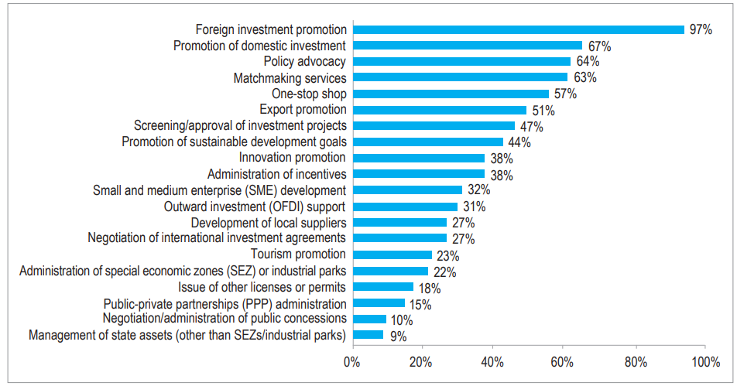
Although a high percentage of IPAs have a formal mandate to conduct policy advocacy, minimal resources are allocated to this function
POLICY ADVOCACY
In a World Bank Group (2020) survey on the state of investment promotion agencies, 64% of the 91 IPAs surveyed indicated that they have a formal mandate for policy advocacy.
However, only 5% of IPAs dedicate budget to policy advocacy activities
Policy advocacy is often neglected by IPAs despite its importance in shaping investment climate.
Mandates performed by IPAs (2020)
Source: Based on World Bank Group (2020

Slide 11
How do IPAs implement policy advocacy?
POLICY ADVOCACY
Close collaboration with government ministries
Direct reporting to Prime Minister/Ministry of Investment: In some countries (e.g. Ethiopia or Turkey), the IPA reports directly to the Prime Minister or President’s Office, which confers them with significant influence on policy. In other countries IPAs are part of a Ministry of Investment (e.g. Egypt and Saudi Arabia), which also facilitates strong policy influence.
Building a policy advocacy team
Dedicated policy advocacy function and relationships with key policy-related stakeholders: IPA advocacy teams consist not only of employees of the IPA but may also include partners in a formal or informal organization. Members of effective IPA advocacy teams, even though they may belong to different organizations, recognize their interdependence and the need for each other's special knowledge, skills and resources.
Having a sound monitoring and evaluation system in place
Building credibility through M&E: A sound monitoring and evaluation system helps the advocacy team track its success, build credibility with support organizations and motivate members to sustain momentum. If IPA policy advocacy activities bring about a desired policy change, the IPA will want to demonstrate a clear connection between its objectives and activities and the policy outcome
Source: Based on UNCTAD (2006)

Slide 12
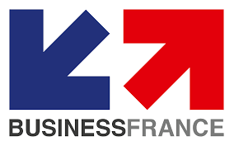
Case Study: Business France’s policy advocacy process
POLICY ADVOCACY
Business France sends a confidential report to the French government presenting about 20 proposals to improve the country’s attractiveness.
These measures are a result of Business France’s consultations with foreign companies supported by the agency in their investment and expansion projects in France.
Proposals are prioritised by investors: a panel of CEOS of foreign affiliates is jointly consulted with a private law firm to gather views on the level of priority to be given to the various recommendations
Proposed measures that have been implemented in recent years
Creation of a multi-year residence permit
Extension of the inpatriate regime
Creation of a single point of entry for foreign investors in Business France and other French regions
Establishment of an information website for foreign investors and talent
Source: OECD: Link

Slide 13
Organizations that can support IPAs with policy advocacy
POLICY ADVOCACY
Professional Service Firms
Business and Industry Associations and Chambers of Commerce
International Organisation
Public/Private Sector Forums
Source: Based on UNCTAD (2006)
Notes:
Professional service firms that assist companies with investment strategy and implementation (lawyers, consultants, investment banks) can be another important source of policy guidance.
Business and industry associations and chambers of commerce who provide services to their members and have constant contact with foreign and local investors can be a key source of information, and typically already provide policy advocacy to their members. Associations organized on a sector basis often have strong sector insights into policies that can improve the busines climate and location competitiveness for a specific sector.
International organizations such as UNCTAD, UNIDO or WTO, institutions such as IFC, and the regional development banks contain information on general or country-specific policy issues that tend to promote or deter foreign investment. Also, there are several non-governmental organizations and think tanks whose websites can be valuable sources of information on best practices in investment.
Public/private sector forums are valuable sources of information on the views of the private sector and the investment environment. In China, each province has a foreign investor' association with which the local IPA has a close relationship, and frequent meetings are organized to discuss issues of concern to investors.

Slide 14
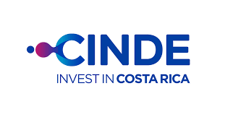
How to identify important areas for policy advocacy
POLICY ADVOCACY
1.Consistent Investor aftercare services are an essential part of the policy advocacy process as investors already established in the country are the richest source of useful information.
For example, CINDE (IPA of Costa Rica) convenes monthly, thematic working groups where investors can discuss key issues affecting the investment climate, such as immigration procedures, infrastructure, human resources and domestic supply issues.
This has led to major policy changes such as the 100% English speaking national program and additional resources for training in cybersecurity and industry 4.0 to help upgrade existing subsidiaries and attract new investors in fast growth, high value added sectors.
Source: Wavteq, CINDE: Link

Slide 15
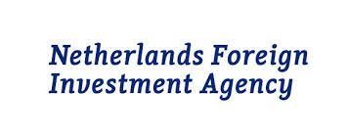
Case Study: NFIA’s investor feedback process
POLICY ADVOCACY
The Netherlands Foreign Investment Agency has a coordinated approach to gathering feedback of current and potential foreign investors on Dutch business climate:
Feedback from daily contacts: Investment managers and regional partners share business climate information provided by their accounts with NFIA.
Feedback on adhoc basis: Foreign investors may share their comments on Dutch business climate at events or special occasions. This input is collected by NFIA staff in a centralised manner.
Feedback from Investor Relations’ Meetings: NFIA and regional partners have aftercare-related (Investor Relations) meetings with existing accounts where business climate issues are discussed.
Feedback from triannual extended survey on Dutch business climate
Analysis of lost projects: NFIA analyses lost projects to understand why foreign companies finally decided not to invest in the Netherlands
Analysis of media, external studies and reports on Dutch business climate (e.g. World Economic Forum’s Competitiveness Report, Global Innovation Index)
Source: OECD: Link

Slide 16
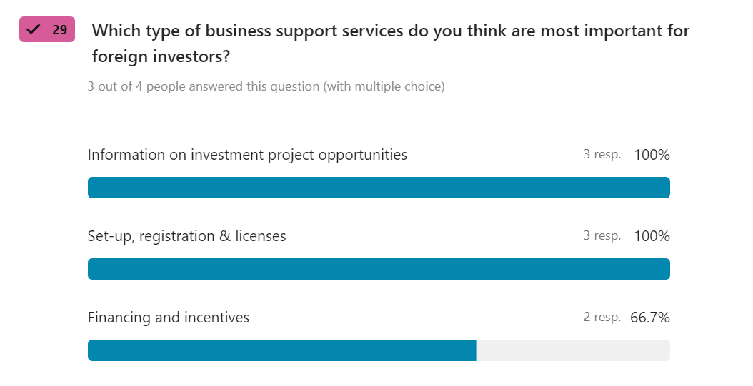
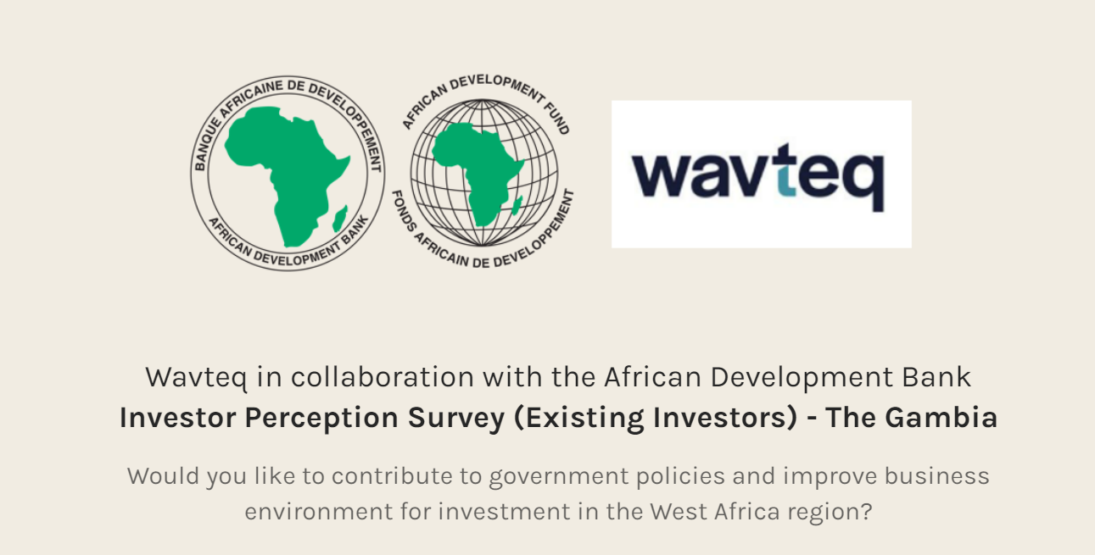
How to identify important areas for policy advocacy (2/3)
POLICY ADVOCACY
2. Existing investors' surveys are also quite useful in canvassing the views and perceptions of both existing investors already established in the country as well as potential investors who have not yet made the decision to invest.
Example outputs from investor perception surveys
Source: Wavteq

Slide 17
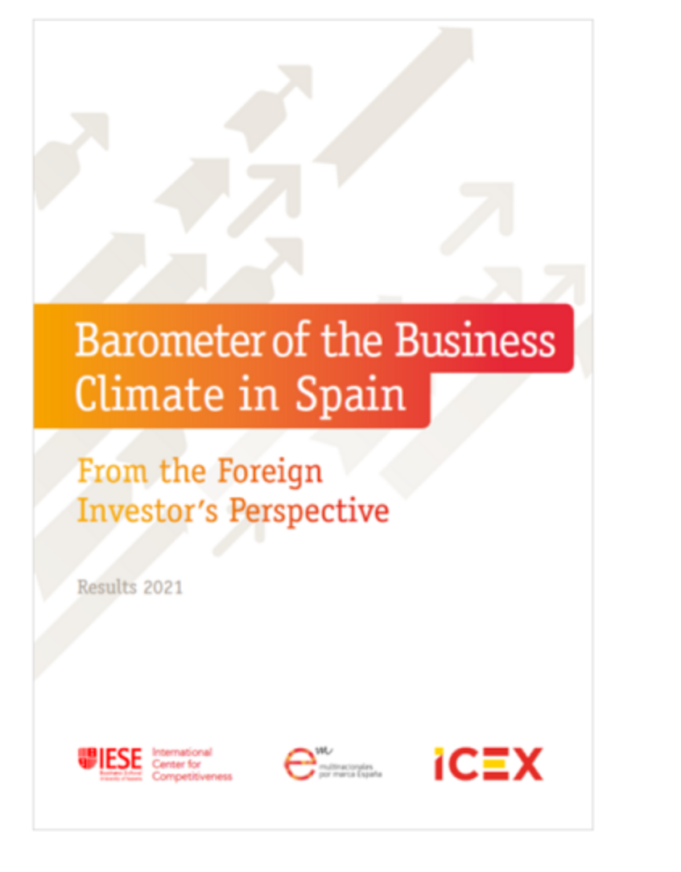
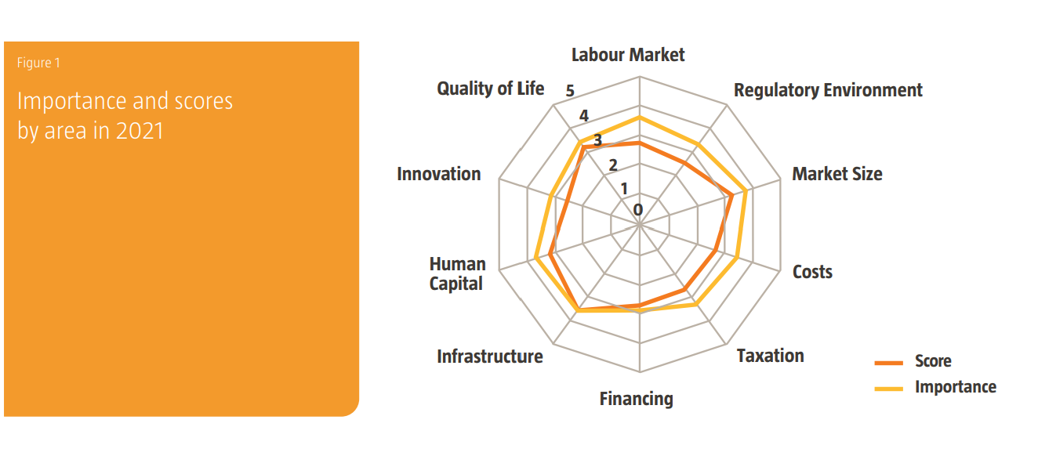
Case Study: ICEX-Invest Spain’s business climate barometer
POLICY ADVOCACY
ICEX-Invest Spain produces an annual report on the “Barometer of the Business Climate in Spain from the Perspective of Foreign investors”.
The report is based on responses from over 500 companies to a survey on their experience as foreign firms in Spain, and on their future prospects.
The survey contains a series of questions that address the main business climate areas and reflect the most pressing concerns for foreign investors
Source: Invest in Spain: Link

Slide 18
How to identify important areas for policy advocacy (3/3)
POLICY ADVOCACY
3. Foreign Investor Councils are also widely used to detail the conditions for foreign investment in the country, where progress has been made, and where more policy changes would be desirable.
The Ghana Investors Advisory Council (GIAC), which advises the President on investment issues, is composed of the 25 leading business executives in the country drawn from multinational companies with operations in Ghana, potential investors, and top local businesses; the CEO of the Ghana Investment Promotion Centre is an observer at GIAC meetings.
The GIAC, which meets every six months, identifies very specific issues that need to be addressed in order to maintain or improve the environment for investment in the country.
Source: Wavteq

Slide 19
2. Introduction to key organisational tools to use: Databases, CRMs
30 mins

Slide 20
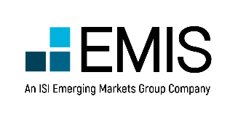
Data sources and resources to help identify target firms
Mass company databases
FDI specific company databases
Databases are an important source of information, but alone they are not sufficient to identify the right companies to target.
Bespoke research and continuous investment intelligence gathering is needed.

Slide 21
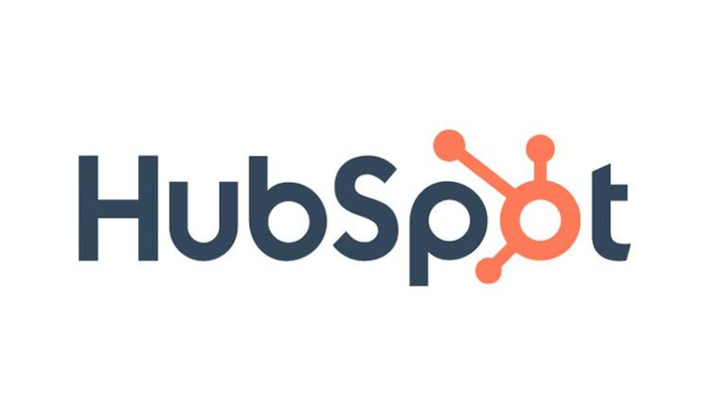
Business Development Tools
Relationship Management Tools
With nearly 600 vendors, the CRM/Relationship management space is crowded. Often the first investment into business development teams, choosing and investing in the right platform is a critical decision. With the rapid change in technology and how economic development and investment promotion organizations are interacting with prospects CRMs are gaining new features by tailoring the user experience to suit expected outcomes and better monitor the activities which are most impactful. It is critical that IPAs choose Operational Systems that are fit for purpose.
Amplify/Salesforce/Dynamics/ Hubspot
CRM’s systems help BD teams keep prospect contact details up to date, track every prospect interaction, and manage accounts through various pipelines.
Estimated Costs: 1K USD per user user/ per year (Amplify), Salesforce/Dynamics 8K - 50K per year.
Influencers
Influencers is curated Network of nearly 30,000 global business site-consultants, advisors & intermediaries in the FDI value chain. Wavteq Influencers is a unique online platform providing a complete solution for IPAs to develop and implement an intermediaries strategy.
Estimated Costs: 5K - 7K USD/ per year
LinkedIn Sales Navigator:
What it does and how it helps: This tool makes it easy to build prospect lists based on decision makers' job titles and responsibilities. Users can also monitor relevant discussions, allowing salespeople to find more meaningful ways to engage.
Estimated Costs: $79 USD per month
Source: Wavteq

Slide 22
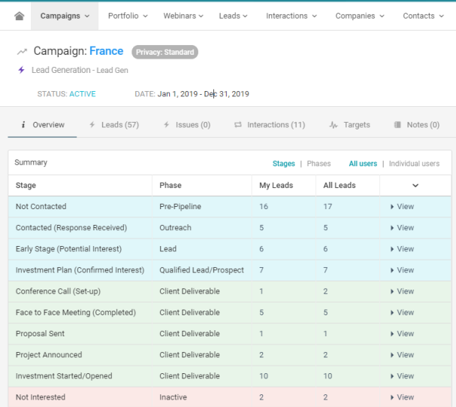
What is a CRM and how can an IPA benefit from it
KEY ORGANIZATIONAL TOOLS AND CRM
Example dashboard from Amplify CRM
A Customer Relationship Management system (CRM) – sometimes referred to as an Investor Tracking System (ITS) – is a digital tool investment promotion agencies use to track key information on their prospective and existing investors.
Examples of key data points that can be tracked on a CRM include: basic company profile information (company size, location of company, industry and sub-sector of investor, most recent communications, potential investor development plans or business expansion requests,
A CRM can also be a useful tool for collaboration between different agencies and stakeholders, especially when destination authorities wish to transfer leads to the national authorities, or report on the status of a lead
Source: Wavteq

Slide 23
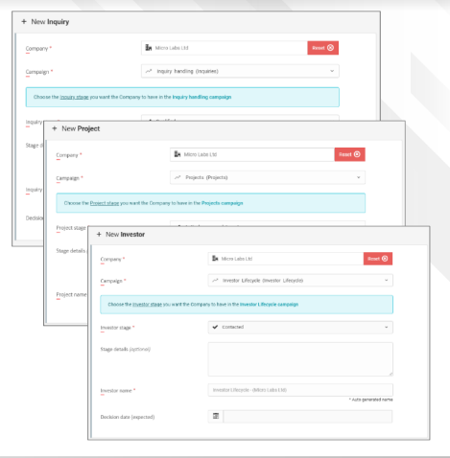
Benefits of a CRM for facilitation and aftercare
KEY ORGANIZATIONAL TOOLS AND CRM
Example from Amplify CRM
Better knowledge management and when used well, minimal loss of information within team
Better documentation of communications and company information that team has conducted with investors
Ability to track information in one location
Ability to track progress of team in achieving key performance indicators and organisational goals
Enhances collaboration potential between destination authority and other organisations responsible for tourism investment promotion
Source: Wavteq

Slide 24
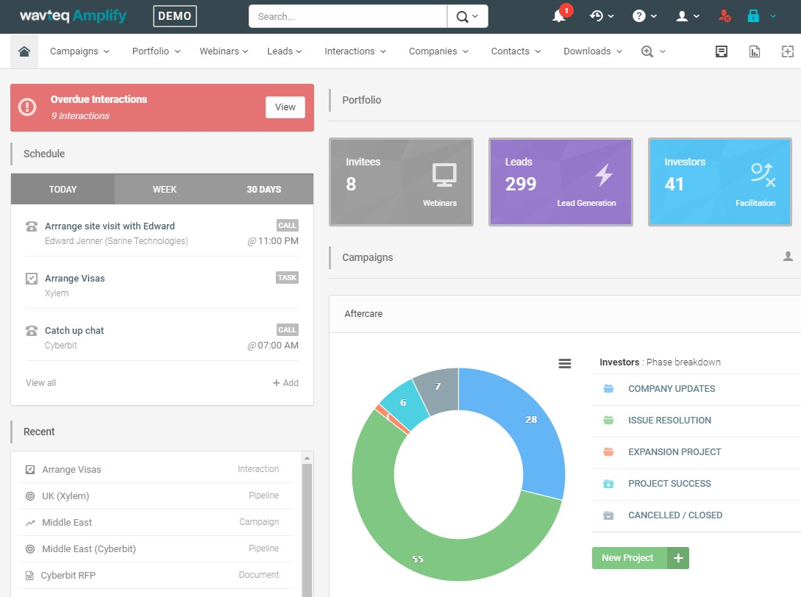
When setting up a CRM for aftercare/facilitation, IPAs need to define their existing approach to these activities
KEY ORGANIZATIONAL TOOLS AND CRM
List each process (activity, service, program or support) your agency delivers.
Define the purpose, key inputs and target outcome
Consider how processes are linked – that is, the successful outcome of one process will result in the commencement of another.
For investment facilitation, this may include securing permits or licenses for an investor, supporting with conducting site visits, and supporting with incentives applications.
For investment aftercare, this will include engaging with existing investors, resolving issues faced with investors, supporting expansion projects, raising business climate issues to higher levels of government.
Main user dashboard in Wavteq Amplify CRM system teq.com/systems/wavteq-amplify/
Source: Wavteq

Slide 25
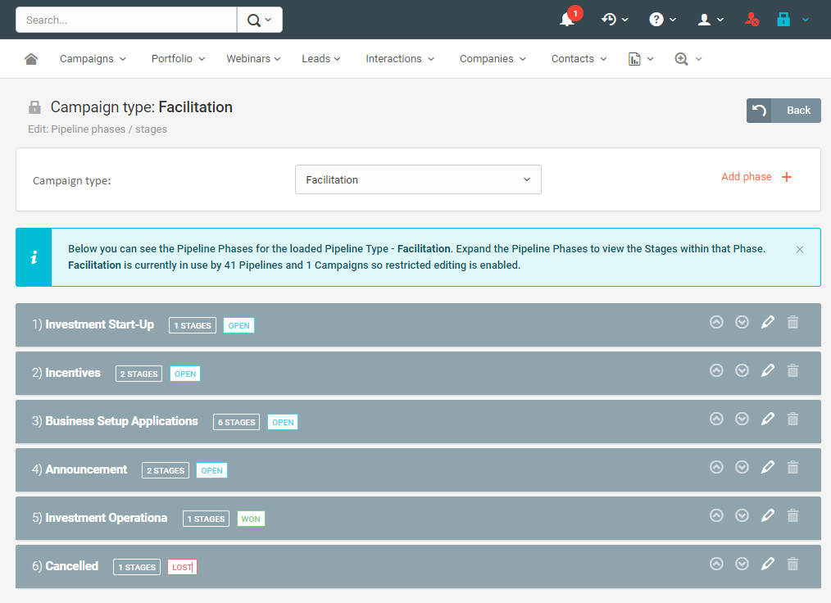
Break down processes into tasks to clarify what needs to be tracked
KEY ORGANIZATIONAL TOOLS AND CRM
For each business process it is important to break it down into individual tasks that will follow a sequential order with aim of delivery on the goal or target outcome for that process
In addition to measuring success, you will also need to consider failure points – when it is proven there is no opportunity or no option for further engagement
For each step in the process, careful consider who needs to complete the action and what types of activities need to take place to complete that step and allow progression to next step
Campaign stages and phases editor in Wavteq Amplify CRM system https://www.wavteq.com/systems/wavteq-amplify/
Source: Wavteq

Slide 26
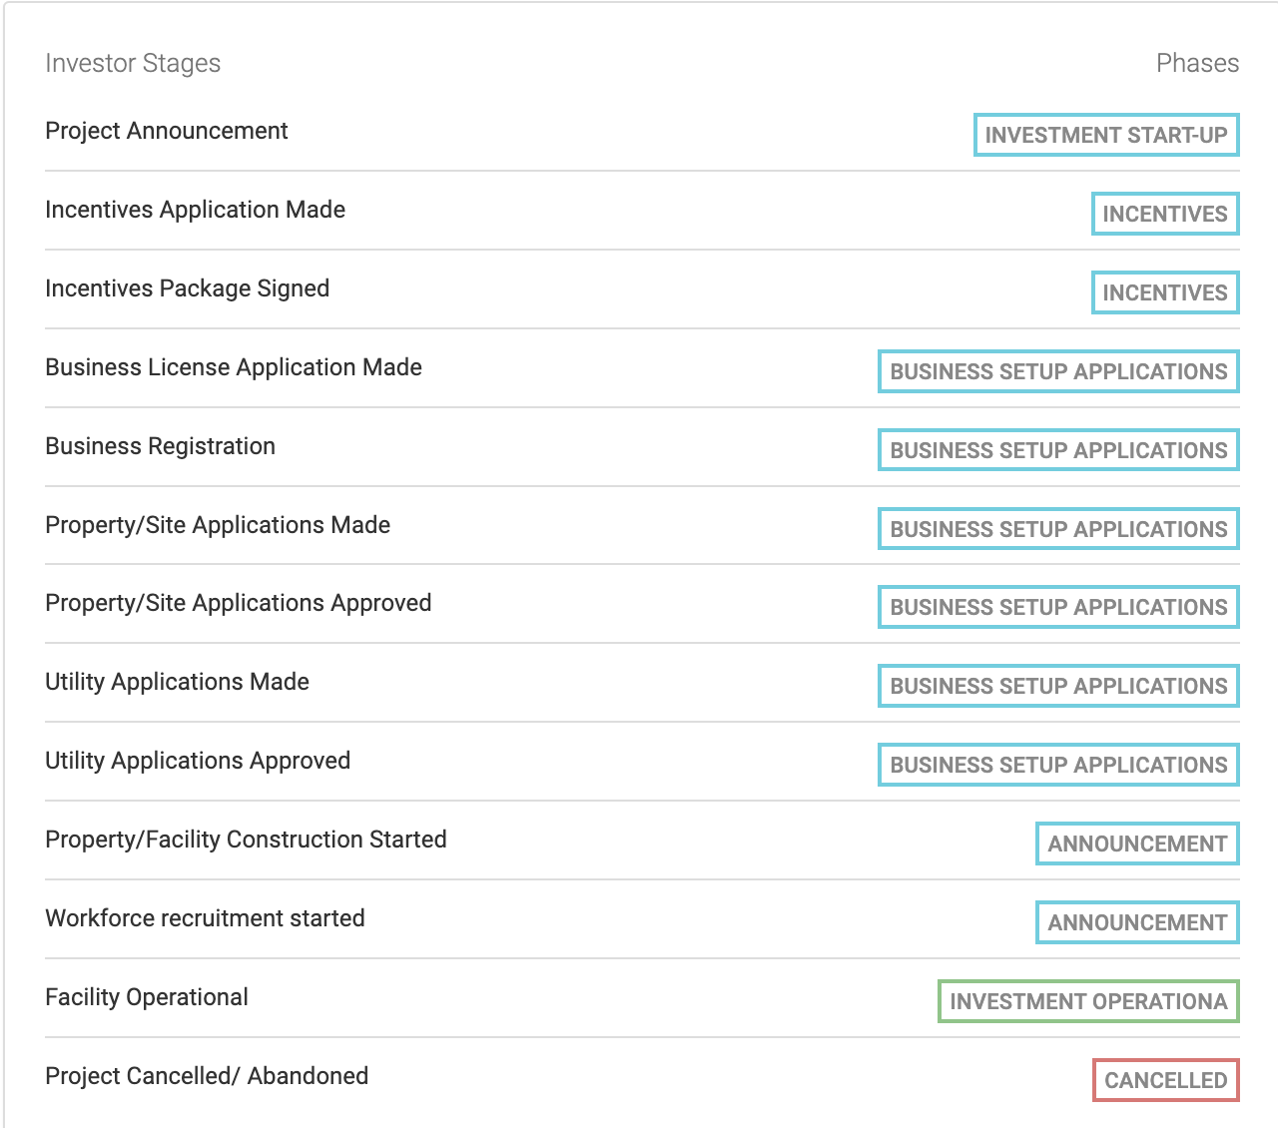
KEY ORGANIZATIONAL TOOLS AND CRM
Facilitation Campaign Stages Break down of Stages and Phases
IPAs can identify initially:
KPIs they are looking to measure (as outlined in Facilitation stages, for e.g #projects announced)
Configure their CRM to suit the different stages and phases based on internal processes
Modify & either add/remove stages and phases that IPAs are not interested in recording
IPAs can set targets in CRMs that are specific and measured. Most CRMs can set targets such as # Number of Business registrations made etc.
Source: Wavteq

Slide 27
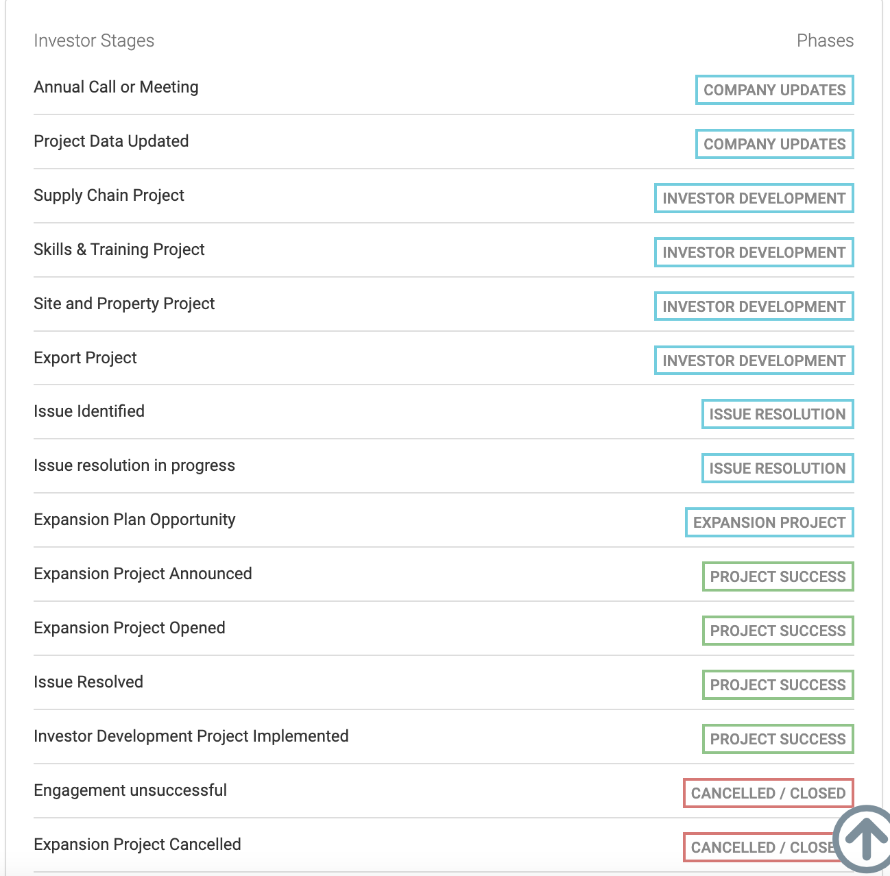
KEY ORGANIZATIONAL TOOLS AND CRM
Aftercare Campaign Stages Break down of Stages and Phases
IPAs can identify initially:
KPIs they are looking to measure (as outlined in Aftercare stages, for e.g #of reinvestment or expansion projects announced)
Configure their CRM to suit the different stages and phases based on internal processes
Modify & either add/remove stages and phases that IPAs are not interested in recording
IPAs can set targets in CRMs that are specific and measured. Most CRMs can set targets such as # Number of expansion plans identified on a quarterly or annual basis.
Source: Wavteq

Slide 28
3. Best practices in CRM usage for investment facilitation and aftercare
30 mins

Slide 29
Invest Northern Ireland has clear targets within their CRM for the facilitation and aftercare-related activities they conduct
KEY ORGANIZATIONAL TOOLS AND CRM
There are clear targets for number of expansion projects, number of expansion jobs, and skills R&D expenditure targets and targets for number of meetings
To monitor achievement of targets and provide comprehensive data on existing investors, an annual survey takes places of all 1,000 accounts, which has been done for last 8-9 years. This captures investment info but also info on sales, R&D, exports etc.
Each account manager has targets to achieve and they typically meeting most significant investors 2-4x a year
A CRM system is used to manage contacts and interactions with investors
Source: Wavteq

Slide 30
NFIA’s CRM is accessible to all agencies that undertake aftercare activities in the Netherlands
KEY ORGANIZATIONAL TOOLS AND CRM
NFIA’s current CRM system is advanced and accessible to all parties that undertake aftercare activities in their regions.
It is the foundation of the aftercare programme and serves as a comprehensive knowledge base of all existing investors in the Netherlands.
All project managers are required to update the CRM and it is the main source of coordination between national, local and overseas agencies.
Source: Wavteq

Slide 31
FIPA Tunisia’s CRM system collects all relevant information on existing investors and investor development plans (1/6)
KEY ORGANIZATIONAL TOOLS AND CRM
Company Basic Information | Example
Company Name | ABC (Ireland) LTD
Parent Company Name | ABC INC
Address | 123 Main Street
Zip / Post Code | A12 BB34
Country | Ireland
State | Mayo
City | Westport
Global Locations of the Company (countries) | USA, Ireland, Spain, India, South Africa (this level of geo-mapping is typically what a national IPA needs)
Global Locations of the Company (states) | e.g. California, Beijing Municipality, Bayern, etc. (this level of geo-mapping is typically what a State-level EDO/IPA needs)
Global Locations of the Company (cities) | e.g. London, Dublin, Boston, Shanghai (this level of geo-mapping is typically what a City-level EDO/IPA needs)
Source of Where the Company was Identified (Type) | e.g. inbound enquiry, external consultant, database, trade show, another government agency, foreign IPA, donor organization, internet research, intermediary, existing investor referral
Source of Where the Company was Identified (Details) | Introduced to CEO, Joe Soap, at MediTechExpo in Los Angeles in 2011, who was eyeing European expansion at the time.
Source: Wavteq

Slide 32
FIPA Tunisia’s CRM system collects all relevant information on existing investors and investor development plans (6/6)
KEY ORGANIZATIONAL TOOLS AND CRM
Company Project Information | Example
Confidential Project | Yes/No
Project Code / Name | e.g. you can add a specific project code or name for each project
Type of Investment Planned | e.g. Greenfield
Expansion Plan Details | Plans to open new European Office focused on Medical Device consultancy (audit and compliance) having achieved ISO17020 accreditation...
Capital Investment Planned | USD 10m
Direct Jobs Planned | 25
Indirect Job Creation Impact | 10
Average Salary Level of Direct Jobs | $50,000
Locations Considered for the Project | e.g. UK, France, Netherlands or Ohio, Kentucky and Ontario
Property Requirement | 200 sqm TurnKey office in Central Location
Property/Sites Submitted | Can list the properties/sites submitted to the company to consider and the Excel download will show each property
Funding in Place for the Expansion | e.g. company has raised $50 million for FDI from….
Source of Project Opportunity (Details) | Press Release on Company Website or Meeting with company
Source of Project Opportunity (URL) | www.abcinc.com/newsroom/european-expansion-iso17020-jan2019.htm
Investment Decision Date | November 2019
Investment Opening Date | May 2020
Project Type: Industry | e.g. Other Manufacturing s (NACE C32
Project Type: Sector | e.g. Manufacture of medical and dental instruments and supplies (NACE 32.5)
Project Type: Sub Sector | e.g. Manufacture of medical and dental instruments and supplies (NACE 32.50)
Project Type: Product/Service | e.g. Syringes & Hypodermic Needles
Project Type: Activity | e.g. Headquarters, R&D, BPO, Manufacturing, Logistics etc
Source: Wavteq

Slide 33
The Gambia’s Investment and Export Promotion Agency (GIEPA) uses their CRM to digitize their incentives application process, and to generated their annual FDI report (1/3)
KEY ORGANIZATIONAL TOOLS AND CRM
Example incentives application pipeline from GIEPA CRM
Source: Wavteq

Slide 34
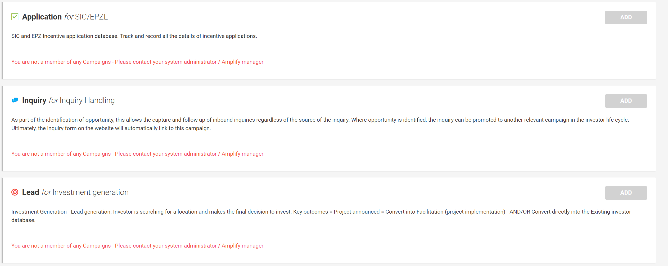
The Gambia’s Investment and Export Promotion Agency (GIEPA) uses their CRM to digitize their incentives application process, and to generated their annual FDI report (2/3)
KEY ORGANIZATIONAL TOOLS AND CRM
Source: Wavteq

Slide 35
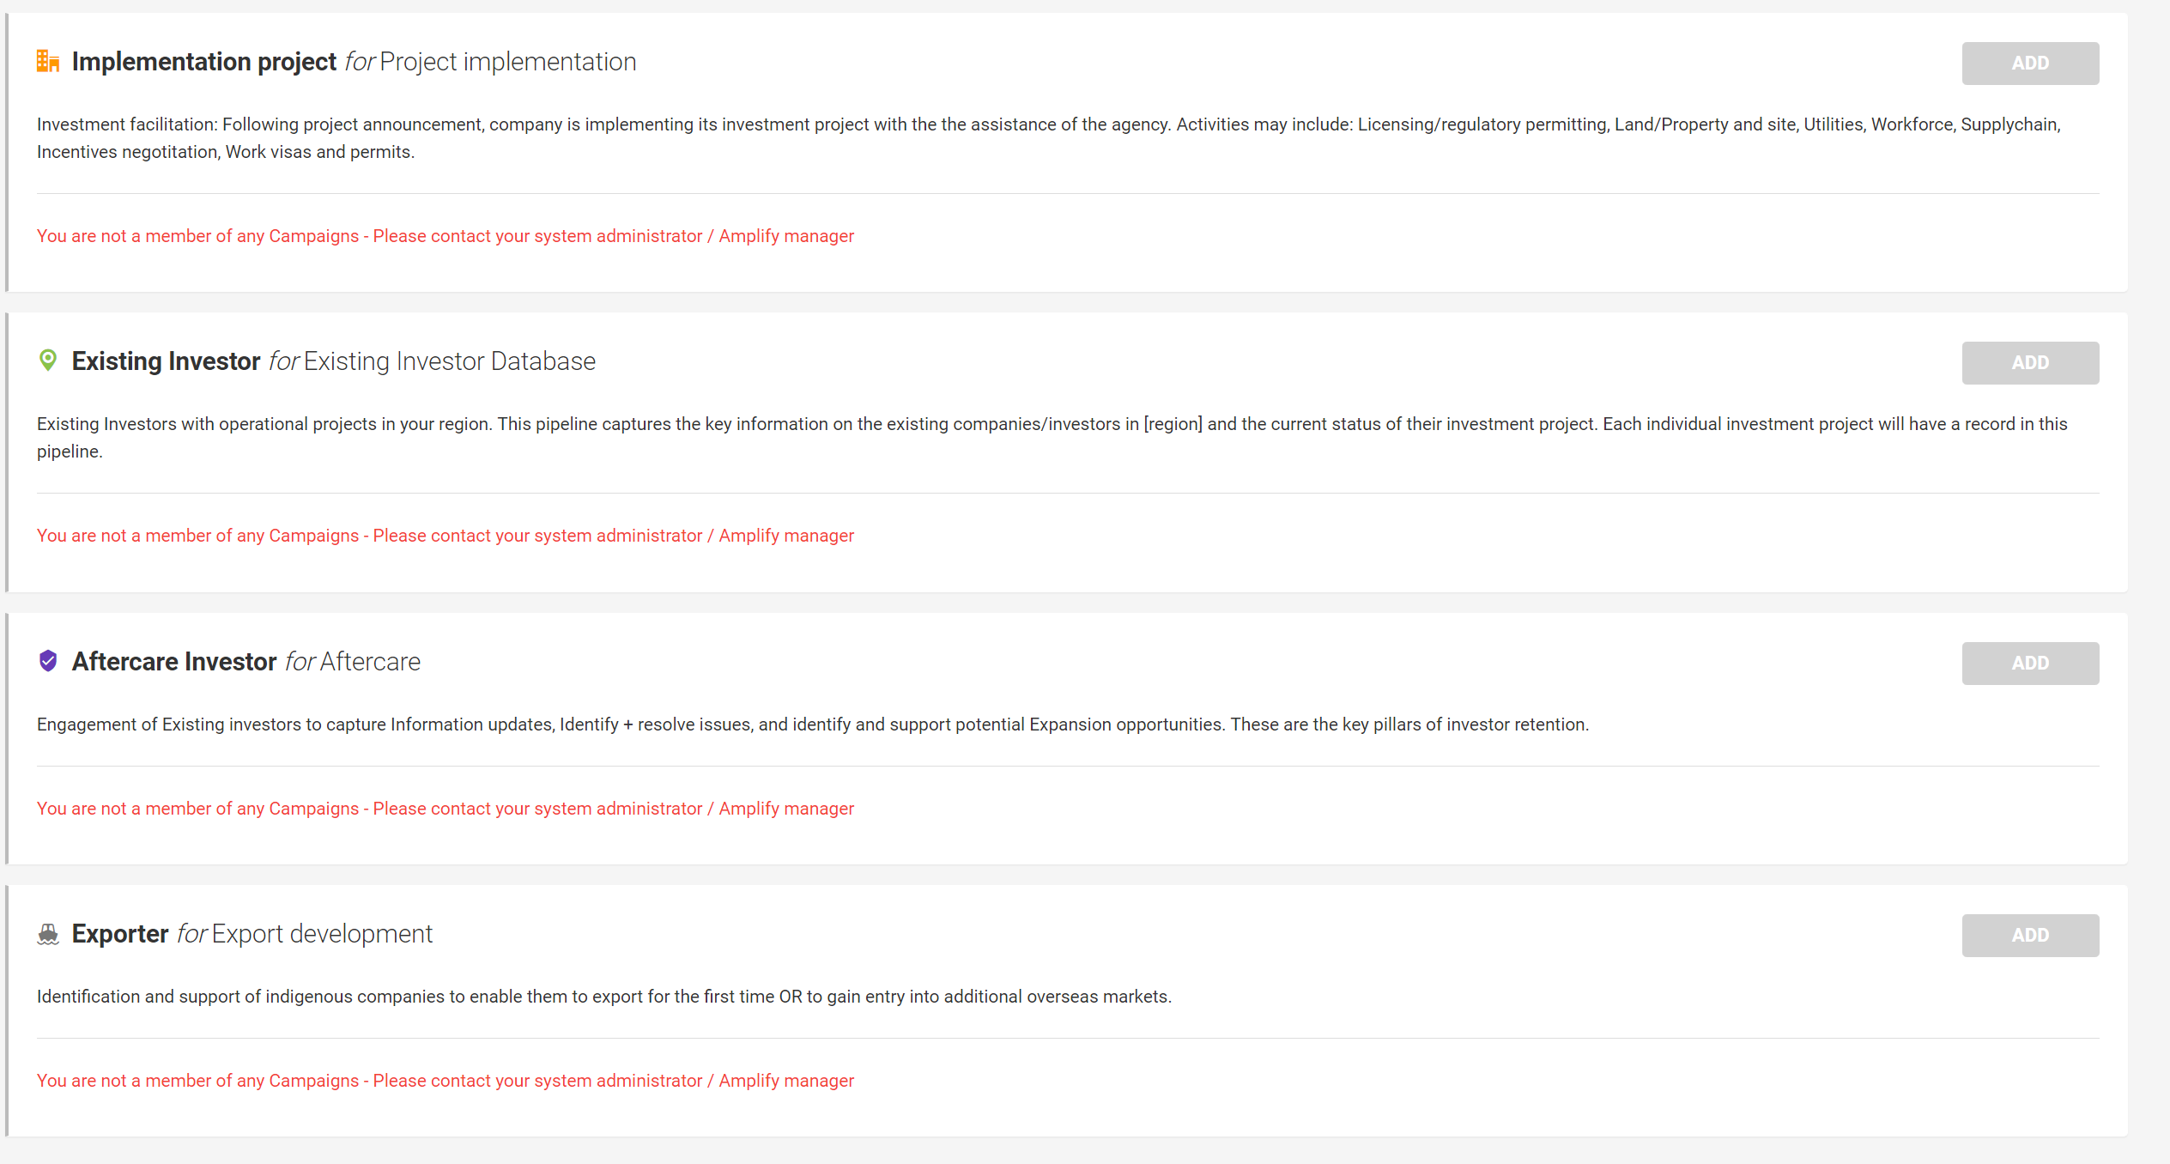
KEY ORGANIZATIONAL TOOLS AND CRM
Source: Wavteq

Slide 36
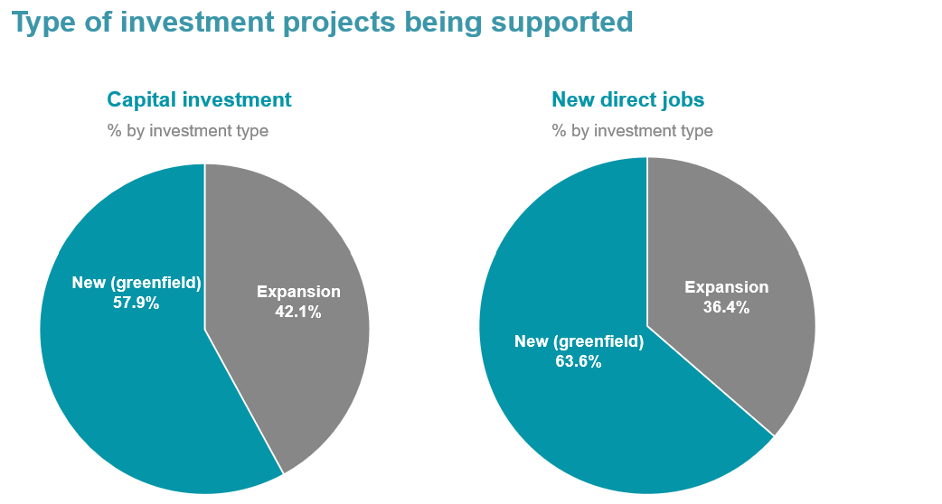
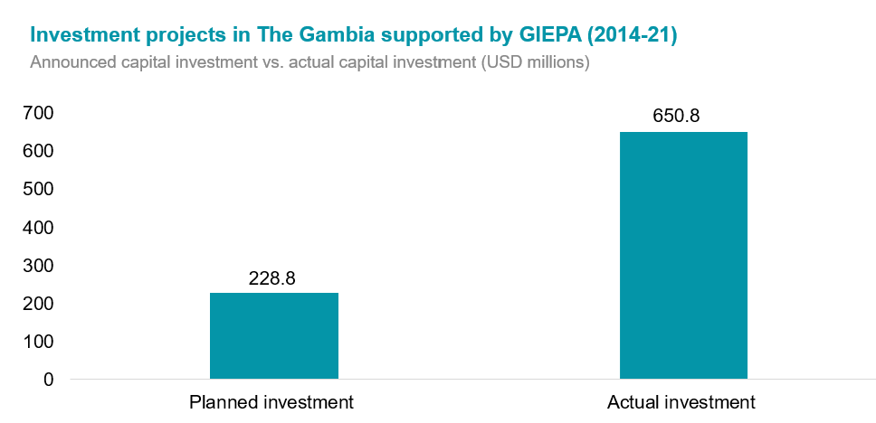
The Gambia’s Investment and Export Promotion Agency (GIEPA) uses their CRM to digitize their incentives application process, and to generated their annual FDI report (3/3)
KEY ORGANIZATIONAL TOOLS AND CRM
Example of trends generated by GIEPA’s CRM
Source: Wavteq

Slide 37
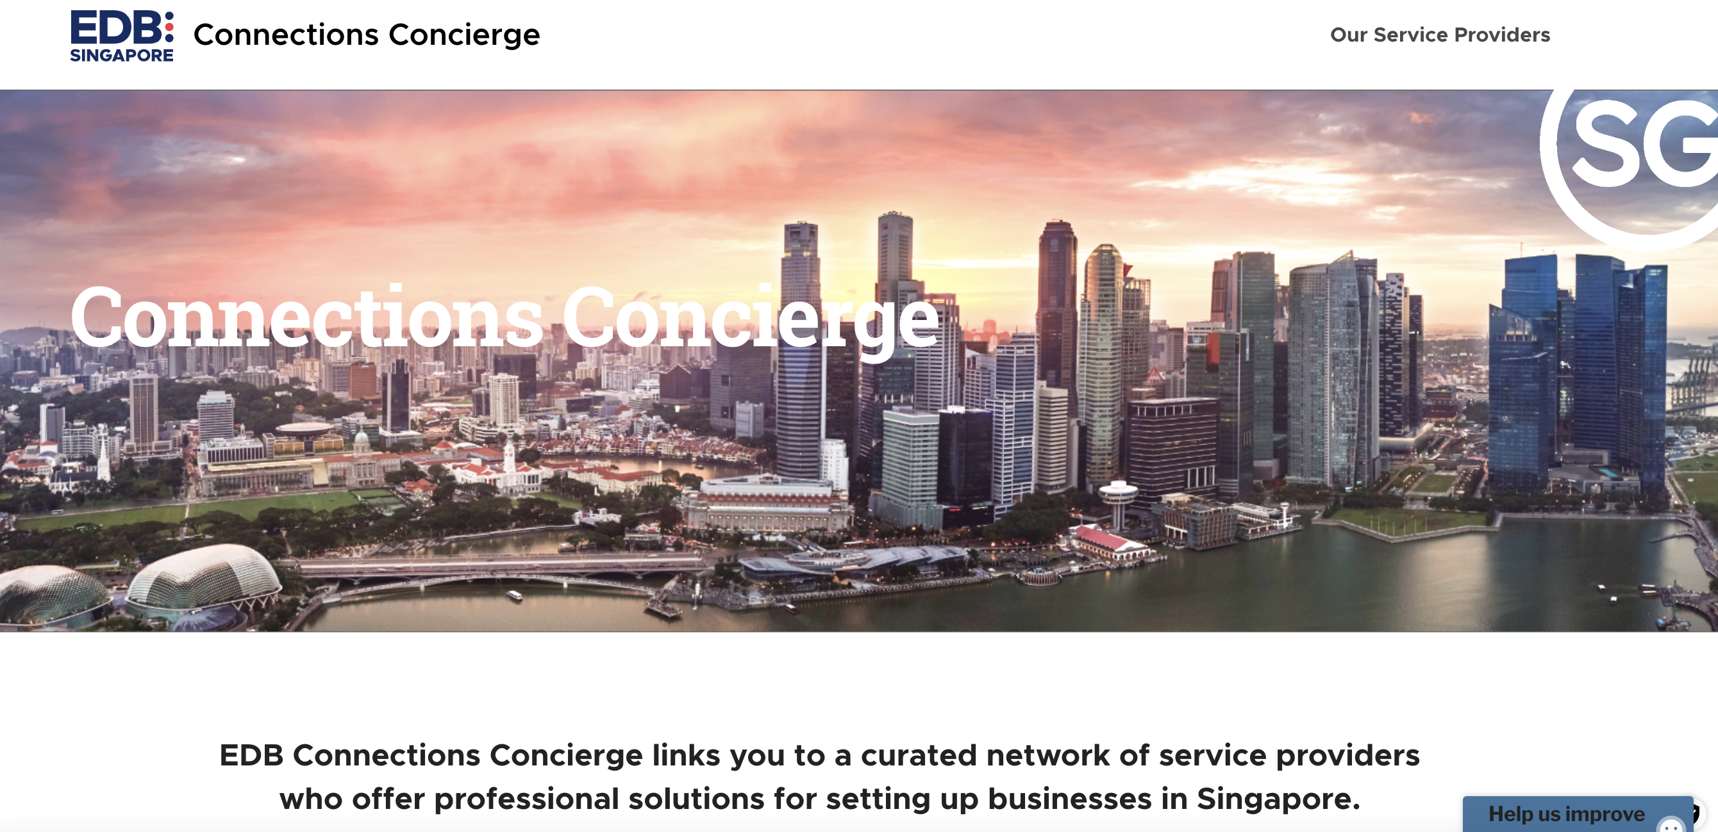
EDB Singapore – Concierge Service for facilitation services
KEY ORGANIZATIONAL TOOLS AND CRM
EDB Singapore’s Concierge service is a best practice curated network for business facilitation which offers a curated network of service providers, location advisors and market entry specialists for business registrations.
Examples of key resources that can be found include: HR & Recruitment, Market entry advisor specialists, Banks and Corporations, work spaces and offices, streamlined set up services.
This can be a useful tool for collaboration between IPAs and service providers as well as to leverage streamlined services in the region.
Source: Wavteq

Slide 38
Questions and Answers
30 mins

Slide 39
Thank you!
30 mins

Slide 40
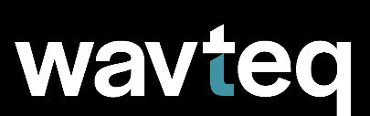
Global Coverage
Wavteq has a global footprint across 14 countries, including:
Bangalore
Belfast
Berlin
Cork
Dubai
Dublin
Dusseldorf
Florida
Hamburg
Hong Kong
Leipzip
London
Marseille
Montana
Montreal
Mumbai
NYC
Phoenix
Seoul
Shanghai
Tel Avv
Tokyo
Valencia
Our Solutions
Consulting Services
to develop strategies, marketing materials, and provide capacity building
Lead Generation Programs
to identify, target and attract investors globally including full in-market representation
Product Solutions
including knowledge & e-learning platforms, CRM systems, and FDI & incentives databases to improve organizational performance
wavteq.com
info@wavteq.com
+44 7557 965393
Notes:
Fonts used throughout:
Arial, Arial-Black, Lexand Deca, Verdana

