Slide 1
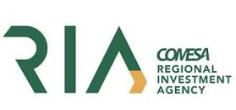
COMESA Workshops – Investment Facilitation & Aftercare Best Practices
Day 2
Aftercare & BRE Workshop
October 18th ,10:00 – 16:00

Slide 2
Partnership Details
The COMESA Regional Enterprise Competitiveness and Access to Markets Programme (RECAMP) is implemented by the COMESA Secretariat in collaboration with the following COMESA institutions: the Alliance for Commodity Trade in Eastern and Southern Africa (ACTESA), the Africa Leather and Leather Products Institute (ALLPI), the COMESA Business Council (CBC)., the Federation of National Associations of Women in Business in Eastern and Southern Africa (FEMCOM) and the COMESA Regional Investment Agency (RIA).
The 10 Euro million project runs until 2023 and is funded by the European Union under the 11th European Development Fund (EDF). RECAMP focuses on improving competitiveness and market access of SMEs and other firms in targeted value chains in the COMESA Member States and on generally improving the business environment for SMEs (including the women and youth) in this region.

Slide 3
Housekeeping rules
Keep mobile phones on mute
Limit movement in and out of training venue while session is in progress
Limit electronic interuptions
Online participants can enter their questions in the chat

Slide 4
Agenda – Day 2
10:00 AM – Welcome and review of Day 1
10:30 AM – Introduction to Aftercare Framework & Key Dimensions
11:00 AM – Coffee break
11:30 AM – Importance of Aftercare & Business Retention and Expansion (Role in an IPA)
12:00 PM – Understanding the signs of existing investors
12:30 PM – Lunch
13:30 PM – Overview of Best Practices of Implementing an Aftercare & BRE Strategy and Process
14:00 PM – Group exercise on Aftercare
15:00 PM – Account Management: Business Retention & Expansion
15:45 PM – Open Discussion Forum & Closing Remarks
Aftercare & BRE (Part 1)

Slide 5
Expected Outcomes from Aftercare Session:
Gain understanding of Aftercare framework, functions & resourcing
Be able to devise a best practice aftercare process & strategy
Grasp full knowledge of role of an IPA in administering a full aftercare and retention division and supporting existing investors
Be able to implement key account management techniques within Aftercare divisions

Slide 6
Welcome & Review of Day 1
30 mins

Slide 7
1. Introduction to Aftercare Framework & Key Dimensions
30 mins

Slide 8
What is investment aftercare?
INTRODUCTION TO AFTERCARE FRAMEWORK
Investment Promotion Life Cycle
Aftercare is a general term covering the “management of relationships with existing investors.” It is the investment promotion equivalent of customer care and account management in the private sector.
In the US and Canada, aftercare is called “Business Retention and Expansion (BRE)”, showing the key focus is on supporting existing investors, rather than facilitating new investors.
The diagram on the right, shows the investment promotion life cycle, with four main components of investment promotion. Components 3 (retention & expansion) and 4 (linkages and spillovers), are aftercare as they are concerned primarily with managing relations with existing investors.
1
2
INVESTMENT ATTRACTION
ENTRY & ESTABLISHMENT
LINKAGES, SPILLOVERS & POLICY ADVOCACY IPSUM
RETENTION & EXPANSION
4
3
Aftercare
Source: Wavteq

Slide 9
Investment aftercare can be an effective way of tackling foreign disinvestment
INTRODUCTION TO AFTERCARE FRAMEWORK
Most frequent political risk derived from Government conduct affecting FDI, % of respondents
According to the World Bank, the rate of investors divesting from developing countries because of irregular government conduct is ~25%.
The reasons behind the disinvestment are three-fold: (1) market conditions; (2) Government actions and policies, and (3) hazardous events (e.g. wars, pandemic, natural disasters)
The process of conducting consistent investment aftercare activities can be an effective way of pre-empting a disinvestment.
Lack of Transparency and Predictability of Public Agencies
Sudden change in the laws and regulations with a negative impact on MNEs
Delays in obtaining necessary government permits and approvals to start or operate a business
Transfer and convertibility restrictions
Breach of contract
Expropriation
Source: The International economic integration agreements includes regional trade agreement (RTAs), international investment agreements (IIAs) and double taxation treaties (DTTs).

Slide 10
Investment aftercare has been identified as an effective means of generating re-investment in a location
INTRODUCTION TO AFTERCARE FRAMEWORK
Technique – most effective | % Agencies using technique | Average score of (5=most effective) | Likely change in importance due to C-19 (Wavteq assessment)
After-care services for existing firms | 100% | 4.1 | Big increase
Sales representatives overseas | 75% | 4.0 | Increase
Outsourcing LG to consultancy firms | 50% | 3.5 | Increase
Diaspora inward investment targeting | 13% | 3.5 | No change
Conferences, seminars | 100% | 3.4 | Big Decline
Inward investment website | 100% | 3.3 | Big increase
Inward FDI missions | 63% | 3.3 | Decline
Outward FDI missions | 63% | 3.3 | Decline
Referrals from the national IPA | 38% | 3.3 | No change
Conventions, exhibitions | 100% | 3.1 | Big decline
Direct mail to targeted companies | 63% | 3.0 | Increase
Outward trade missions | 38% | 3.0 | Decline
Source: fDi Intelligence survey of IPAs, and Wavteq Covid-19 assessment

Slide 11
The importance of aftercare-related FDI by subsector
INTRODUCTION TO AFTERCARE FRAMEWORK
The graph below shows the % of global greenfield FDI comprises of expansion projects in selected high job creating subsectors, with expansions accounting for over half of FDI job creation in many sub-sectors.
Role of Expansions in Greenfield FDI (% of FDI jobs by sub-sector country), 2020 (Jan.-Oct)
Source: Wavteq based on fDi Markets data

Slide 12
Types of Aftercare/BRE services
INTRODUCTION TO AFTERCARE FRAMEWORK
Types of Aftercare/BRE services IPAs are providing
Source: Wavteq (2020a). Based on 207 IPA respondents.

Slide 13
How many resources do IPAs allocate to aftercare/BRE?
INTRODUCTION TO AFTERCARE FRAMEWORK
OECD IPA’s budget and personnel allocation across core functions (%)
Source: OECD-IDB (2018)

Slide 14
Key benefits of aftercare / BRE
INTRODUCTION TO AFTERCARE FRAMEWORK
Protect existing investment.
Stimulate second generation activity – expansions and upgrading.
Support subsidiaries win investment from the Corporate HQ, e.g.; automotive plants.
Inward investment by suppliers.
Local linkages and local supplier exports.
‘Knock-on’ gains.
Strategy development and planning
Sector initiatives
Training and skills development initiatives
Joint marketing initiatives
Policy advocacy to improve the business & investment climate
Happy and profitable investors are the best promoters of your country or region and can become “investment ambassadors” for your location.
Using existing investors as “ambassadors” who will influence other firms to consider the country as an investment site is a key method of lead generation. Developing good links with local managers has been central to investment promotion in the most successful locations. Happy and profitable clients are good promotional tools!
Columbia Center on Sustainable Investment
Source: Wavteq based on Columbia Centre on Sustainable Investment

Slide 15
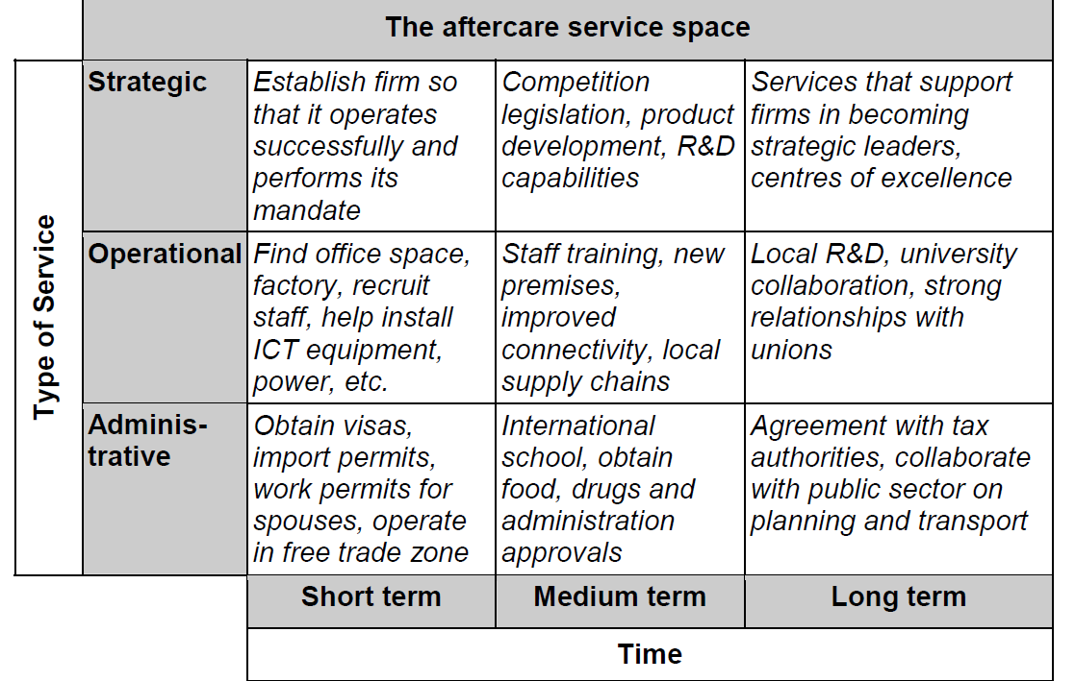
UNCTAD aftercare services space – a long term roadmap for aftercare/BRE
INTRODUCTION TO AFTERCARE FRAMEWORK
Using existing investors as “ambassadors” who will influence other firms to consider the country as an investment site is a key method of lead generation. Developing good links with local managers has been central to investment promotion in the most successful locations. Happy and profitable clients are good promotional tools!
Source: UNCTAD

Slide 16
Wavteq’s framework for aftercare / BRE
INTRODUCTION TO AFTERCARE FRAMEWORK
Type of support to investors
Reactive
Proactive
Customized
Advocacy
Using existing investors as “ambassadors” who will influence other firms to consider the country as an investment site is a key method of lead generation. Developing good links with local managers has been central to investment promotion in the most successful locations. Happy and profitable clients are good promotional tools!
1. Business Retention
4. Policy Advocacy
3. Investor Development
2. Business Expansion
Key focus: ensuring successful project operations
Problem solving
Permits & licenses
Land & sites access
Infrastructure & utilities
Resident & work permits
Incentives monitoring
Project tracking
Key focus: securing project expansions
Key account management
Investor retention
Investor expansion
Key focus: project upgrading, local linkages and spillovers
Investor-specific plans
Subsidiary upgrading
New project exploration
Supply chain development
Skills & training
Research & development
Key focus: improving policies and long-term competitiveness
Policy advocacy
Investor grievance mechanisms
Source: Wavteq

Slide 17
Coffee Break
30 mins

Slide 18
2. Importance of Aftercare & BRE – Structures of Aftercare divisions
30 mins

Slide 19
The case for assigning resources to aftercare
IMPORTANCE OF AFTERCARE & BRE, AFTERCARE ORGANIZATIONAL STRUCTURES
2. Economic Development Case
Additional jobs
Additional investor’s contributions
Growth of clusters
Greater connectedness
1. Business Case
Cost effective
Lower risk
Efficient use of resources
Effective when it comes to volume vs. output
2
Text
Text
Text
Text
Text
Text
Text
Text
Text
Text
Text
Text
Text
Text
Text
Text
Text
Text
Text
Text
Text
Text
Text
Text
Text
Text
Text
Text
Text
Text
Text
Text
Text
Text
Text
Text
Text
Text
Text
Text
Text
Text
Text
Text
Text
Text
1
3
3. Governance
Lower risk
Stronger accountability
More transparency
More trust
Source: Investment Aftercare Explained: A Guide for FDI Practitioners and Policymakers on How to Grow and Retain Investors

Slide 20
The business case for Aftercare
IMPORTANCE OF AFTERCARE & BRE, AFTERCARE ORGANIZATIONAL STRUCTURES
Cost effectiveness: When a foreign investor makes a long-term investment in a location, they increase their knowledge of how to do business in the location, and build stronger relationships with local stakeholders in the business community. IPAs can leverage this relationship to encourage further re-investment. This process is cheaper as it requires fewer investment promotion resources, since the investor has already bought into the location.
Lower risk: Existing investors have already proven their adaptability to local conditions, and are more likely to thrive compared to new investors that have yet to experience the local business environment.
Efficiency: Working together with local stakeholders and firms that have successfully established in the location can be an effective marketing function – where existing investors serve as case studies for the location
Source: Investment Aftercare Explained: A Guide for FDI Practitioners and Policymakers on How to Grow and Retain Investors

Slide 21
The economic development case for Aftercare
IMPORTANCE OF AFTERCARE & BRE, AFTERCARE ORGANIZATIONAL STRUCTURES
Creates local jobs and improves local capacities
Increases an investors’ contribution to the local economy: Long-term investors are better positioned to contribute to the local business community. Tangible benefits can include skillset development, better integration of the local economy into the global value chain and resilience in times of uncertainty.
Grows clusters and fosters connectedness through supporting expansion of companies working in the same industry sector.
Source: Investment Aftercare Explained: A Guide for FDI Practitioners and Policymakers on How to Grow and Retain Investors

Slide 22
The governance case for Aftercare
IMPORTANCE OF AFTERCARE & BRE, AFTERCARE ORGANIZATIONAL STRUCTURES
Risk management: A meaningful aftercare proposition signals to local stakeholders that tax payers’ money is being used to both retain existing investors and secure additional jobs. It also helps manage risks associated with potential disinvestment and political risks.
Government Transparency and Accountability: Aftercare fosters transparency as they implement reporting policies and community engagement practices that address local concerns. Additionally, aftercare programmes with a strong impact evaluation and measurements, and reporting mechanisms can reassure funders and the public that they are making good use of tax-payers’ money.
Source: Investment Aftercare Explained: A Guide for FDI Practitioners and Policymakers on How to Grow and Retain Investors

Slide 23
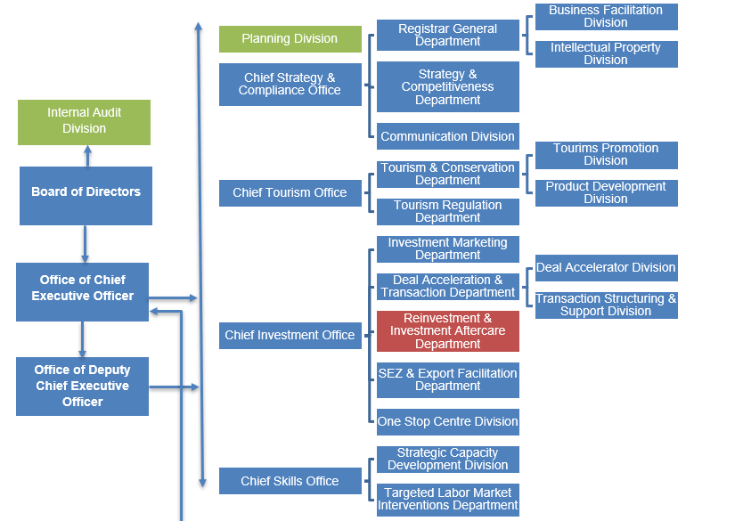
Organizational Structure – Dedicated aftercare division
IMPORTANCE OF AFTERCARE & BRE, AFTERCARE ORGANIZATIONAL STRUCTURES
Key Characteristics
Merger of key industries responsibilities under 1 organisation (Tourism, Conservation, Investment) for greater organisational efficiency, and to ensure all teams within IPA have a common organisational culture
Skills development division within IPA – the Chief Skill Office communicates regularly with the Reinvestment & Investment Aftercare Department regarding local workforce demands and other investment environment factors that it can support the Aftercare Department with. It also works with chambers of commerce of the country’s priority sectors (ICT, Tourism, Manufacturing) to develop strategic capacity development programmes and address local workforce constraints.
Source: RDB

Slide 24
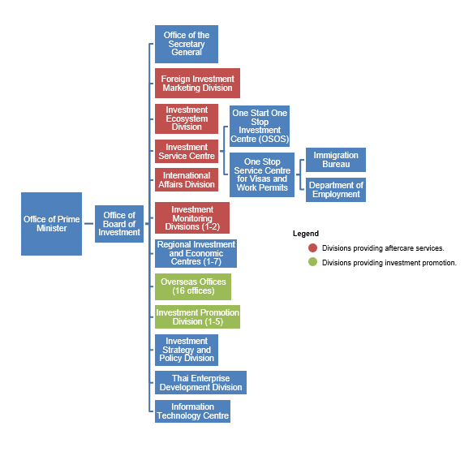
Organizational Structure – Combined aftercare and facilitation function
IMPORTANCE OF AFTERCARE & BRE, AFTERCARE ORGANIZATIONAL STRUCTURES
Key Characteristics
Strong engagement with corporate headquarters of investors
Strong collaboration across multiple divisions for aftercare activities / aftercare services spread across multiple divisions
Investment Ecosystem Division: focuses on ensuring that investment environment is conducive for foreign investors. This division spearheads the supply chain development programmes in BOI Thailand
Investment Services Division: focuses on problem-solving and business administration issues
International Affairs Division: focuses on trade and policy environment, and how new trade agreements may influence domestic investment environment for foreign investors
Investment Monitoring Division: monitors key performance indicators of the organisation, including for aftercare services
Source: Board of Investment Thailand (BOI)

Slide 25
Organizational Structure – Blended approach
IMPORTANCE OF AFTERCARE & BRE, AFTERCARE ORGANIZATIONAL STRUCTURES
Key Characteristics
Assistance and Follow-up Unit (4-6 full-time staff)
Sector teams also support with aftercare
Overseas offices support aftercare at corporate HQ level
Strong coordination role with other government agencies (via Memorandums of Understanding) – investment authority and IPA
Strong use of KPIs and tracking to increase effectiveness of division
Use of a CRM to manage aftercare
Defined aftercare process with standard procedures:
Identification of new investors that require support
Contacting operational projects on an annual basis to check on issues and collect data
Assessment of difficulty of solving problems, identification of new support needed with annual targets
Government coordination
Organisation of company visits with annual targets
General Promotion Department
International Cooperation and Studies Department
Consumer Products Promotion Department
General Director
Advanced Technology Product Promotion Department
Coordination Unit with Overseas Offices
Communications and Publishing Department
Administrative and Financial Affairs Department
Central Registry Office
Organisation and Computer Programming Unit
Secretary General
Internal Audit and Management Control Unit
Assistance and Follow-up Unit
Documentation and Archives Unit
Source: FIPA Tunisia

Slide 26
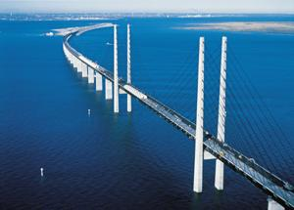
Organizational Structure – Small IPA with 1-3 staff
IMPORTANCE OF AFTERCARE & BRE, AFTERCARE ORGANIZATIONAL STRUCTURES
Key characteristics
3 full-time employees dedicated to expanding and retaining existing investors:
1 logistic expert only focusing on logistics projects (and food);
2 experienced business development managers focusing on regional sales & marketing HQs, shared services, R&D etc; and
Support from marketing, student helpers and external agencies.
Result: 400+ jobs per annum (50% of total job creation of the IPA).
Sector expert
Experienced BD managers
Ad-hoc support
Source: Copenhagen Capacity

Slide 27
Should aftercare be a standalone unit?
IMPORTANCE OF AFTERCARE & BRE, AFTERCARE ORGANIZATIONAL STRUCTURES
Advantages of this approach
Less resources are required and there is some overlap in skillset: IPA staff can double up as both investment facilitation officers and aftercare officers and develop skills in both the investment facilitation and aftercare process. There is some overlap in the skills required for investment facilitation and aftercare service provision in terms of relationship building, key account management and problem solving.
Development of strong relationships with investors from point of investment: Strong relationships can be developed between sector teams and investors as they help investors set-up in the short term, and help investors resolve major operational issues in the medium to long term.
Disadvantages of this approach:
No dedicated staff for aftercare can reduce quality of aftercare service provision: Provision of aftercare services can be time consuming, with long time horizons. In addition, there are usually several ongoing aftercare accounts, as opposed to investment facilitation accounts that tend to be progress to the aftercare stage once all relevant licenses and permits have been issued. A lack of dedicated staff allocated to aftercare can negatively impact the quality and quantity of aftercare services provided.
Lack of dedicated staff will make it difficult for aftercare services to be proactive, rather than reactive: Proactive elements of aftercare including business expansion, investor development and policy advocacy require the time commitment of full-time staff.
Source: Wavteq

Slide 28
3. Understanding the signs for reinvestment and divestment
30 mins

Slide 29
How do foreign investors reinvest or expand in a location
UNDERSTANDING THE SIGNS
International businesses that are established in a location have multiple ways of expanding or re-investing in a location:
1. Traditional FDI
Text
2. Non-Traditional FDI
Text
Text
Text
Text
Text
Text
Text
Text
Text
Text
Text
Text
Text
Text
Text
Text
Text
Text
Text
Text
Text
Text
Text
Text
Text
Text
Text
Text
Text
Text
Text
Text
Text
Text
Text
Text
Text
Text
Text
Text
Text
Text
Text
Text
Text
Business expansion / Re-investment (of an existing operation)
Equity investments: Mergers & Acquisitions (M&As), Joint Ventures (JVs)
Non-equity modes (NEMs): Subcontracting, licensing, production, sharing, franchising, management and turnkey projects
Public-private partnership projects
Source: Wavteq Institute

Slide 30
Foreign investors will expand their investment based on the desired benefits they hope to reap from doing so
UNDERSTANDING THE SIGNS
FDI Group | Type of FDI | Job Creation | Fixed Capital Formation | Technology Transfer & Development | Access to Export Markets | Foreign Exchange Earnings | Long Term Finance
Traditional FDI | Business Expansion / New physical operation | Medium-High | Medium-High | Medium-High | Medium-High | High | High
Non-traditional FDI | M&A | Low | Low | High | High | High | High
 | Non-equity modes of investment (NEM) | Medium | Medium | High | High | Low | High
A 10% increase in investment promotion budget leads to a 2.5% increase in FDI flows or in other words $60,000 of promotion leads to a $5 million increase in FDI
There a 2-5 year lag for the impact of increased promotion to feed through to increased FDI, which shows that investment promotion activities need to take place as part of a 2-3 year strategy and evaluation cycle
Source: Wavteq Institute
Notes:
Notes:
The type of FDI to target also depends on:
The sectors in the economy (e.g. R&D and tech sectors are driven more by M&A and NEM types of FDI).
The existence of local firms both suitable for, and which have a clear desire for, engaging in M&A and/or NEM transactions with foreign investors.
The capability of the IPA/EDO to promote and facilitate non-Greenfield types of FDI.

Slide 31
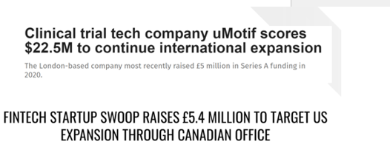
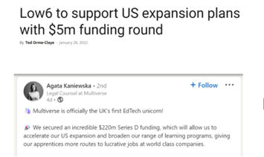
Key indications of reinvestment
UNDERSTANDING THE SIGNS
Current FDI strategy / expansion plans – google alerts, industry journals, sector news webpages, social media
New financing received for international expansion
Trends based on existing global footprint: By mapping out a company’s global operations, key gaps in value chain can be identified, including whether there are further expansion opportunities
Drawing projects from current size and growth of company (revenue figures and employment numbers)
Source: Wavteq

Slide 32
Why do foreign investors divest?
UNDERSTANDING THE SIGNS
A company’s decision to divest can be due to factors that are internal, external or a combination of the two.
Where businesses are in a decline phase, typically the parent will arrange capital withdrawals and consider the sale, downsizing or closure of a subsidiary.
While disinvestment decisions are made in the corporate boardroom, there are opportunities for practitioners and policymakers to pre-emptively address key issues for these investors before the reach a decision to exit.
When host economies have no influence over divestment decisions, IPAs can still help manage the corporate exit or closure in a manner that is efficient, and that minimizes the impact on the economy.
A 2019 World Bank study found that investors divest from developing countries during a normal year at a rate of 25%
Source: Investment Aftercare Explained: A guide for FDI Practitioners and Policymakers on How to Grow and Retain Investors, OECD, WBG.

Slide 33
A divestment involves a change in a firm’s ownership and business structure, and it can take several forms
UNDERSTANDING THE SIGNS
Divestment can take the following forms:
Sale of some or all of a firm’s assets/subsidiaries
Spin-off – creation of a new company through sale or distribution of new or existing businesses of a parent company
Equity carve-out – sale of shares or a business unit
Leveraged buy-out – acquisition of a firm using bonds or loans
Business closure
Reduction in investment funds
Source: OECD (2020)

Slide 34
An OECD analysis of MNEs sheds light on the importance and frequency of divestments in FDI
UNDERSTANDING THE SIGNS
1 of every 5 foreign-owned MNEs (~20%) divested in their host countries
23% of employees were affected by divestment activity
34% of total assets of foreign-owned firms were involved in divestment activities
Source: OECD analysis tracking 62,000 affiliates globally and their parent companies from 2007-2014

Slide 35
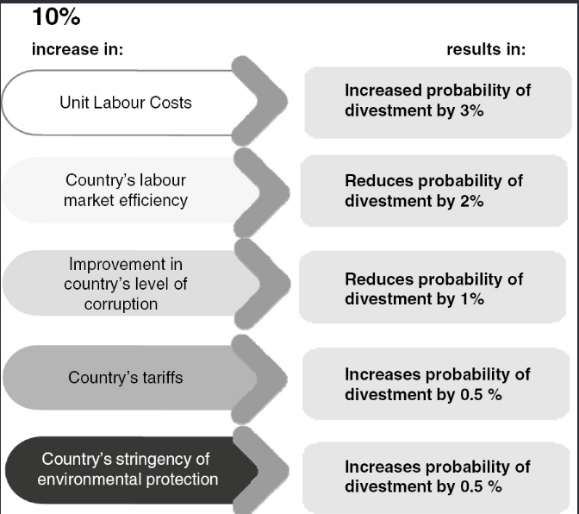
Investor grievances that result in divestment can be caused by several factors
UNDERSTANDING THE SIGNS
Financial challenges: Company’s investments do not meet the expectations of its shareholders or subsidiary failing to achieve profitability in the desired timeframe.
Exchange rate volatility: A US study of MNCs operating abroad cited exchange rate volatility as a key reason for divesture due to the unpredictability it introduced for the cost of doing business.
Institutional issues in a country that hinder ease of doing business: This can take the form of changes in the political system or institutions in a host country that can affect the operations of foreign investors in a country.
Sudden policy changes that are not favourable to foreign investment (see next slide)
OECD Divestment factors
Source: Investment Aftercare Explained: A guide for FDI Practitioners and Policymakers on How to Grow and Retain Investors, based on OECD report

Slide 36
How can IPAs proactively deal with investor grievances and pre-empt divestment?
UNDERSTANDING THE SIGNS
Investor Aid
Consistent investor check-ins through establishing a system for collecting investor complains and providing proactive follow-up and ad hoc contact to anticipate and respond to investor needs
Offering mediation support
Creating a forum or platform for investors to resolve issues that are raised, prior to imposing legal rules.
Ombudsperson
A formally appointment professional, unconnected to the IPA to assist in the resolution of the investor grievance.
Source: Investment Aftercare Explained: A guide for FDI Practitioners and Policymakers on How to Grow and Retain Investors, based on OECD report

Slide 37
Case Study 1: Board of Investment Thailand’s Investor Aid Clinic
UNDERSTANDING THE SIGNS
In November 2020, BOI Thailand set up an online clinic for existing investors to set up appointments with BOI Thailand on a variety of issues related to investor complaints.
Through the portal, existing investors can set up Zoom meetings or make appointments with BOI staff to address concerns or raise issues that they need BOI support with.
Source: BOI Thailand website: Link

Slide 38
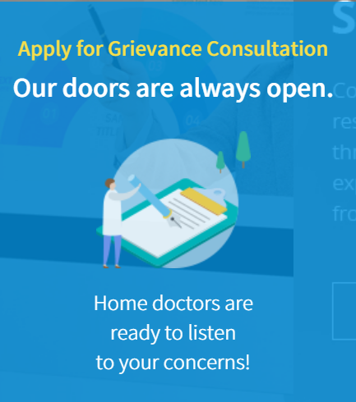
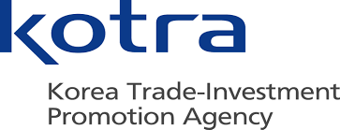
Case Study 2: Korean Ombudsman Office (OFIO) (1/3)
UNDERSTANDING THE SIGNS
South Korea was the first country to introduce an Ombudsperson following the Asian Financia Crisis.
The Ombudsman is commissioned by the President of the Republic of Korea on the recommendation of the Minister of Trade, Industry & Energy, following discussions with the Foreign Investment Committee
As a grievance resolution body, the OFIO collects and analyses information concerning the problems foreign firms experience, requests cooperation from and recommends implementation thereof to relevant administrative agencies, proposes new policies to improve the foreign investment promotion system, and carries out other necessary tasks to assist foreign-invested companies in resolving their grievances
Source: Investment Aftercare Explained: A guide for FDI Practitioners and Policymakers on How to Grow and Retain Investors, Kotra website: Link

Slide 39
The Ombudsman interfaces between the government and the foreign investor, as an independent party (2/3)
UNDERSTANDING THE SIGNS
Source: KOTRA: Link

Slide 40
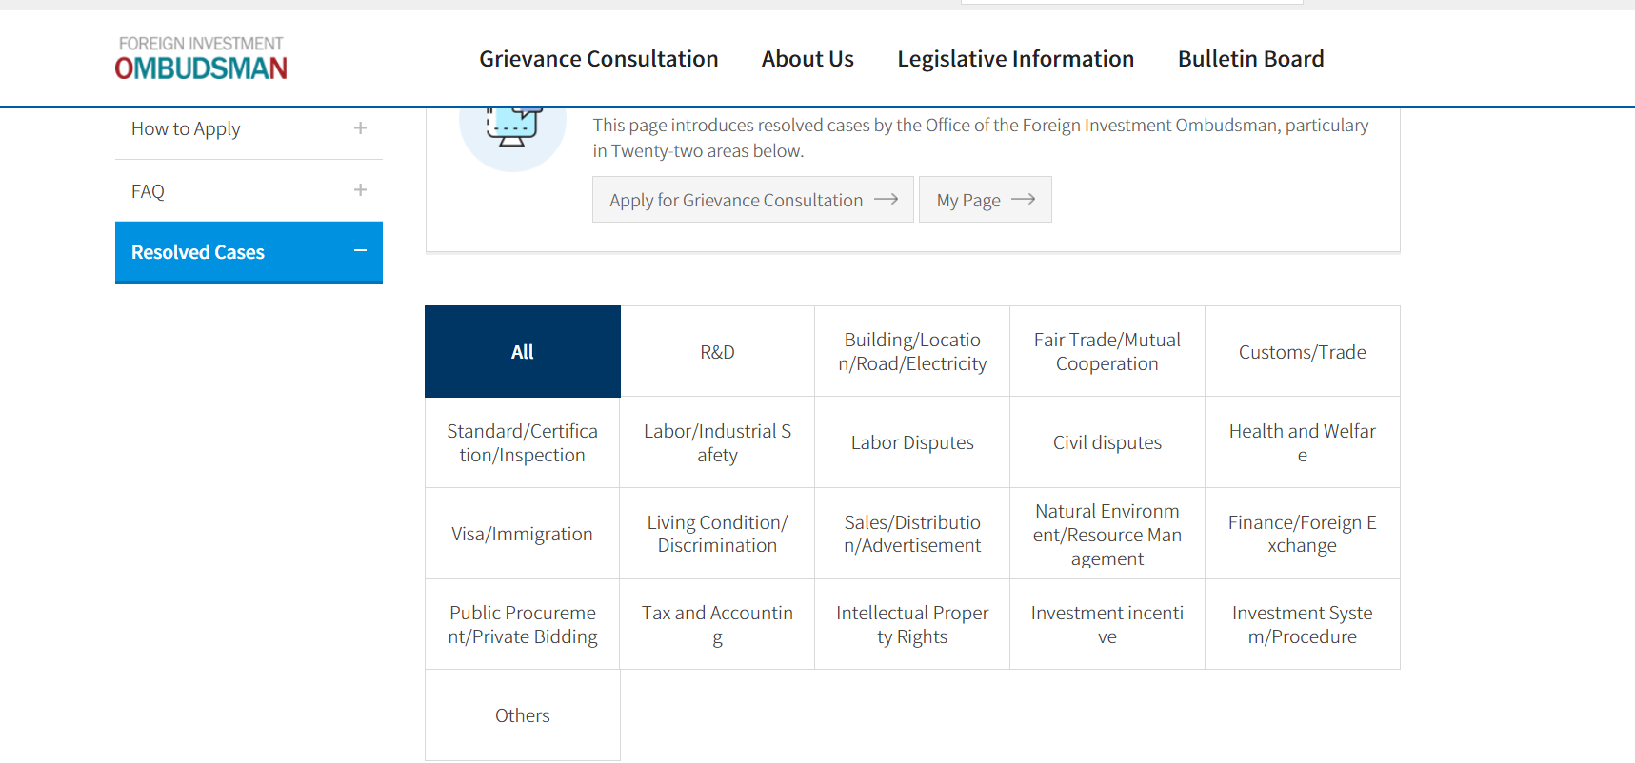
OFIO’s website showcases a list of previous successfully resolved cases that the office has handled (3/3)
UNDERSTANDING THE SIGNS
Source: KOTRA: Link

Slide 41
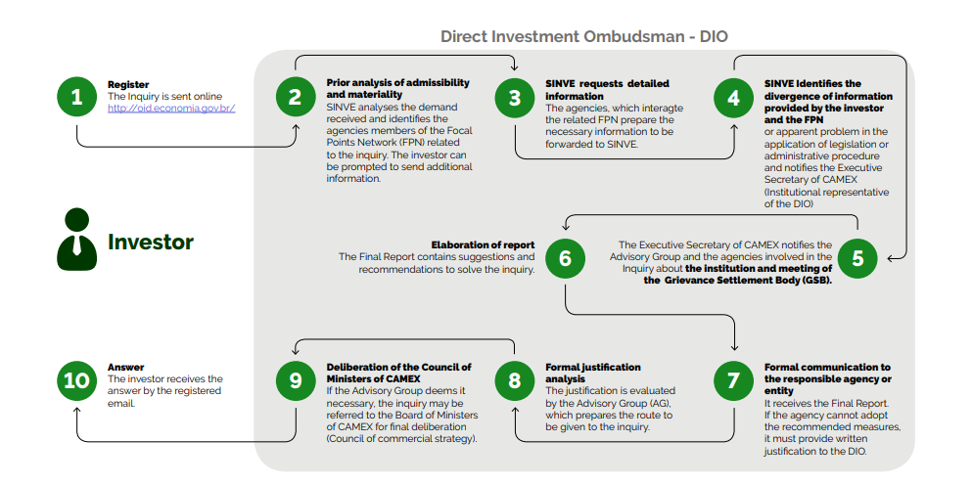
Case Study 3: Brazil’s Direct Investment Ombudsman
UNDERSTANDING THE SIGNS
Source: IISD (2021)

Slide 42
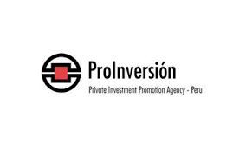
Case Study 4: Peru’s Coordination and Response System for International Investment Disputes (SICRECI)
UNDERSTANDING THE SIGNS
SICRECI comprises the Ministry of Economy as Coordinator and a Special Commission (SC)—which includes the Ministry of Foreign Affairs, ProInversión, and the Ministry of Justice
The SICRECI serves as an early alert mechanism for investor complaints and grievances: Any government agency that is made aware of a possible dispute with an investor must report to the SICRECI within 5 days.
Online platform: The SICRECI provides an online platform that allows investors to register complaints with the MEF
Capacity building program: The SICRECI has developed a capacity-building program for public officials on topics related to investment disputes and has published a dispute prevention manual
Source: IISD (2021), SICRECI: Link

Slide 43
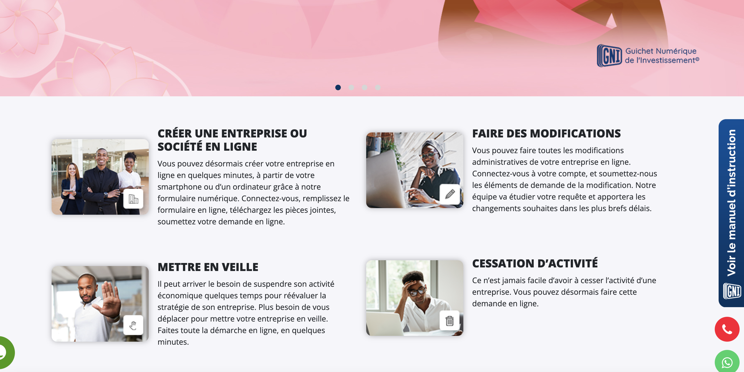
Case study 5: ANPI Gabon Digital Window for grievance consultation
UNDERSTANDING THE SIGNS
REGIONAL INVESTMENT EXAMPLES
The GNI serves as an early alert mechanism for investor complaints, downclosure, suspension, modification etc: Any government agency that is made aware of a possible dispute with an investor must report to the GNI and all foreign and domestic investors have a unique login to the GNI – Guichet Numerique D’investissement of Gabon.
Source: https://www.gni-anpigabon.com/

Slide 44
4. Overview of best practices of implementing an Aftercare & BRE strategy
30 mins

Slide 45
Steps for devising a proactive aftercare program (1/3)
BEST PRACTICES IN IMPLEMENTING AFTERCARE & BRE STRATEGY
1
Aftercare Team
Presence of a well-equipped and dedicated Aftercare division, with sector experts that have strong sector-specific experience and knowledge
2
Aftercare Strategy
Strategy has a vision, objectives, services, activities, targets, input and output key performance indicators, resources, and a clear action plan for executing on the strategy
3
Key Account Management Approach
Consistent tiering of existing investors, engagement strategy for each tier of investors, annual development plans for key investors, key performance indicators linked to key accounts, and monitoring and evaluation of each key account management approach
Source: Wavteq

Slide 46
Steps for devising a proactive aftercare program (2/3)
BEST PRACTICES IN IMPLEMENTING AFTERCARE & BRE STRATEGY
1
Aftercare Team
Presence of a well-equipped and dedicated Aftercare division, with sector experts that have strong sector-specific experience and knowledge
2
Aftercare Strategy
Strategy has a vision, objectives, services, activities, targets, input and output key performance indicators, resources, and a clear action plan for executing on the strategy
3
Key Account Management Approach
Consistent tiering of existing investors, engagement strategy for each tier of investors, annual development plans for key investors, key performance indicators linked to key accounts, and monitoring and evaluation of each key account management approach
Source: Wavteq

Slide 47
Steps for devising a proactive aftercare program (3/3)
BEST PRACTICES IN IMPLEMENTING AFTERCARE & BRE STRATEGY
4
Investor Support Services
Strong focus on resolving problems faced by investors, opportunity identification for business expansions, facilitation of linkages within ecosystem and with funding institutions, strategy for engaging with corporate HQs of subsidiaries,
5
Target setting
Clear targets for the number of meetings to be conducted, investment created and retained (jobs / investment figures) and local linkages developed
6
Coordination with key stakeholders
Protocols for how organisation works with regional and national agencies in coordinating Aftercare to companies, standard operating procedures and system solutions for collaboration
Source: Wavteq

Slide 48
Key elements of an aftercare program (3/3)
BEST PRACTICES IN IMPLEMENTING AFTERCARE & BRE STRATEGY
7
Data and Tools
Utilisation of scorecard to use with existing investors to validate support and impact of support, annual aftercare report showing activities and recommendations for upcoming year,
8
Monitoring & Evaluation Impact
Clear targets for the number of meetings to be conducted, investment created and retained (jobs / investment figures) and local linkages developed
9
Investor Communications
Clear strategy for communicating with existing investors covering e-newsletters, social media, IO website, media and intermediaries
Source: Wavteq

Slide 49
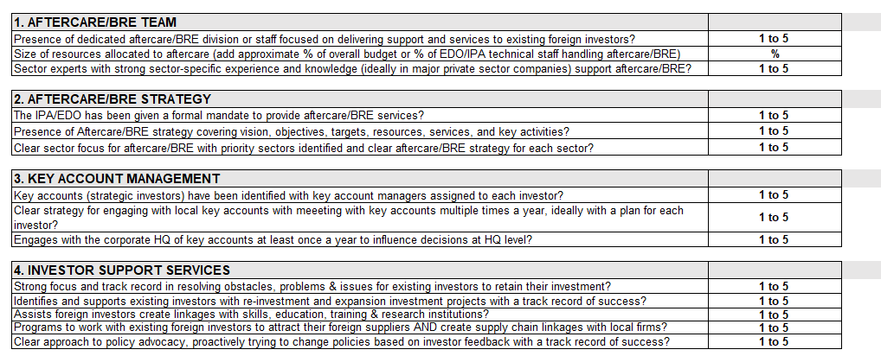
Self assessment of your IPA’s aftercare program
BEST PRACTICES IN IMPLEMENTING AFTERCARE & BRE STRATEGY
Source: Wavteq

Slide 50
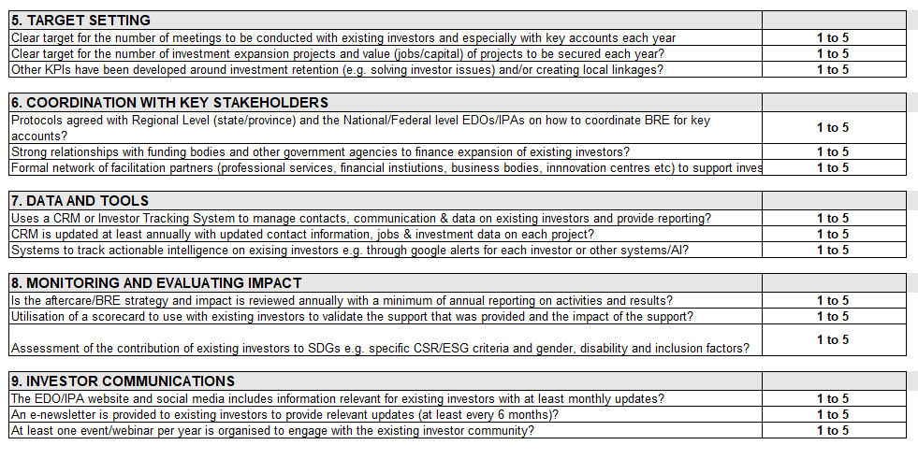
Self assessment of your IPA’s aftercare program
BEST PRACTICES IN IMPLEMENTING AFTERCARE & BRE STRATEGY
Source: Wavteq

Slide 51
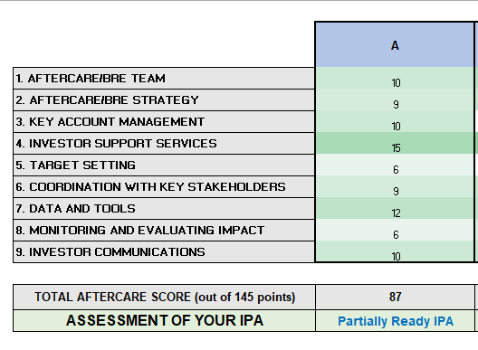
Self assessment of your IPA’s aftercare program
BEST PRACTICES IN IMPLEMENTING AFTERCARE & BRE STRATEGY
Click here to access diagnostic tool: Link
Source: Wavteq

Slide 52
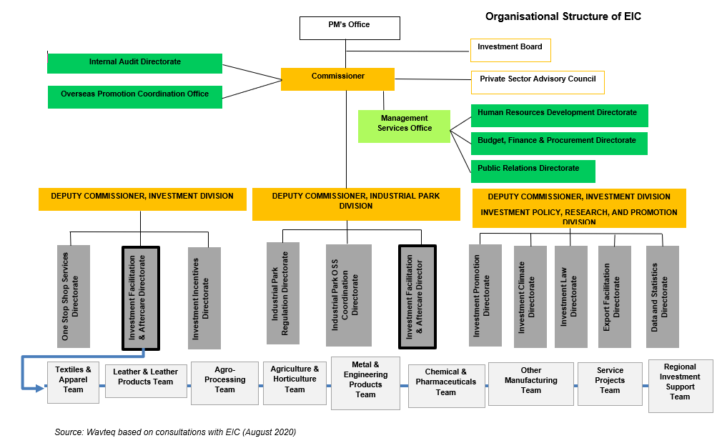
Best practices in Aftercare & BRE Strategy – EIC Ethiopia
BEST PRACTICES IN IMPLEMENTING AFTERCARE & BRE STRATEGY
EIC has a dedicated Directorate for aftercare called the “Investment Facilitation and Aftercare Directorate”. It comprises 8 sector teams and a regional support team
Source: Wavteq

Slide 53
EIC’s aftercare division has a strong mandate, and clear objectives
BEST PRACTICES IN IMPLEMENTING AFTERCARE & BRE STRATEGY
Main objective of aftercare directorate is to transfer registered projects to the implementation and operational phases through efficient follow-up support.
Collaboration between Industrial Park Division and EIC Aftercare Division: The aftercare directorate only focuses on investors located outside of industrial parks. A separate industrial park division takes care of aftercare for companies established in Industrial Parks and there is collaboration between both divisions depending on company needs and requests.
EIC has a clear government mandate and visibility in both the investment community and in government: Ethiopia’s New Investment Proclamation outlines key mandate of EIC in aftercare to attract and retain investment
Target groups for aftercare
New first-time investors in Ethiopia
Existing investors with expansion projects
Source: Wavteq

Slide 54
Ethiopia’s New Investment Proclamation (January 2020)
BEST PRACTICES IN IMPLEMENTING AFTERCARE & BRE STRATEGY
Establishment of an Inter-Regional Council (Council): the New Proclamation establishes a high level inter-regional council that will coordinate federal and regional state administrations in the area of investment. The composition of the Council includes the Prime Minister, all regional presidents, mayors of the two administrative cities, EIC and regional investment bureaus.
Additional Mandate to EIC: the New Proclamation grants EIC broad powers that would allow it to meet its renewed objective of establishing a conducive investment climate, attract and retain investments, and implement a transparent and efficient investment administration system.
Regulating Brownfield Investments: All foreign investors, both entering Ethiopia through greenfield and brownfield investments (acquisition or buying of shares of existing enterprises) to obtain EIC’s services.
Collaboration with the Ministry of Labour and Social Affairs (MOLSA): EIC has the mandate to work with MOLSA in regulating matters related to (a) the necessity of expat employees; (b) the implementation of trainings for Ethiopians replacing expats; (c) mechanisms to avail suitable local workforce to investors and (d) procedures for the issuance, refusal and cancellation of work permits.
Visa Facilitation and Visa Benefits: EIC is granted new powers to facilitate visas for investors coming into Ethiopia and for investors and families already in Ethiopia. Furthermore, the new law grants up-to five years of multiple entry business visas.
Coordination with Regional Investment Bureaus: mandates EIC to create investment desks within its office in Addis Ababa to facilitate the efficient provision of pre and post-investment services and resolve investment bottlenecks encountered by investors. Furthermore, the New Proclamation allows for efficient coordination between EIC and regional states in the application and allocation of land to investors.
Provision of Investment Land: new mandate to regions to establish a transparent and predictable system for land allocation. Thus, regional states are required to identify and classify land to be used for investment projects. Regions may establish special procedures that will allow them to respond to land requests by investors within a maximum of 60 days (for the manufacturing sector) and a maximum of 90 days for other sectors.
Source: Wavteq

Slide 55
EIC has a strong aftercare programme covering all areas of the aftercare process
BEST PRACTICES IN IMPLEMENTING AFTERCARE & BRE STRATEGY
Investment facilitation
Post-investment support
EIC provides services to existing investors around problem solving and facilitating reinvestment and expansion projects.
Investor development
Policy advocacy
EIC currently provides policy advice to the government through the regular meetings of the Investment Board.
EIC has a comprehensive services to support investors implement and operationalise projects, which are clearly understood by their team.
Excel-based tracking system in place to track progress of projects.
Account managers are assigned based on sector expertise and this assists in building sector knowledge in team.
The Relationship Building Program (RBP) is a proactive program with a robust criteria to identify companies and proactively engage with existing investors.
Under this program, each sector team has identified the most important investors in Ethiopia (outside of industrial parks), based on a criteria covering investment capital, employment, industry linkages, exports, value chain building, import substitution and technology transfer. For these strategic investors there is proactive outreach to see if these investors need any support for expansion projects or have any issues which they need help resolving.
Source: Wavteq

Slide 56
Example of database of existing investors from Relationship Building Program
BEST PRACTICES IN IMPLEMENTING AFTERCARE & BRE STRATEGY
 | Company Name | Year Invested | Origin Country | Sector | $ Total Investment | # Full Time Employees | Impact analysis
1 | Company 1 | 1996 | Ethiopia/china | Manufacturing Of Textiles | 866,810,769 | 300 | Industry Linkage And Job Creation
2 | Company 2 | 1994 | Ethiopia | Textile And Thread Production | 56,808,379 | 3,000 | Job Creation And Value Chain
3 | Company 3 | 1985 | Ethiopia | Garment Factory | 30,375,000 | 1500 | Export
4 | Company 4 | 2004 | Pakistan | Garment Manufacturing | 37,689,000 | 1000 | Job Creation
5 | Company 5 | 2005 | Indian | Textile Manufacturing | 642,281,591 | 1200 | Industry Linkage, Export And Job Creation
6 | Company 6 | 2006 | Saudi Arabia | Manufacturing Of Textile And Garment (2nd Expansion) | 102,680,000 | 300 | Export
7 | Company 7 | 2007 | China | Weaving, Finishing And Printing Textiles (Expansion) | 53,428,716 | 300 | Export, Value Chain
Source: Wavteq

Slide 57
Examples of data collected by EIC for aftercare
BEST PRACTICES IN IMPLEMENTING AFTERCARE & BRE STRATEGY
The number of investment projects handled by EIC can be seen below with a breakdown by investor stage.
Source: Wavteq based on EIC database

Slide 58
Examples of data collected by EIC for aftercare
BEST PRACTICES IN IMPLEMENTING AFTERCARE & BRE STRATEGY
EIC records if an investment project is a New project or an Expansion project, following international IPA best practice. The graphs below show time series data on the number of FDI projects in Ethiopia by New vs. Expansion.
Source: Wavteq based on EIC investment database

Slide 59
Examples of data collected by EIC for aftercare
BEST PRACTICES IN IMPLEMENTING AFTERCARE & BRE STRATEGY
The graphs below show the proportion of new vs. expansion FDI by sector, looking at the 6 largest sectors for FDI which accounted for 95.5% of FDI investment projects from 2010-2018.
Number of investment projects
Total investment capital ‘000 Birr
Permanent jobs #
Source: Wavteq based on EIC investment database

Slide 60
Key account management best practices
BEST PRACTICES IN IMPLEMENTING AFTERCARE & BRE STRATEGY
IPAs must have a has a strong aftercare programme with a comprehensive key account management strategy, coupled with key performance indicators that monitor the most value-adding activities for aftercare
Key account management best practices (drawn from work with some COMESA IPAs)
Responsible account manager: is assigned to licensed investment projects, at least up to the stage of starting operations. Account manager from the aftercare division who must reach out to the investor and report back within 15 days.
Aftercare account manager facilities requests with local agencies: IPA will facilitate infrastructure requests and work together with the relevant governmental organisation to implement requests – especially with regards to land acquisition, electric power supply and access to road infrastructure.
Proactive outreach strategy for aftercare: There is proactive outreach for these strategic investors to see if they need further support with their expansion projects or have any issues that need to be resolved. For example, there are about 20 strategic investors in the textiles and garments sector that have been identified for this programme.
Continuous learning within the team: Every 15 days all 8 sector teams in IPA get together to discuss with each other and the Director issues facing investors. Each team leader prepares a PPT on problems and solutions. The Director can escalate to the DC level if major projects are facing issues in implementation or operation.
Source: Wavteq

Slide 61
Aftercare KPI Template – Implemented by IPAs
INTRODUCTION TO AFTERCARE FRAMEWORK
KPI | Description | Target | Actual | % of target achieved
1. Total employment Opportunity | Job Opportunity planned to get from Operational projects
2. No. environmentally friendly projects | No of projects who started Operation and observed how environmentally friendly they are.
3. Land delivered to Investment Projects | No of projects who get land to Implement their Projects with the cooperation work done with the regional land administration offices and city administrations.
4. No. of projects who started their Implementing their Project | No of projects who started their Implementing / beginning of construction, fencing, foundation and start machinery importation/ their projects.
5.No of projects who started their production and service | No of projects who started their Production and service
6. No. of projects who started expansion or re-investment. | Existing investment in Operation that are requesting to expand or Re-investment
7. Investment projects are being implemented properly | Investment projects who are monitored during their implementation.
8.Updated information of investment projects | Current updated status of the investment projects
9. No. of meetings with Regional investment offices and stakeholders | Arranged Meetings with Investment stakeholders and Regional Investment offices to review current performance and plan the next.
10. No. of capacity building trainings | Capacity building trainings based on the request of regional investment offices.
Source: Wavteq based on EIC

Slide 62
Key areas for development identified by EIC to strengthen program
INTRODUCTION TO AFTERCARE FRAMEWORK
Relationship building programme
Definition of prioritised accounts for proactive aftercare activities through assessing project’s impact on projects, jobs and capital investment.
Investor Development Plans
Appointment of investor development managers for each strategic account in charge of developing proposals for expansion plans / embedding company in local ecosystem.
Development of a network of partners in Ethiopia that enable EIC to provide valuable support to strategic accounts.
Supply chain development
Hold discussions with key accounts about their hiring requirements and potential bottlenecks.
Outlining a defined communications protocol with existing investors including check-ins with existing investors each year.
Frequent meetings with policy-related entities to feedback input from investors to stakeholders who can address issues at a policy-level
Implementation of an FDI tracking tool to store all investor-related information and key actions for aftercare team members
Work with investor to attract their supply chain to also invest in the country
Based on this knowledge, the EIC can conduct an “inventory” of the certifications held by major investors relative to global industry standards. Where major gaps are identified, the EIC can approach the investor to determine their interest in receiving a specific certification for their Ethiopian operation.
Working with local skills institutions to address skills gaps in industry
Source: Wavteq based on consultation with EIC (2021)

Slide 63
Summary of best practices in developing a proactive aftercare program
INTRODUCTION TO AFTERCARE FRAMEWORK
Stage | Best practice | Examples
1. Set objectives | Clearly defined & shared. | e.g. increase jobs and capital investment, increase local content, attract suppliers, increase skills etc.
2. Define services | Identification of agency added-value services to different groups of investors. | e.g. operating permits, sites & property, recruitment, supply chains, training, R&D, policy advocacy.
3. Identify target group | Prioritization of sectors, companies. (manageable number) | e.g. focus on the specific sectors & companies that have the best opportunities/risk mitigation for aftercare.
4. Develop approach to firms | Pro-active, long term and at senior level – need CRM to monitor all contacts. | e.g. senior officer for small # major investors to build relations and junior officer for high # small investors.
5. Regularity & coverage of visits | At least twice a year. | e.g. more proactive visit program for major investors. Surveys of all investors. (e.g. every 3 years)
6. Status of individuals in visits | Senior, sector expertise and dedicated client accounts. | e.g. senior officer should have 5-10 years experience in MNEs in key target sectors be covered by the program.
7. Project management | Co-ordination at all levels and with private sector. | e.g. close working relationship with Departments for exports, education, local enterprise support, colleges…
8. Arrangements for source country | Co-ordination with national agency and embassies. | e.g. ensure that overseas reps/embassy staff know who the “key accounts” and are part of the aftercare service.
9. Decide level of resources | High in time. Few dedicated staff, but large team . | e.g. 1 senior staff for each industry being targeted for aftercare (they can also do facilitation) + junior support.
10. Impact and success rates | Clear targets and evaluation mechanism needed. | e.g. # meetings, projects,# jobs, $ capital investment, % local content, $ contracts for local firms. Annual review.

Slide 64
5. Group Discussion Exercise
30 mins

Slide 65
We want to hear from you
The starting point for aftercare is to have comprehensive database of all foreign investors in your location, be able to identify and segment them in terms of most / least strategic and to engage with strategic investors as part of a continuous Aftercare & BRE Program.
What data sources can IPAs use to build a comprehensive FDI database?
What criteria could IPA use to prioritise investors to identify the most important ones?
What ideas do you have for how IPA could engage with strategic investors?
GROUP DISCUSSION

Slide 66
6. Account management: Business expansion, investor development
30 mins

Slide 67
Wavteq’s framework for aftercare / BRE
BUSINESS EXPANSION & INVESTOR DEVELOPMENT
Type of support to investors
Reactive
Proactive
Customized
Advocacy
Using existing investors as “ambassadors” who will influence other firms to consider the country as an investment site is a key method of lead generation. Developing good links with local managers has been central to investment promotion in the most successful locations. Happy and profitable clients are good promotional tools!
1. Business Retention
4. Policy Advocacy
3. Investor Development
2. Business Expansion
Key focus: ensuring successful project operations
Problem solving
Permits & licenses
Land & sites access
Infrastructure & utilities
Resident & work permits
Incentives monitoring
Project tracking
Key focus: securing project expansions
Key account management
Investor retention
Investor expansion
Key focus: project upgrading, local linkages and spillovers
Investor-specific plans
Subsidiary upgrading
New project exploration
Supply chain development
Skills & training
Research & development
Key focus: improving policies and long-term competitiveness
Policy advocacy
Investor grievance mechanisms
Source: Wavteq

Slide 68
Best practices in key account management
BUSINESS EXPANSION & INVESTOR DEVELOPMENT
Definition
Key account management is a term used in the private sector relating to “aftercare” services provided to key accounts.
For most established private sector companies, most sales come from existing or repeat customers.
The same applies to inward investment.
“Key accounts” are your most important existing inward investors.
“Management” refers to the fact that you should be actively managing your existing investors, rather than being purely reactive.
A robust key account management strategy is at the core of every successful aftercare/BRE program.
Critical dimensions
Proactive, not reactive.
Focused on company growth and maximizing opportunities, not just problem solving.
Targeted at specific investors, not comprehensive for every investor.
High level client engagement with investors – typically with the general manager or equivalent in the local operation.
Ideally the IPA will have a dedicated member of staff (or more than one!) for key account management – working with existing investors.
Over time, targets should be put in place for number of expansion projects, suppliers attracted, value of local supply chains contracts etc.
Source: Wavteq

Slide 69
Best practices in key account management
BUSINESS EXPANSION & INVESTOR DEVELOPMENT
Case study of key account management strategy – Department for International Trade
The UK Department for International Trade (DIT) established a dedicated account management team to work with existing foreign investors.
DIT developed a “One List” of all foreign owned enterprises in the UK, categorised by company size and national economic impact:
Strategic Accounts: Top 100 UK investors are assigned a senior government “contact” minister. Engagement is frequent and multi-pronged across different company and government departments and levels of hierarchy. 12 account managers make a strategic plan for each investor.
Global Accounts: The next Top 200-300 investors. 30 account managers. Specific strategic plan for each investor. (around 100 expansion projects per annum)
Investment Services Team: management of approx. 1500 investors. Contact at least once every 12 months. Team of approximately 25 account managers. Each account manager has a target of around 15 reinvestment projects per annum.
CRM system is used for managing the relationship with each company.
Overall, expansions account for around 60% of DIT’s FDI results and grew by 18% in 2014/15 after the key account management program was established.
While the UK is one of the world’s top destinations for FDI with a very well-resourced IPA, the principles of how DIT developed its key account management strategy should be considered by every IPA adjusted to the number of existing foreign investors in their country/region and IPA resources.
Source: Inter-American Development Bank (November 2018) “Innovations in Foreign Direct Investment Attraction” (Technical Note: IDB-TN-1572) https://www.wavteq.com/publications/special-reports/#outerdiv-6892
xx

Slide 70
Best practices in key account management
BUSINESS EXPANSION & INVESTOR DEVELOPMENT
The private sector provides valuable best practices for how IPAs can develop and implement key account management
Account management system
All clients are added to an account management system, so the FT knows their complete client base
A designated manager is allocated to each client. This is mainly done on a geographic basis with a manager for each country/region who handles all clients in that country. For some industry segments a specialist account manager handles accounts
The system allows the FT track the volume of business from each client, what services they currently take as well as providing user stats and email reminders about renewals
CRM
The FT use a CRM to enter all dialogue with clients. If ever someone is to leave the replacement will know all the details.
The CRM sends reminders telling account managers to contact clients regularly.
24-hour response to all client emails is expected.
The CRM also tracks “usage” of each customer of FT services, and alerts the account manager if there is low usage.
Sales Matrix
Identifies which services are provided to which clients. Informs the proactive sales strategy for existing clients (easier to sell new products to existing clients than find new clients).
Client surveys are also used to understand current and future needs of clients and test new service ideas.
Usability testing is conducted every two years to ensure clients get maximum benefit from the services being provided.
Key account management implementation (for the largest client)
Monthly calls & quarterly meetings + visit each year to HQ (and/or meetings at key trade shows)
LinkedIn connection to all contacts to track movement of executives making it possible to follow up with new company and allows relationship with the people rather than the organization.
Preferential treatment for the most important accounts including: Corporate hospitality; Events attendance; Lunches/Dinners; and Informal business advice – asking opinions/brainstorming with the FT account manager on different subject areas.
Source: Wavteq

Slide 71
Best practices in key account management
BUSINESS EXPANSION & INVESTOR DEVELOPMENT
FIPA proactive BRE Piot Program, with the IFC and Wavteq
Investor Identification
Identification of investors based on clear criteria: (1) target sector; (2) jobs; (3) capital expenditure figures; (4) research and development, and innovation; (5) exports; and (6) supply chains.
CRM
In total, 24 existing investors were shortlisted for the BRE program. The CRM was updated fully for each company and FIPA pooled its existing knowledge on each investor (for example known issues, retention risk, expansion plans, current contacts at the company)
Creation of Company Profile and Action Plan
A company profile was created on each company, including their international operations and context.
An action plan was made for each company as the basis for a meeting with the investor with a clear strategy for what FIPA is trying to achieve from the meetings
Meetings with Companies and Action Items
Meetings were conducted with subsidiary managers and contact was made with corporate headquarters when needed.
The action plans were updated as a result of the meetings, with a clear road map for each investor.
Results
New issues were identified enabling FIPA to provide proactive support to investors to help retain their investments.
Companies with expansion projects were identified from companies that had proved resilient during the Pandemic.
Strong relationships were built with major existing investors.
Source: Wavteq

Slide 72
Suggested approach to identifying and categorising accounts
BUSINESS EXPANSION & INVESTOR DEVELOPMENT
Tier | Typical characteristics | Typical number | Key account management principle
Tier 1: Strategic Investors | Key importance to the economy. Have a major impact on the volume of FDI, exports, and employment in their industry and may have a discernable GDP impact. Strong potential for future investment in the country. | 50-100 in a large location with a very big base of FDI 25-50 in a medium sized location with a big base of FDI 5-25 in a smaller location | Clear key account management strategy and investor development plan for each investor with at least bi-annual meetings A senior Director level member of staff in the IPA as their relationship manager. Relations should also be built with decision makers in the regional/global HQ of the investor
Tier 2: Major Investors | Significant volume of investment and jobs and may contribute wider sustainable development goals but they are typically not the largest investors or may not have the capacity for new major investments. | 100-300 in a large location with a very big base of FDI 50-100 in a medium sized location with a big base on FDI 25-50 in a smaller location | Require a proactive approach to ensure the investor is happy and continues to invest. A dedicated key account manager should be provided from the IPA with meetings at least once a year.
Tier 3: Smaller Investors | Smaller investors, which have a lower level of economic impact and lower potential for further FDI. | Remaining investors | Investors are reactive and do not have a permanent account management but are kept in contact with using general communications
Source: Wavteq

Slide 73
Coordination of key accounts between stakeholders
BUSINESS EXPANSION & INVESTOR DEVELOPMENT
Coordination between national/regional and local level: In larger countries, there maybe a need for coordination between national/regional and local level IPAs to ensure a joined-up approach to the company. If the company has multiple investments across the country it becomes even more important to have such coordination.
Examples of close coordination include Canada, Netherlands, Sweden, and UK.
In these examples, the national IPAs in each country have programs to coordinate with and support (including financially in the case of Canada) regional and local IPAs.
In both the UK and Netherlands, Tier 1 investors (strategic accounts) are agreed between the national IPA, relevant Ministries, and sub-national IPAs to ensure a coordinated approach.
Developing a shared CRM: In some cases, a shared CRM is used, which is best practice if this can be achieved!
The national or state/provincial IPAs typically take the lead in engaging with the corporate HQ of the parent company of Tier 1 investors as part of aftercare. c
Source: Wavteq

Slide 74
Suggested key performance indicators for business retention and expansion (1/2)
BUSINESS EXPANSION & INVESTOR DEVELOPMENT
KPIs | Suggested metrics for a business expansion program
Expansions | Number of expansion project leads identified Number of expansion projects announced Value of associated investment capital and job creation announced projects
Investor Meetings | Number of meetings per company per year with each Tier of investor Number of existing investors that are captured which were not engaged before Time to respond to investors Investor satisfaction evaluation
Problem Solving (and Policy Advocacy) | Number of problems/issues identified by investors passed to the Business Retention teams to handle Percentage of problems/issues resolved for investors Issues identified which have gone through to policy advocacy Number of stakeholder policy meetings
Source: Wavteq

Slide 75
Suggested key performance indicators for business retention and expansion (2/2)
BUSINESS EXPANSION & INVESTOR DEVELOPMENT
KPIs | Suggested metrics for a business retention program
License and Permits | Number of renewed business/investment licenses with percentage of existing investors renewing (mainly for developing country IPAs) Number of licenses and permits the IPA helps existing investors obtain, with breakdown by type of permit/license
Problem Solving | Number of problems/issues identified by investors Percentage of problems/issues resolved for investors
Project Monitoring | Number of meetings with existing investors – F2F or virtual Number of operational investment projects who are monitored with updated information on the investment capital, jobs, key contacts in the company Number and percentage of operational projects that have investment/project targets (e.g. in order to have received incentives), which have met their contractual targets
Grievances | Number of grievances identified by investors which are passed to the Investor Response Mechanism/Ombudsman, where one exists (mainly for developing country IPAs)
Stakeholder Meetings | Number of meetings with key national and regional investment stakeholders to discuss coordination and support for aftercare
Source: Wavteq

Slide 76
Providing customized support to embed major existing investors through investor development
BUSINESS EXPANSION & INVESTOR DEVELOPMENT
Investor development is different to business retention and expansion (BRE); while BRE aims to keep existing investors happy, solving their problems, and encouraging and helping them to expand investor development is focused on:
Subsidiary upgrading
Increasing linkages of the foreign investor in the local economy
Maximizing the spill-over benefits of FDI
The overall objective is to upgrade the investor’s subsidiary in the country to higher value added and more strategic activities and embed the investor in the country.
Source: Wavteq

Slide 77
Key types of investor development (1/2)
BUSINESS EXPANSION & INVESTOR DEVELOPMENT
Investor development approach | Description
Subsidiary upgrading | Working systematically with strategic accounts to not only expand their operations but to upgrade their operations into higher value added and more strategic functions e.g. move from manufacturing into R&D, or from a sales office to a full regional HQ
Supplier attraction | Working systematically with strategic accounts to encourage their foreign suppliers to also invest. Requires close coordination between the aftercare/BRE and the investment promotion/new business development teams to target foreign suppliers.
Supplier linkages | Working systematically with strategic accounts to encourage them to purchase inputs from local suppliers rather than import them in as well as to bring local firms into their supplier development programs to increase their capacity. Requires close coordination between the aftercare/BRE team and local SMEs and external industry associations and SME development agencies.
Skills & training | Working systematically with strategic accounts to create linkages with skills and training institutions to develop tailored programs to meet skill requirements of investors and enable increased productivity and expansion/upgrading of investment projects.
Source: Wavteq

Slide 78
Key types of investor development (2/2)
BUSINESS EXPANSION & INVESTOR DEVELOPMENT
Investor development approach | Description
R&D linkages | Working systematically with strategic accounts to create linkages with R&D institutions to encourage R&D partnerships and subsidiary upgrading.
ESG/CSR standards | Working systematically with strategic accounts to understand what international standards they currently have adopted – and what opportunities these create – as well as encouraging the adoption of international standards (especially for EMs). IPAs should consider how they can encourage existing investors to implement the highest standards of Corporate and Social Responsibility (CSR) and Environmental and Social Governance (ESG) as this will help ensure projects make the widest contribution to the location and help the country achieve its Sustainable Development Goals.
Policy advocacy | Provide a policy advocacy service to systematically capture investor feedback and consult with investors to develop concrete policy proposals with a clear mechanism for discussing these recommendations within the IPA and government.
Source: Wavteq

Slide 79
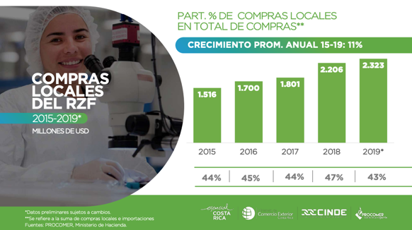
Case Study 1: CINDE – Supplier Linkages
BUSINESS EXPANSION & INVESTOR DEVELOPMENT
CINDE provides a detailed listing of local suppliers, service providers, and contract manufacturers.
The Agency also provides assistance in contacting and developing local suppliers through PROCOMER’s Linkages Department, and work in close coordination and planning with established companies to help attract their key suppliers to Costa Rica.
Source: Wavteq

Slide 80
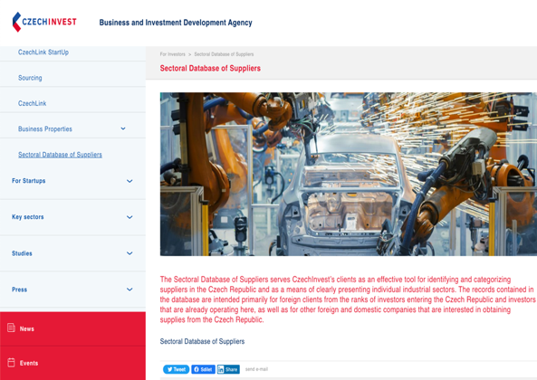
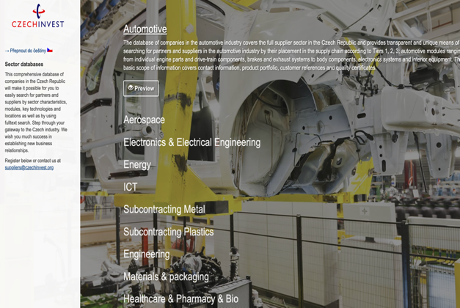
Case Study 2: Czech Invest - Supplier Linkages
BUSINESS EXPANSION & INVESTOR DEVELOPMENT
A global MNE survey by the World Bank Group in 2020 found that over 60% of MNEs consider linkages to be important or critically important in their location decisions
CzechInvest provides an online supplier database which foreign investors can search
Source: CzechInvest: Link

Slide 81
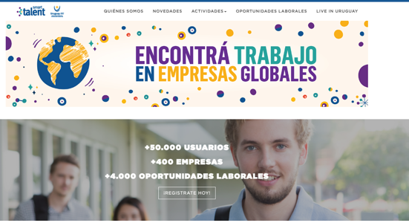
Case Study 3: Uruguay XXI - Smart Talent & Finishing Schools
BUSINESS EXPANSION & INVESTOR DEVELOPMENT
Uruguay XXI created a service package with the purpose to position Uruguay as a strategic location for global services, by providing capacity development support
Smart Talent portal thought to unify global services companies -which could post job offers- and young people who can apply for those jobs
Finishing schools program allows Global Services companies to finance up to 70% of the costs of their training-on-demand plans, both in soft and technical skills. It is developed by Uruguay XXI in strategic alliance with INEFOP
It is directed to companies with operations in Uruguay that export services of the following sectors: Business Services, IT Industry, Life Sciences and Architecture & Civil Engineering Services.
Through the Visa Fast-track, investors and employees working at companies exporting services may request a temporary residence. After submitting required documents, the residence will be obtained in 8 business days
Source: Uruguay XXI - Link

Slide 82
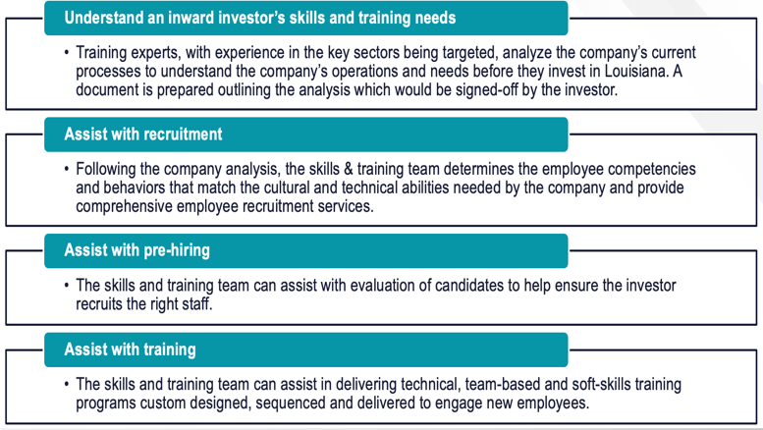
Case Study 4: LED workforce training
BUSINESS EXPANSION & INVESTOR DEVELOPMENT
Louisiana Economic Development’s (LED) dedicated workforce training initiative for inward investors in Louisiana (“LED FastStart”), has been ranked as the best training program in the United States for ten years running by both The Economist and Business Facilities Magazine.
To date, LED FastStart has worked on 147 different projects in every region of the state of Louisiana. The services are offered at no cost to the company and are part of the incentives package negotiated by LED.. To qualify for LED FastStart’s services, a company must first commit to creating a net of at least 15 new, permanent manufacturing jobs, or a net of at least 50 new permanent service-related jobs.
https://www.opportunitylouisiana.com/faststart/how-it-works
See Loewendahl (2018) for a more detailed case study

Slide 83
Key performance indicators for investor development
BUSINESS EXPANSION & INVESTOR DEVELOPMENT
KPIs | Suggested metrics
Subsidiary upgrading | Number of companies that have upgrading their investment projects to higher value added activities (e.g. manufacturing to R&D, sales to HQ, inbound call center to outbound technical support etc.) and size of the upgrading projects (jobs, investment)
Foreign Suppliers Attracted | Number of potential suppliers recommended by existing investors. Number of potential foreign suppliers contacted and engaged with Number of potential foreign suppliers making site visits Number of foreign suppliers establishing a presence, as well as related job creation and capital expenditure
Local Supply Chains Agreements Facilitated | Number of local companies identified that are qualified to supply key foreign investors Number of meetings between local suppliers and foreign investors arranged by the IPA Number of contracts secured by local companies Value of contracts secured by local companies Job creation in local companies as a result of new contracts
Source: Wavteq

Slide 84
Key performance indicators for investor development
BUSINESS EXPANSION & INVESTOR DEVELOPMENT
KPIs | Suggested metrics
R&D and Skill & Training Programs | Number of linkages between key accounts and local universities or research institutes facilitated by your IPA Number of customized training programmes by key investors facilitated by your IPA Number of people getting trained
Meetings, Contacts, and Roundtables | Number of meetings with designated key accounts (“Tier 1”) Number of new contacts at senior management level of key accounts in your location Number of new contacts at senior management level of key accounts at the regional or global HQ Number Investor Development Workshops/Seminars/Webinars organised by your IPA Number of key account companies participating in Investor Development Workshops/Seminars/Webinars Number of key account management plans developed based on detailed company research
CSR and ESG Standards | Number of operational projects encouraged to have a CSR policy in a standardized format like the Global Reporting Initiative (GRI) As above for certification in key standards, specifically ISO14001, SA8000, and WRAP, and other industry-specific standards
Source: Wavteq

Slide 85
Questions & Answers
30 mins

Slide 86
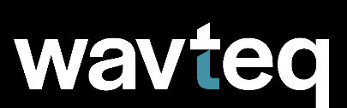
Global Coverage
Wavteq has a global footprint across 14 countries, including:
Bangalore
Belfast
Berlin
Cork
Dubai
Dublin
Dusseldorf
Florida
Hamburg
Hong Kong
Leipzip
London
Marseille
Montana
Montreal
Mumbai
NYC
Phoenix
Seoul
Shanghai
Tel Avv
Tokyo
Valencia
Our Solutions
Consulting Services
to develop strategies, marketing materials, and provide capacity building
Lead Generation Programs
to identify, target and attract investors globally including full in-market representation
Product Solutions
including knowledge & e-learning platforms, CRM systems, and FDI & incentives databases to improve organizational performance
wavteq.com
info@wavteq.com
+44 7557 965393
Notes:
Fonts used throughout:
Arial, Arial-Black, Lexand Deca, Verdana

